Slide 1

Introducing Pharmaceutical Technology through Educational Materials for Undergraduate Engineering Courses
Stephanie Farrell, Mariano J. Savelski,
C. Stewart Slater
Department of Chemical Engineering
Rowan University
Glassboro, New Jersey
Session 1a
2012 ASEE Summer School for ChE Faculty
Orono, ME July 21-26, 2012

Slide 2

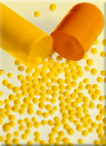

Types of Materials Developed
Problem Sets
  Drug terminology
    API, excipient, FDA, GMP, …
  Pharma systems
    Solid/solid, solid/liquid, …
  Pharma manufacture
    Mixing, blending, drying, tablet pressing, milling, …
  Drug delivery
    Parenteral, oral, …
Life Cycle Assessment Methodology
  for API synthesis
  Self-paced tutorial
  Illustrative examples
  Design case studies

Slide 3
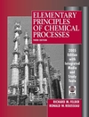
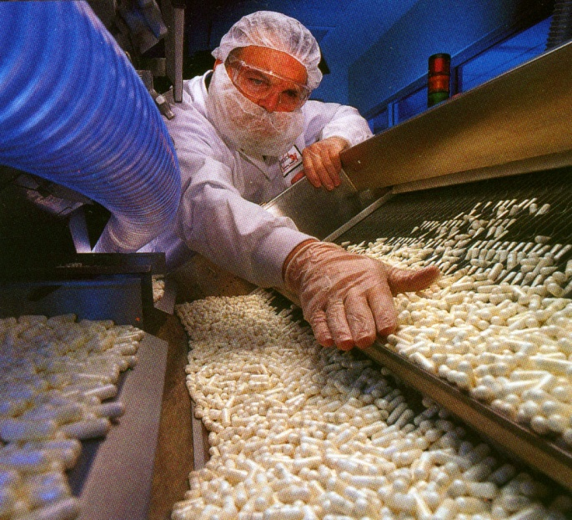
Educational materials grouped by course topics / subject areas
  Intro. to Eng. Calculations/Conv. and Units
  Material Balances/Multiple Unit Processes
  Etc.
Problem introduce a pharmaceutical:
  “Term of art”
  Common/unique process
  Widely used drug or consumer product
Teaching philosophy
  Integrate into lecture (in-class) example
  Homework assignment
Felder, Rousseau, Elementary Principles of Chemical Processes 3rd, John Wiley & Sons, New York, 2005

Slide 4
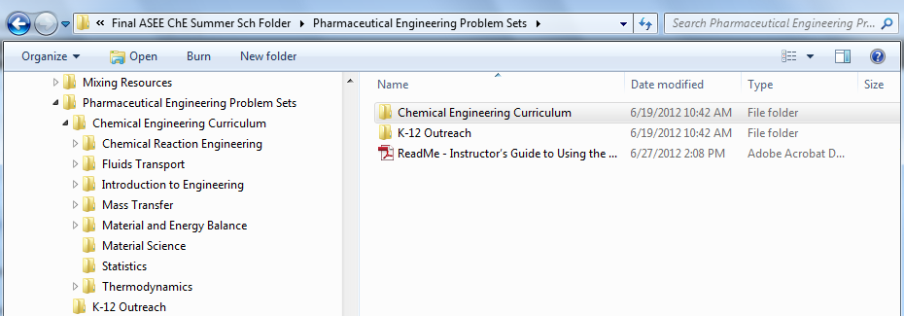
Workshop Materials
Problem sets (problem statement and solution) organized by course on “USB drive”
These folders are further divided by sub-topics (like chapters) in a course
Problem and solution pair is an individual pdf file (~150)

Slide 5
Thumbnail Sketches of Problems
Most problems developed for Introductory ChE courses and Material and Energy Balances (55)
Some are being used in the new 4th edition of Felder & Rousseau, Elementary Principles of Chemical Processes, J. Wiley & Sons, Hoboken, NJ, 2013
Supplemental supporting materials referenced or available from Instructors (Niazi, Handbook of Pharmaceutical Manufacturing Formulations)
Note: Problem statements condensed from original version for this presentation
Problems sets also available through www.PharmaHUB.org (Resources: Teaching Materials)

Slide 6

DEG poisoning
(Unit conversions, Safety, Drug regulations)
Years ago, a company developed an “elixir” with diethylene glycol. Serious side effects were reported in the press. After a madcap chase by nearly the entire FDA staff, most of the distribution was collected on a legal technicality after almost 100 people had died of taking it.
  The dosage instructions for the preparation were “…2 to 3 teaspoonsful [sic] in water every four hours…”. Assume each teaspoon to be pure DEG and calculate the mass of DEG a patient would have ingested in a day.
  The probable oral lethal dose of diethylene glycol is 0.5 g/kg weight. Determine the human weight for which this dose would be fatal.
  Explain why this would be dangerous even if the patient was well above this weight.
  Develop a chronological list showing the wrong steps taken and the corrective actions necessary that would have prevented this. Discuss the role of the FDA in this incident.
Farrell, Savelski, Slater, Problem Sets on Pharmaceutical Engineering for Introductory Chemical Engineering Courses, Part I, ERC Educational Modules, www.pharmaHUB.org/resources/360, 2010

Slide 7

DEG poisoning solution
Engineering principles
  Use of “household” and toxicology units
  Making good assumptions
  Safety and health
Pharmaceutical principles
  Unique concern: FDA safeguards and regulation
  Institutional memory/history
    Based on an actual case
      1937 Elixir Sulfanilamide Incident
http://www.fda.gov/AboutFDA/WhatWeDo/History/ProductRegulation/SulfanilamideDisaster/default.htm

Slide 8
Tablet press for Antibiotic Treatment
(Process variables, Unit conversions: Pharma unit operations)
Nitrofurantoin is an antibiotic used primarily in treatment of urinary tract infections. The active pharmaceutical ingredient (API) in the mixture is Nitrofurantoin. In manufacture of a 1000-unit batch of 100 mg Nitrofurantoin tablets, the following ingredients are mixed in a V-Blender until a well mixed state is achieved. The mixture is then passed through a 0.8 mm sieve and compressed under a low compression tablet press apparatus. Table 1 contains the components required for the aforementioned formulation.
a) Draw a process diagram and provide basic specifications for a commercial mixer and a tablet presses
b) Using any available literature, research the functions of Items 2-4 in Table 1
c) If the net force required for an effective compression of each tablet is 980 MPa, how many people would need to stand on a square 1ft x 1ft to obtain the force required. (Assume an average body weight of 180 pounds)
d) Calculate the mass fractions of each component in a 1000 tablet batch
e) How many pounds (lb_{m}) of Nitrofurantoin are required for 6750 tablets of final product
Farrell, Savelski, Slater, Problem Sets on Pharmaceutical Engineering for Introductory Chemical Engineering Courses, Part II, ERC Educational Modules, www.pharmaHUB.org/resources/389, 2010

Slide 9
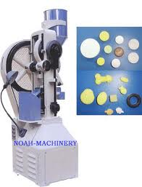
Antibiotic tablet press solution
Engineering principles
  Unit conversions, Pressure
  Process diagram
  Scale-up calculation
Pharmaceutical principles
  Drug formulation terminology: API, filler, lubricant, ….
  Bill of Materials*
  Pharma engineering unit operations: V-Blender, Tablet press (pressure on solid!)
Niazi, Handbook of Pharmaceutical Manufacturing Formulations, Vol. 1, 2nd Ed, Informa Healthcare, 2010

Slide 10

Cholesterol Drug Manufacturing Process
(Material Balance/Multi-unit Process: Pharma Manufac. Unit Processes)
About one in five Americans have a cholesterol level of above 200 mg/dL, this is considered to be very unhealthy. A pharmaceutical company sets up a batch process in order to manufacture 1000 Cholesterol tablets used to lower the LDL and raise the HDL cholesterol.
The process of creating these tablets is initiated by adding equal amounts of two active ingredients and 50.16 g of a filler to a kneading mixer. Once this is done another stream of excipients consisting of 90.7% liquid by mass is added to the kneader. The resulting liquid mixture consists of two parts of water and one part ethanol.
The kneading mixer produces a wet mass called a cake, which is spread over trays and kept in an oven at 45°C for eight hours. During the course of this time 17.3 wt% of the mass of the cake is evaporated. This dry substance is blended with a lubricant and a binder, it is then finally sent to be compressed into 100 mg tablets. The end product (tablet) has the following composition (% wt): 20% API, 51.7% excipients, 27.5% binder and the remaining lubricant. How much of each liquid is added to the kneader?
Farrell, Savelski, Slater, Problem Sets on Pharmaceutical Engineering for Introductory Chemical Engineering Courses, Part I, ERC Educational Modules, www.pharmaHUB.org/resources/360, 2010

Slide 11
Cholesterol Drug Manufacturing Process solution
Engineering principles
  Batch process calculation
  Multiple unit processes
  Solid and liquid properties
Pharmaceutical principles
  Drug formulation terminology
    API, Binder, Lubricant, …
  Pharmaceutical engineering processes
    Mixers, Kneaders, Blenders, Dryers

Slide 12
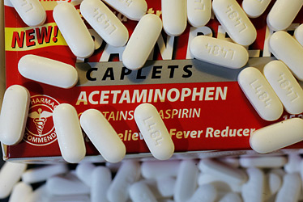
Acetaminophen Reaction
(Reaction stoichiometry: Drug synthesis)
Acetaminophen is used to treat many conditions such as headaches, arthritis, backaches, toothaches, colds, and fevers. To produce acetaminophen, p-aminophenol and acetic anhydride reacted in the presence of the catalyst NaHSO₄·SiO₂. The reaction stoichiometry is given below:
The feed to the reactor is 45.5 mole % p-aminophenol and the balance acetic anhydride. For a 48.18 kg-mole feed of reactants and a fractional conversion of 95%, find :
  The limiting reactant
  The percentage excess of the non limiting reactant
  Mass (kg) acetaminophen produced
Farrell, Savelski, Slater, Problem Sets on Pharmaceutical Engineering for Introductory Chemical Engineering Courses, Part I, ERC Educational Modules, www.pharmaHUB.org/resources/360, 2010

Slide 13
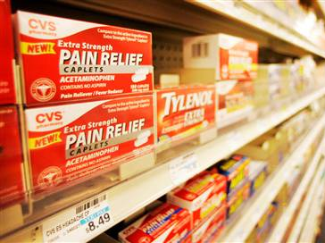
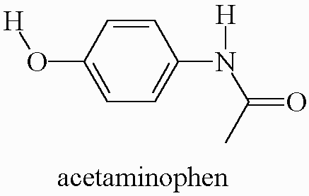
Acetaminophen Reaction solution
XYZ
Rxr
Engineering principles
  Limiting reactant and % excess
  Extent of reaction (ξ)
Pharmaceutical principles
  Introduces a widely used and
  commonly produced drug
  Application of organic chemical synthesis of API
$$$

Slide 14
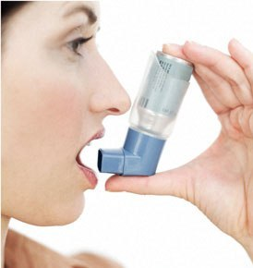
Drug Inhaler Propellant
(Equations of State; Drug delivery)
In a metered-dose inhaler (MDI), such as those used for asthma medication, the medicine is delivered by a pressurized propellant, similarly to a can of spray paint. When the inhaler is activated, a set amount of the medicine is expelled from the mouthpiece to be inhaled. In the past, chlorofluorocarbons (CFCs) were used as propellants; however because of their reactivity with the Earth’s ozone layer they have been suppressed. The new propellants, hydrofluorocarbons (HFCs), are considered “greener” because they do not react with the ozone layer.
You are assigned to calculate the amount of substance required to meet specifications of an MDI. The original propellant, CFC 12, has been replaced by HFC 227ea. Both contain 100 mL of propellant under 80 psia. The high pressurization of the cylinder requires the use of the truncated Virial equation of state.
Farrell, Savelski, Slater, Problem Sets on Pharmaceutical Engineering for Introductory Chemical Engineering Courses, Part I, ERC Educational Modules, www.pharmaHUB.org/resources/360, 2010

Slide 15
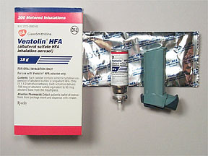

Drug Inhaler Propellant solution
Engineering principles
  Use of a non ideal EoS (Virial)
  Research!
    Systematic names instead of CFC/HFC
    Required physical constants
  Interpretation of model results
Pharmaceutical principles
  Unique drug delivery method
  Green pharmaceutical engineering

Slide 16
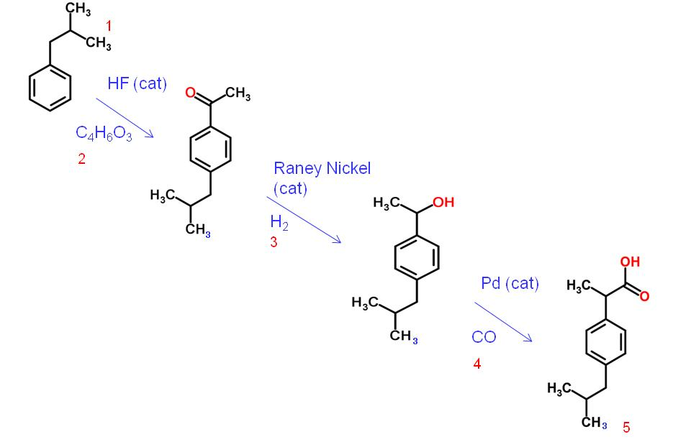
Green Synthesis of Ibuprofen
(Stoichiometry; Green metrics, API synthesis
In 1997, the Presidential Green Chemistry Challenge Award went to the Boots-Hoechst-Celanese (BHC) company for a greener process to synthesize ibuprofen, the active pharmaceutical ingredient in pain relief drugs.
This new BHC process involves only 3 reaction steps and replaces the Boots process which contained 6 steps. The newer process can produce larger amounts of ibuprofen in less time and more economically.
Compare the atom economies to determine which process has the best synthesis efficiency using this metric
Review the literature to determine what other aspect of the new process is a green improvement
Farrell, Savelski, Slater, Problem Sets on Pharmaceutical Engineering for Introductory Chemical Engineering Courses, Part III, ERC Educational Modules, www.pharmaHUB.org/resources/490, 2011

Slide 17
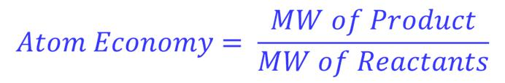
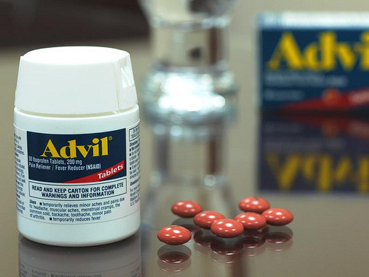
Green Synthesis of Ibuprofen solution
Engineering Principles
  Stoichiometry
  Green metrics: Atom economy
  Catalysts
Pharmaceutical Principles
  Multi-step API synthesis
  API process development

Slide 18
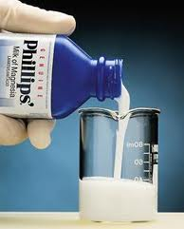
Over the Counter Drug Formation
(Bal. Reactive Sys./Heats of Formation: Drug Formulation)
Milk of magnesia (magnesium hydroxide in aqueous solution) is an old, widely used and commonly seen over the counter (OTC) medication for constipation and pyrosis (heartburn). The standard heat of formation of magnesium hydroxide* is -924.66 kJ/mol and it is commonly produced by reaction of calcium chloride, magnesium chloride with calcined dolomite* (CaMgO₂) (heat of formation: -556 kcal/mol) in water. Determine the heat of formation and state whether it releases or absorbs heat (using the correct terminology).
*CRC Press, CRC Handbook of Chemistry and Physics: A Ready-Reference Book of Chemical and Physical Data, 90th ed., Lide, D. R., Ed. Boca Raton: CRC Press, 2004
Farrell, Savelski, Slater, Problem Sets on Pharmaceutical Engineering for Introductory Chemical Engineering Courses, Part II, ERC Educational Modules, www.pharmaHUB.org/resources/389, 2010

Slide 19

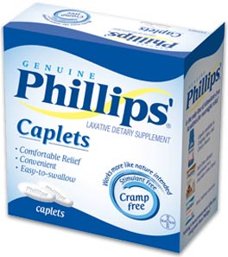
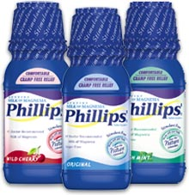
Milk of Magnesia solution
Engineering principles
  Heat of formation calculation
  Research!
    Reaction
    Properties
Pharmaceutical principles
  Drug terminology (OTC)
  Formulation (suspension)
  Solid vs. liquid dosage
CRC, Martin Marietta Magnesia Specialties, NIST-JANAF Thermochemical database

Slide 20
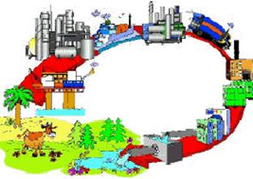

Life Cycle Assessment Methodology
Integrate basic life cycle concepts
  Avoids having a specialized course or curricula
  Start with a “faculty champion”
Lower division
  Freshman Engineering Clinics
  Material and Energy Balances
  Heat Transfer
Upper Division
  Separation Processes
  Plant Design
  Junior/Senior Clinic Projects
LCA tutorials using SimaPro®
developed
Hitchcock, Savelski, Slater, Life Cycle Analysis with Application to Consumer Products and Pharmaceuticals, www.pharmaHUB.org/resources/503, 2011

Slide 21
About our Tutorial
Designed to introduce the concepts of life cycle assessment and teach users how to use software through modules
  Module 1: Overview of Life Cycle Analysis
  Module 2: How to use environmental assessment software, SimaPro®
  Module 3: Modeling processes in SimaPro®
Essential elements (Module 1&2) can be used for introductory course
Module 3 and applications can be integrated in upper division courses
Hitchcock, Savelski, Slater, Life Cycle Analysis with Application to Consumer Products and Pharmaceuticals, www.pharmaHUB.org/resources/503, 2011

Slide 22
Life Cycle Assessment
Material extraction
Material processing
Manufacturing
Use
Waste management
Raw Materials
Material Processing
Product manufacturing
Use
Disposal
Recycle
Re-manufacture
Re-use
Cradle
Where all raw materials begin
Gate
Where everything enters the plant
Gate
Where everything exits the plant
Grave
The end of the product’s life
The life cycle of a product includes many inputs. The raw materials and the energy required for every process contribute to the emissions and cost associated with a product
An LCA can be performed over any boundary

Slide 23

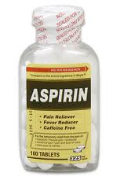
Example Material from Modules
Illustrate basic life cycle concepts
Show context for product and process
  Consumer products
Start with simple case
Compare alternative design routes via more complex case
Aspirin manufacture illustrates advanced application of SimaPro®
Integrates pharmaceutical synthesis with environmental decision analysis

Slide 24
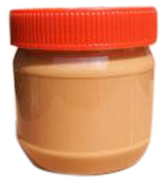
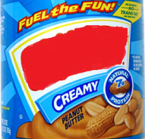
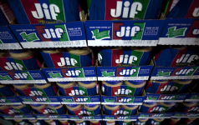
Jar of Peanut Butter Process Map
Raw Materials
Material Processing
Product manufacturing
Use
Disposal
Peanuts
Roasting/Grinding
Distribution Center
Sugar
Waste
Mixing
Oil
Individual Packaging
Retailer
Jar Production
Glass
Polypropylene
Lid Production
Paper
Recycling
Labels
Ink
Box printing/ forming
Carton Packaging
Cardboard
User Storage and consumption
Film
Shrink Wrapping

Slide 25
A Closer Look
Each box in the manufacturing section of the process map is simplified
Below is a general diagram of a manufacturing process
Emissions
Emissions
Product
Emissions
Raw Materials Manufacture
Raw
Materials
Manufacturing Process
Waste
Waste Management
Energy
Raw
Materials
Energy
Energy
Raw
Materials

Slide 26

SimaPro®
SimaPro® is a detailed environmental analysis tool
  Used for a product or process
    Products and processes are both called processes in this program
  Quantification of the raw material, energy use, and emissions to the air, water, and soil
  Concept of Life Cycle Inventory
  Characterization of environmental impacts
  The databases contain many common products and processes, but not everything
    Products and processes not already in the databases need to be created by the user
A free trial of the Software is available at http://www.pre-sustainability.com/content/simapro-demo

Slide 27
Energy and Emissions
SimaPro® is used to calculate the emissions and energy, but some of these need to be added individually
Measured/calculated from process
Calculated by SimaPro
Emissions
Emissions, By-products,
Waste
Raw materials gathering and manufacturing
Product manufacturing process
Raw materials
used
Energy
Energy

Slide 28
Calculating the LCA
Raw Materials
Process Energy
Disposal
R = Amount of Raw Material used in manufacture of the chosen basis of product
E = Energy used to produce the chosen basis of product
W = Waste emissions associated with producing the chosen basis of product
r = number of raw materials
e = different type of energy used
w = number of waste streams that are sent to waste treatment

Slide 29
Aspirin Case Study
Aspirin is formed from acetic anhydride, toluene, and salicylic acid
This can be performed with or without recycling the acetic anhydride by-product
Aspirin without recycle
Process Requirement | Amount, kg /kg aspirin
Process Inputs
Acetic anhydride | 8.51
Toluene | 6.67
Salicylic acid | 7.68
Useful By-products
Acetic anhydride | 2.83
Acetic acid | 3.33
Kamlet, J. (1956). Process for the manufacture of acetylsalicylic acid. Patent No. 2731492. US.

Slide 30
Aspirin Case Study Recycling
The acetic anhydride can be recycled
The acetic acid can react with a ketene (R₂C=C=O) to form acetic anhydride
In SimaPro®, this is modeled by adding the recycled acetic anhydride process
  This is a modified acetic anhydride process that utilizes the acetic acid already present
Recycling also increases the process yield nearly tenfold
Aspirin with recycle
Process Requirement | Amount, kg /kg aspirin
Process Inputs
Acetic anhydride | 0.861
Toluene | 0.674
Salicylic acid | 1.552
Recycled acetic anhydride | 0.574
Kamlet, J. (1956). Process for the manufacture of acetylsalicylic acid. Patent No. 2731492. US.

Slide 31
Inventory comparison
 | Without Recovery | With Recovery | Amount Saved Through Recovery | Percent Reduction
Raw Materials Used, kg | 47.1E+01 | 9.43E+00 | 3.76E+01 | 80%
Water Used, kg | 1.11E+05 | 2.58E+04 | 8.53E+04 | 77%
Total Emissions, kg | 4.97E+01 | 1.03E+01 | 3.94E+01 | 79%
Total Air Emissions, kg | 2.35E+00 | 5.58E-01 | 1.79E+00 | 76%
Total Water Emissions kg | 1.36E-02 | 3.77E-03 | 9.87E-03 | 72%
Total Soil Emissions kg | 4.89E+01 | 1.01E+01 | 3.88E+01 | 79%
CO2, kg | 8.03E-02 | 1.85E-02 | 6.17E-02 | 77%
CED, MJ | 4.71E+01 | 9.43E+00 | 3.76E+01 | 80%
The acetic anhydride recycling results in a much lower environmental impact
This case study can be used to illustrate how recycling can be more effective both in decreasing environmental impact and increasing process output

Slide 32
Case Study - Production of THF
Corn Cobs
Furfural
Furan
THF

Slide 33
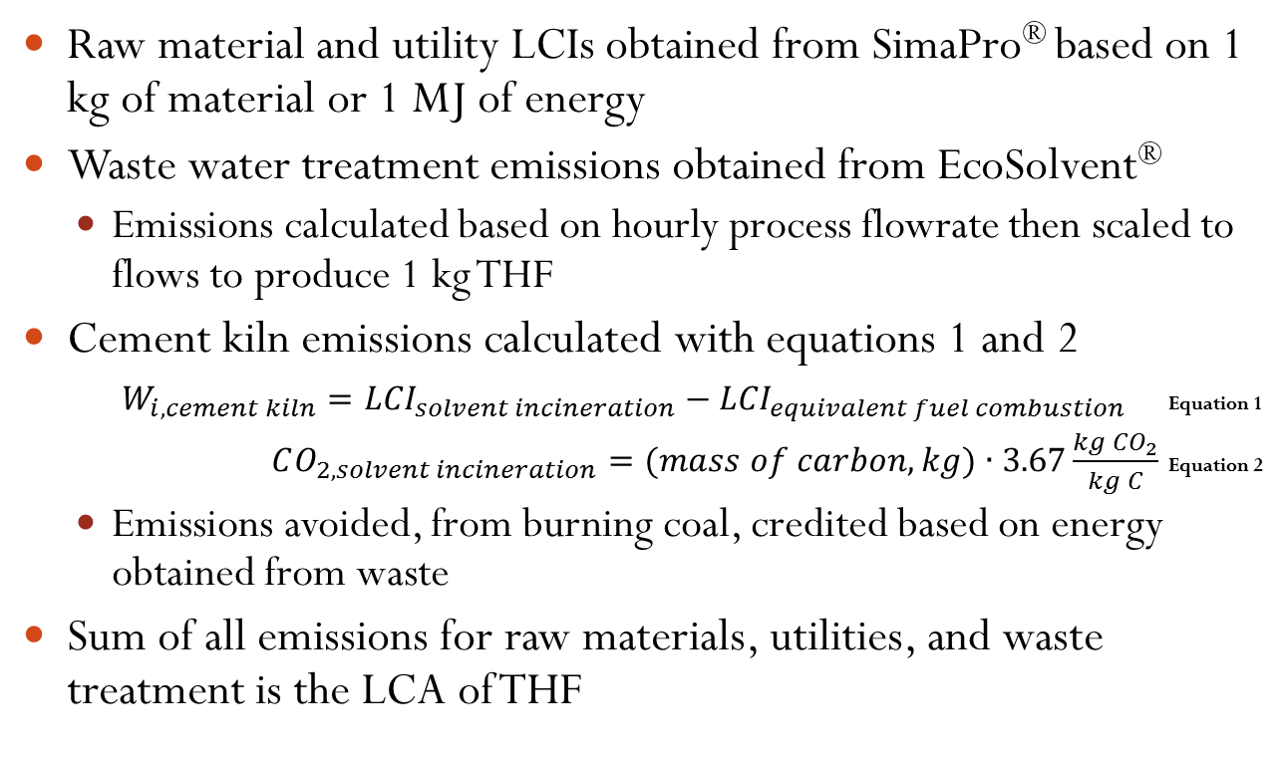
Life Cycle Analysis Methods

Slide 34
Life Cycle Analysis Contributions
THF LCA comparison with chemical route, based on 1 kg produced
 | Proposed Process | From 1,4-butanediol
Total Raw Materials Used, kg | 2.32E+02 | 4.01E+00
Total CED, MJ-Eq | 8.25E+00 | 1.32E+02
Total Air Emissions, kg | 2.76E+00 | 5.52E+00
CO₂, kg | 2.72E+00 | 5.46E+00
CO, kg | 1.05E-02 | 4.82E-03
Methane, kg | 3.89E-03 | 1.45E-02
NO_{X}, kg | 2.04E-02 | 8.67E-03
NMVOC, kg | 3.28E-03 | 3.25E-03
Particulates, kg | 2.28E-03 | 3.57E-03
SO₂, kg | 2.90E-03 | 1.15E-02
Total Water Emissions, kg | 1.23E-01 | 1.26E-01
VOCs, kg | 5.38E-06 | 7.93E-06
Total Soil Emissions, kg | 1.87E-03 | 2.31E-03
Total Emissions, kg | 2.89E+00 | 5.65E+00

Slide 35
Acknowledgements
NSF ERC for Structured Organic Particulate Systems: grant # 0540855
Rutgers University
  Henrik Pederson, Center Director – Education
  Aisha Lawrey, Center Associate Director – Education, Outreach and Diversity
U.S. Environmental Protection Agency: grant #NP97212311-0
Rowan University students
  Vladimir De Delva, David Hitchcock, Muhammad Iftikhar, Pavlo Kostetskyy, Keith McIver, Kathryn Whitaker, Kaitlyn Zienowicz, Adrian Kosteleski, Sarah Wilson

