Slide 1
INFLUENCE OF PHYSICS OF TABLET COMPRESSION
Scale-up
Presenter: Alberto Cuitino
November 3rd, 2010

Slide 2
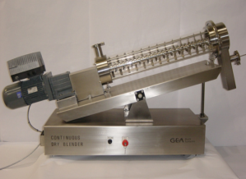
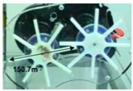



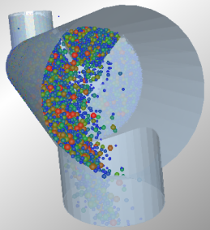
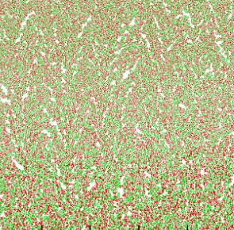
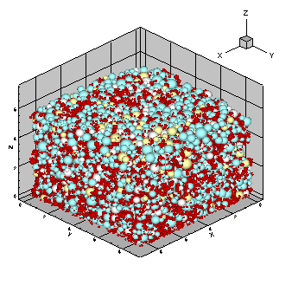
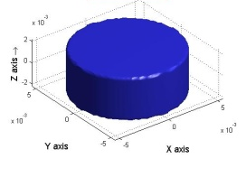
Design Pharmaceutical Solids
EXPERIMENTS
Integrated
Mixing
Die Filling
Compression
Breakup
Dissolution
Integrated
MODELING & SIMULATIONS

Slide 3
Large-Scale
Mechanistic models are used to generate coarse-graining schemes (response surface) for scaled-up systems
Response surface is utilized for selecting best mechanistic parameters
Parameters are utilized for overall product level optimization

Slide 4
Key modeling aspect for scale-up: Bonding

Slide 5
History-Dependent Bonding
Modified Logistic Equation
Bonding Force
History-dependent strength
σ
A – contact area

Slide 6
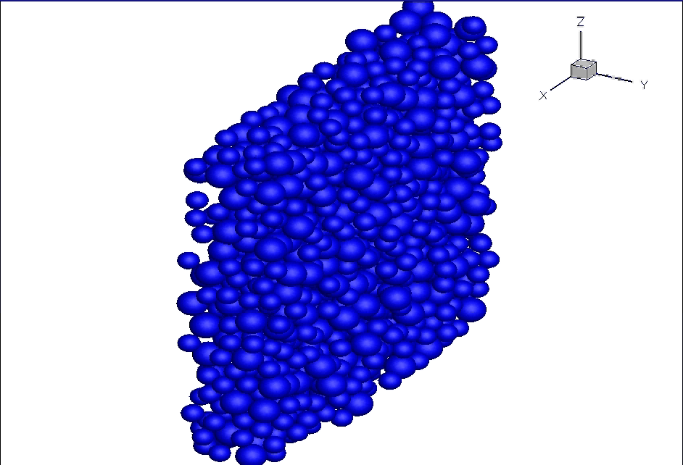
History-Dependent Bonding
Color represents the strongest bond a particle has with its neighbors.
Young’s Modulus
E=25GPa
Poisson Ratio
ν=0.3
Size Range
Avicel 101: 60±10μm - 50%
Avicel 102 :110±10μm - 50%

Slide 7
Tablet Compaction and Tensile Loading
Tensile Loading
Failure
Displacement
Relaxation
Compressive Loading
Pressure

Slide 8
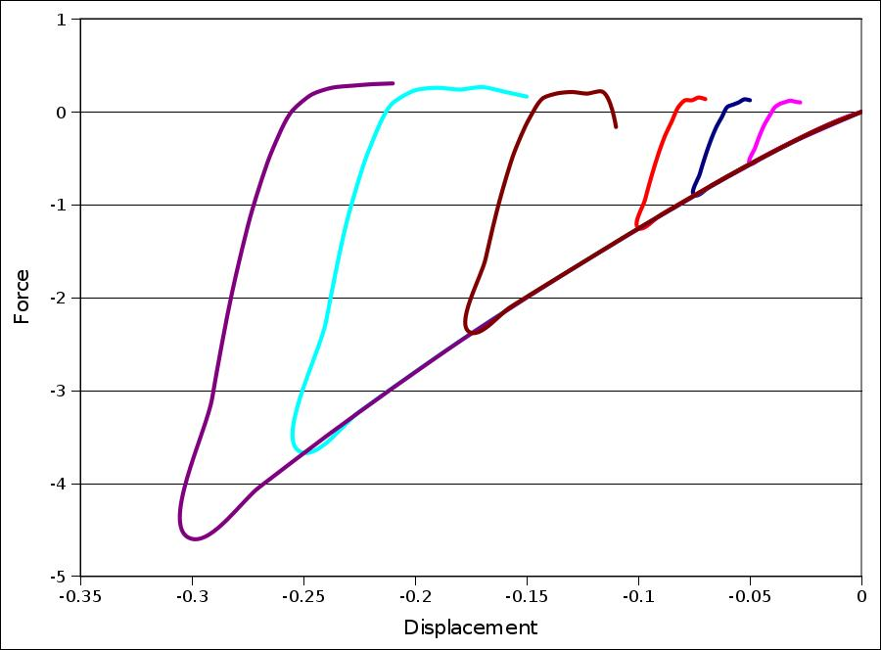
Tablet Compaction and Tensile Loading

Slide 9
Here goes the connection with the Abbott Data (Steve)

Slide 10
Conclusion

