Slide 1
INFLUENCE OF PHYSICS OF TABLET COMPRESSION
Small-Scale
Presenter: Alberto Cuitino
November 3rd, 2010

Slide 2
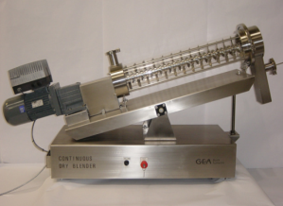
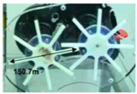

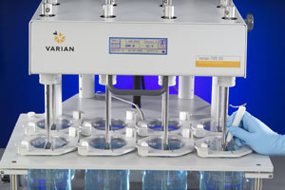

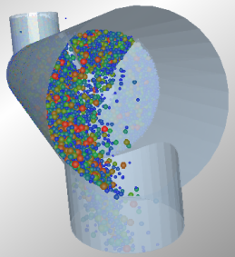
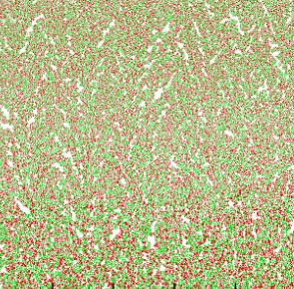
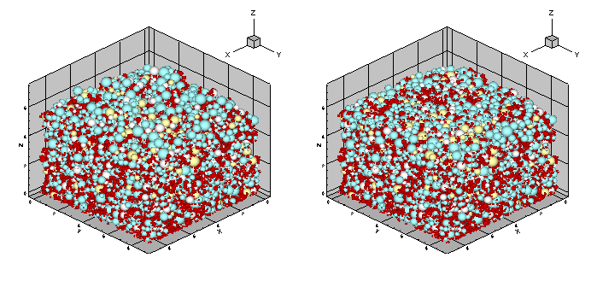
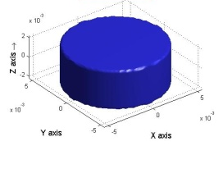
Design Pharmaceutical Solids
EXPERIMENTS
Integrated
Mixing
Die Filling
Compression
Breakup
Dissolution
Integrated
MODELING & SIMULATIONS

Slide 3
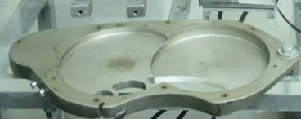
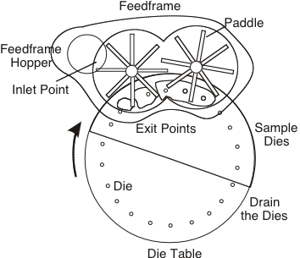
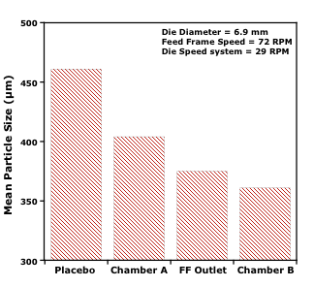
Die Filling – Feed frame
EXPERIMENTS
A
152.3mm
B
initial
exit 1
exit 2
exit 3

Slide 4
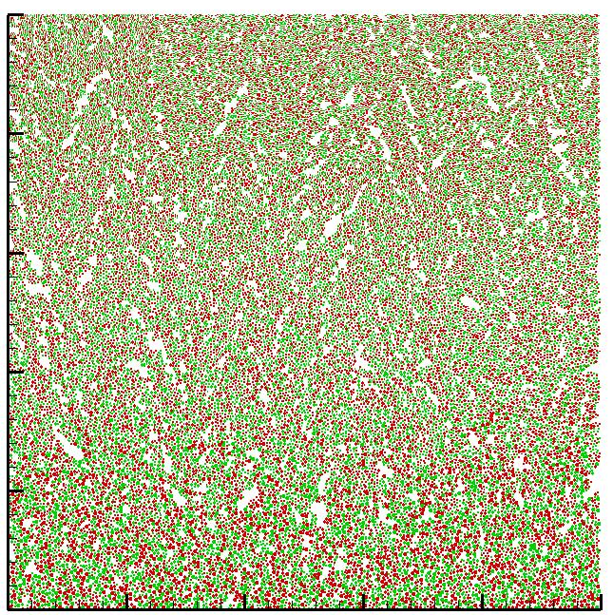
Die Filling – Feed frame
MODELING & SIMULATIONS
Smaller Particles
More Surface Area
Larger Particles
Less Surface Area
Void/porous Microstructure
IMPACTS
STRENGTH and DISSOLUTION

Slide 5
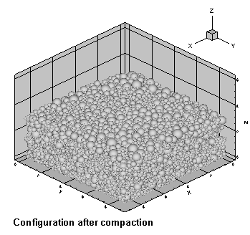

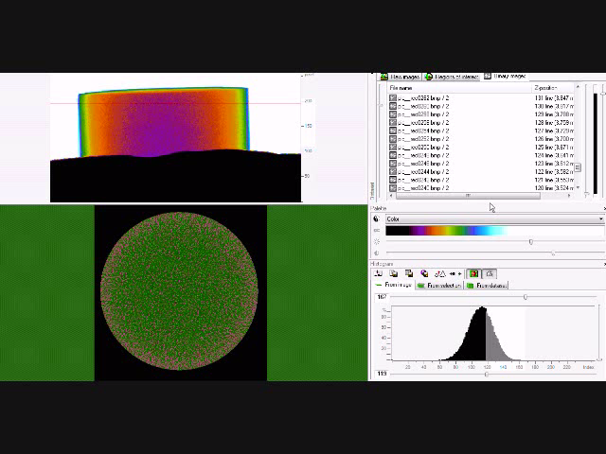
Consolidation
MODELING & SIMULATIONS
Multiscale Modeling – Concurrent particle-continuum description
EXPERIMENTS
Tablet Compaction Model:
  Multiscale
  Preserves local heterogeneous structure of the powder bed
  Predicts macroscopic trends
Micro-structure from X-ray CT

Slide 6
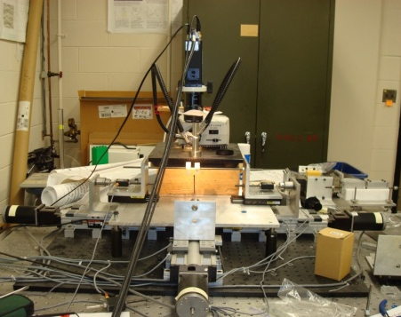
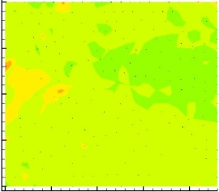
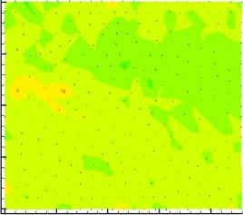
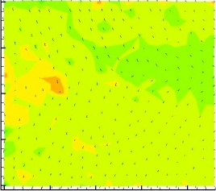
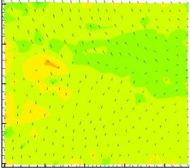
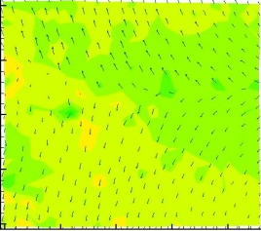
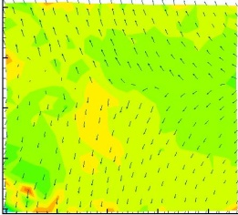
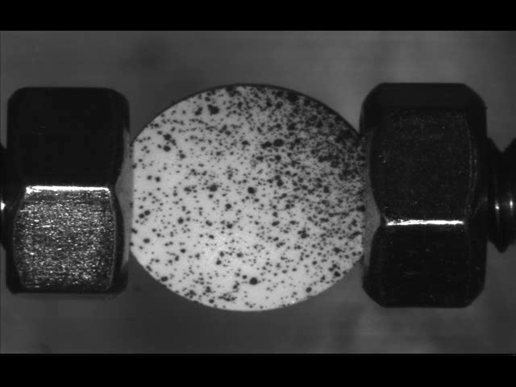
Bonding-Debonding
EXPERIMENTS
Non-uniform fields
Fracture dominated
by weakest regions
Crack
Displacement fields in a uniaxially loaded tablet during the formation of a crack.

Slide 7
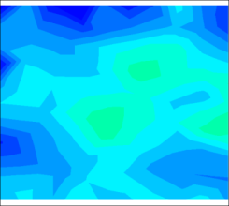
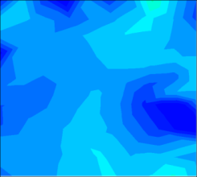
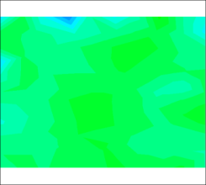

Bonding-Debonding
MODELING & SIMULATIONS
Macroscopic
development of
history dependent
inter-particle bonding
Displacement
TENSION
COMPRESSION
force
Non-uniform fields
A – contact area
Evolving Force Field
Compact Strength
σ
Inter-particle Kernel
TABLET
Microscopic
Experiments

Slide 8
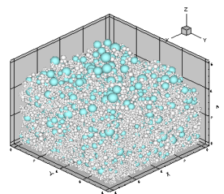
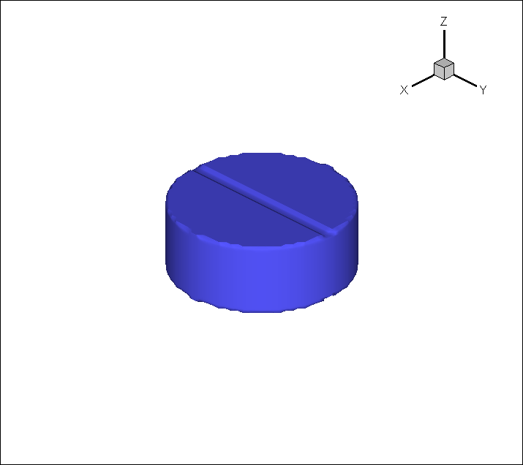
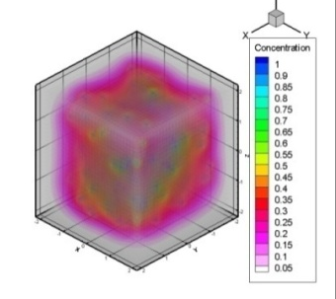
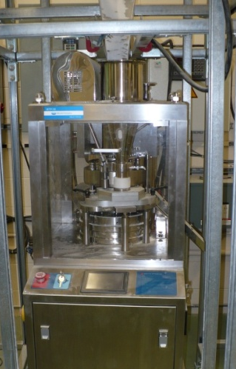
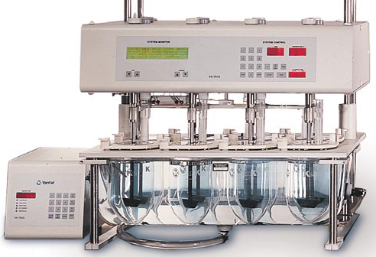

Dissolution
MODELING & SIMULATIONS
Structure “carried” downstream
VALIDATION
EXPERIMENTS
Notes:
Dissolution predictions for blends B3 (9% Mic.Acetaminophen + 45% Avicel 102 + 45% Pharmatose + 1% MgSt) and B6 (9% Mic.Acetaminophen + 44% Avicel 102 + 44% Pharmatose + 1% MgSt + 1% Cab-O-Sil + 1% Talc) Modeling

Slide 9
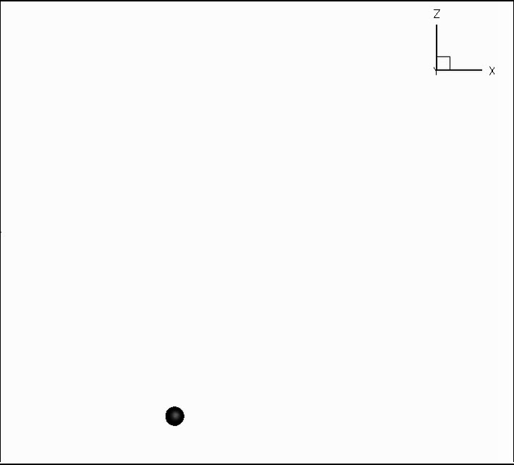


Die Filling
A ballistic deposition technique is used to simulate die-filling.
Powder composition
Particle size distribution
Powder cohesion

Slide 10
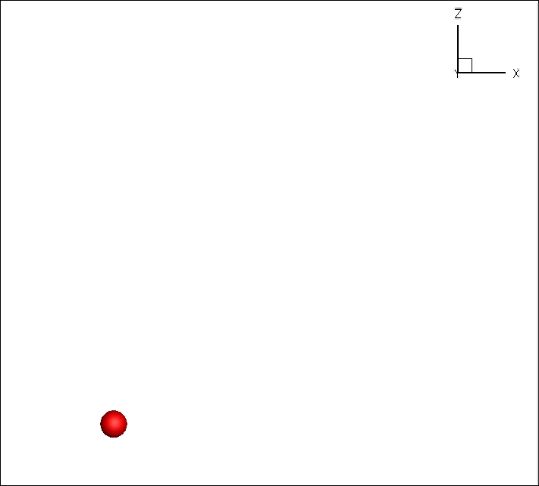
Multicomponents
Individual particles are dropped from the top of the container, falling until they reach a stable position.
Multiple powders can be considered with different size distributions and physical properties.

Slide 11
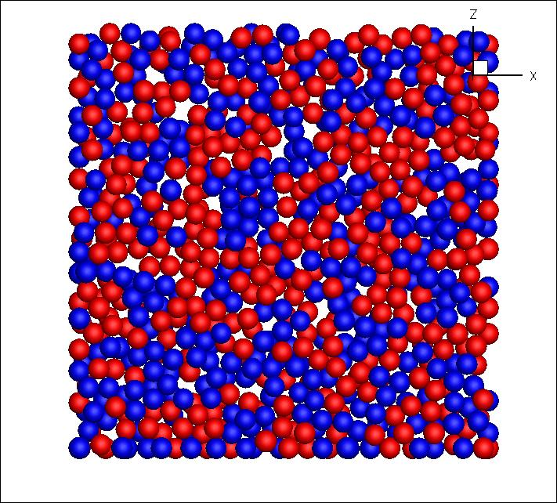
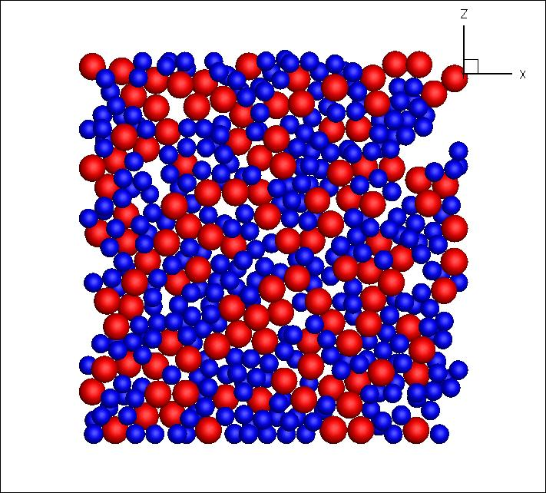
Cohesion
Particle cohesivity determines the stability of structures in the powder bed.
Cohesion is considered through the critical angle, at which a particle will start rolling.

Slide 12
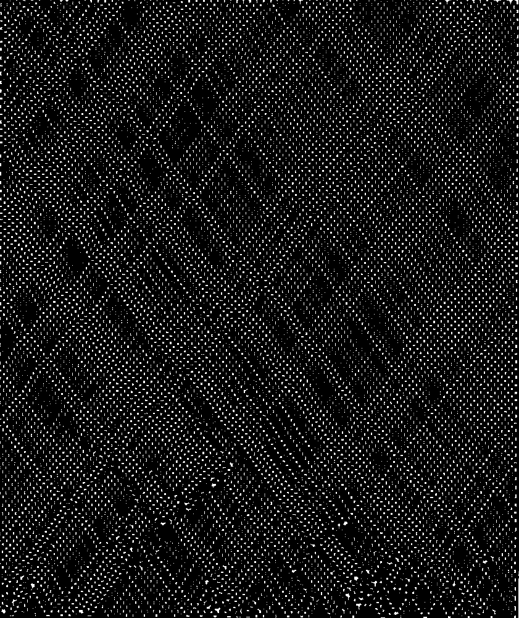
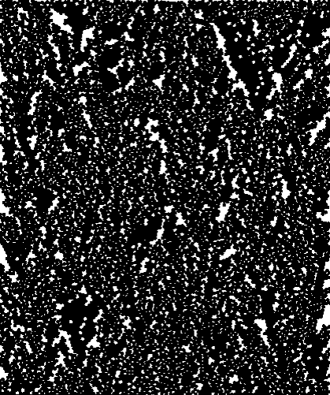
Cohesion
No cohesion
Cohesion

Slide 13
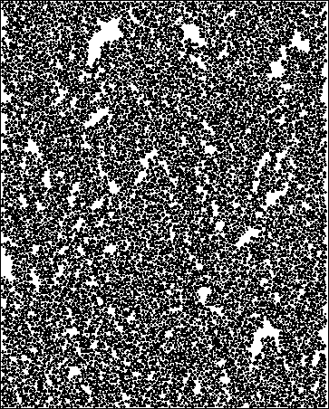
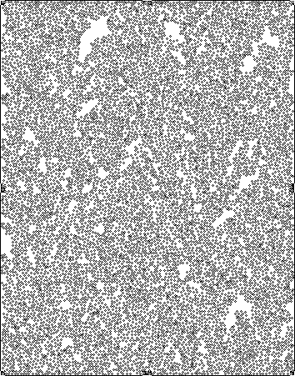
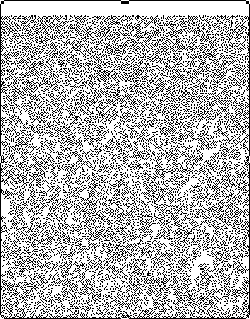
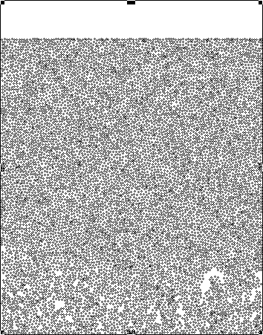
Particle Rearrangement

Slide 14
Compaction
Once the particles are closely packed, further increases in pressure lead to particle deformation as the only mechanism available for volume reduction.
The compaction stage is modeled using a mixed discrete-continuum approach.
The particle motion is constrained by a grid with dimensions of the same order as the size of the system.
Standard Finite Element techniques are utilized to generate a grid, with the motion of each simulated particle described in terms of the behavior of the vertexes of the grid’s nodes. Inter-particle interactions are modeled using local constitutive relations.

Slide 15
Compaction Forces
The particle interactions during the compaction process have a strong influence on the mechanical properties of solid product. The types of interactions include contact forces (elastic, elastic-plastic, fully plastic) as well as tensile forces.
In the current implementation of the numerical method, the elastic contact is modeled using a Hertzian law.
where
E_{i} and ν_{i} are the Young’s moduli and Poisson ratios of the particles in contact and R_{i} are their radii. The plastic regime following the elastic response is modeled using a power law, characterized by a hardening exponent.

Slide 16
Compaction Forces
Caused by the formation of liquid bridges – as liquid vapors from the ambient gas phase condensate on the particle surfaces, a liquid meniscus forms, bonding particles to each other.
α
R
H
d
θ
Where γ is the liquid surface tension

Slide 17
Compaction Forces
Van der Waals forces – short range forces, usually dominant for either small particles or during the particle fragmentation stages of compaction.
Δ – the distance between the particles.

Slide 18
Filling/Rearrangement/Compaction
Tertiary Mixture
D and S2, S3, S4
Initial configuration
Configuration after rearrangement
Mass (g) | Dimensions (mm) | Number of Particles | Expected Solid Density (g/ml)
0.4 | 9×9×6.1 | 33,764 | 1.68 | 0.75

Slide 19
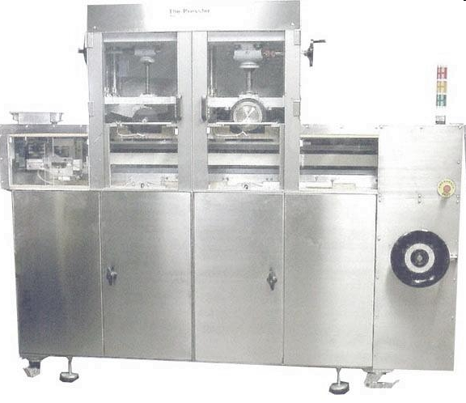
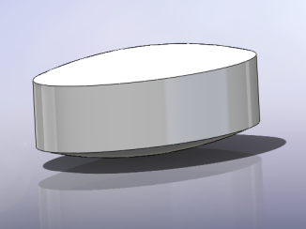
Presster™ Studies
PressterTM tablet press simulator
  Set to mimic Stokes B2 press
  Tooling
    Oval, deep cut
    i.e., tablets are oval with domelike top and bottom surfaces
Presster data:
  Upper compression force
  Tablet x-section area
  Tablet thickness
  Tablet weight
  radial die wall force, ejection forces, stage speed …

Slide 20
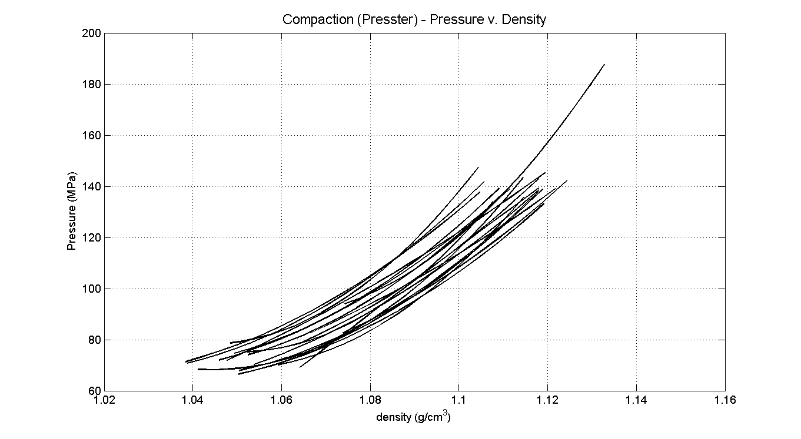
Presster™ Studies
Presster data collected at different compaction forces (10kN, 15kN, and 20kN )

Slide 21
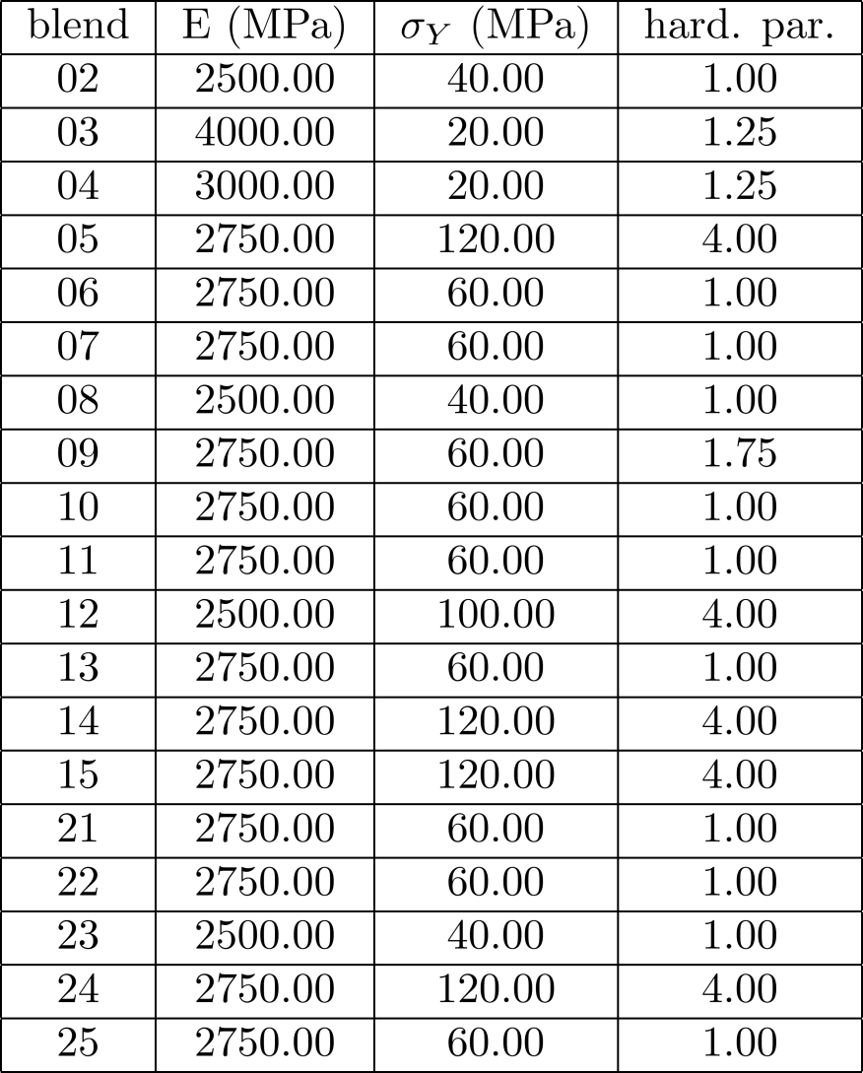
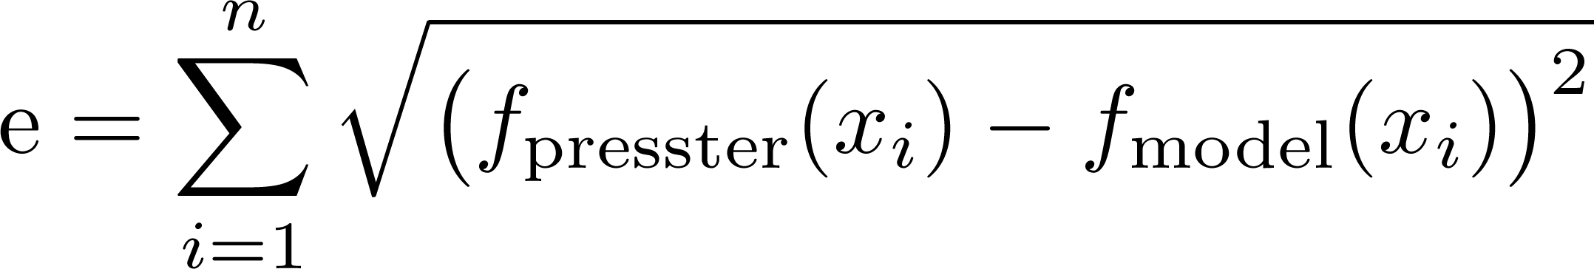
Identification of critical blend properties from 500 simulations
The model can be used to simulate the evolution of the configuration of the powder bed with time as well as monitor the values of various quantities indicative of its mechanical properties.
Several different powders have been considered, both individually and in a blend to demonstrate the versatility of the method.
Each blend can be mapped to granulation parameters by:
  Simulations vs. PressterTM Data
  Error minimization

Slide 22
Small-Scale Study
Provides mechanistic parameters for granulations
The parameters can be used for generating SIMULATED surface response models for conditions other than tested using models

