Slide 1



Wet Granulation
Small Scale Experiments

Slide 2
Quantitative Engineering Approaches
How do we design experiments and scale ?
What do we know?
Implications
Nothing except parameters we can vary
Statistical Experimental Design
Lots of experiments at all scales
Careful formulation and process characterization
Designing experiments based on dimensionless groups and regime maps
Reduced experiments at all scales
Use dimensionless groups to scale up
Controlling mechanisms
Careful formulation and process characterization
Design min. number of experiments to validate and fine tune the model
Least number of experiments
Pilot/full scale model validation and parameter estimation
Fully predictive model

Slide 3
BACKGROUND
Granulation Rate Processes:
    Nucleation
    Consolidation
    and Growth
    Breakage

Slide 4
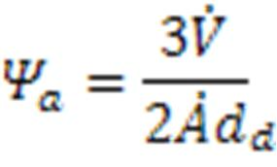
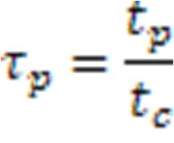
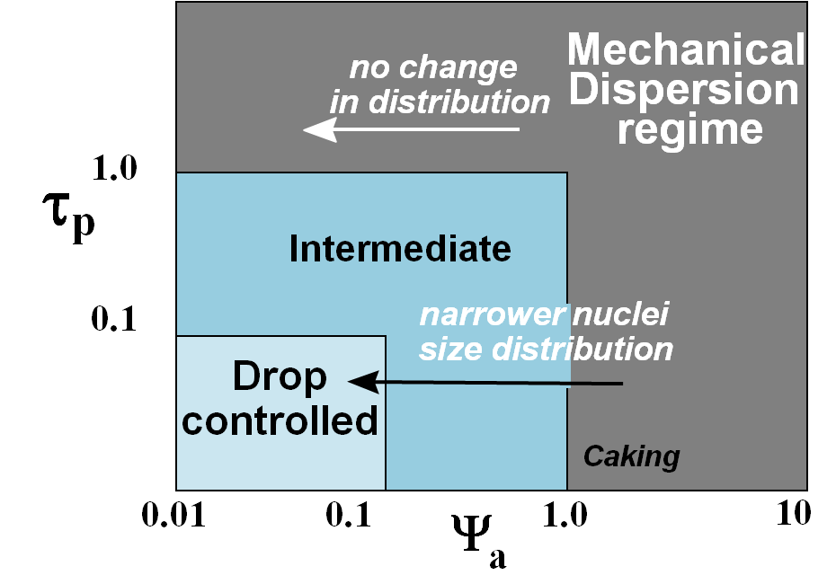
BACKGROUND
Nucleation regime dimensionless numbers:
Dimensionless spray flux (Ψ_{a})
Dimensionless drop penetration time (τ_{p})
: spray flux
: powder flux
d_{d}: drop diameter
t_{p} : drop penetration time
t_{c} : circulation time
Hapgood, Litster & Smith, AIChE J, 49, 350-361, 2003

Slide 5
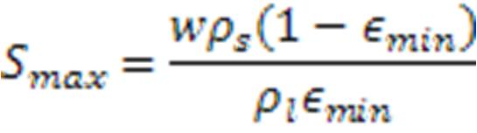
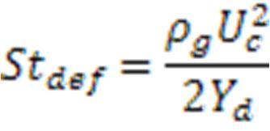
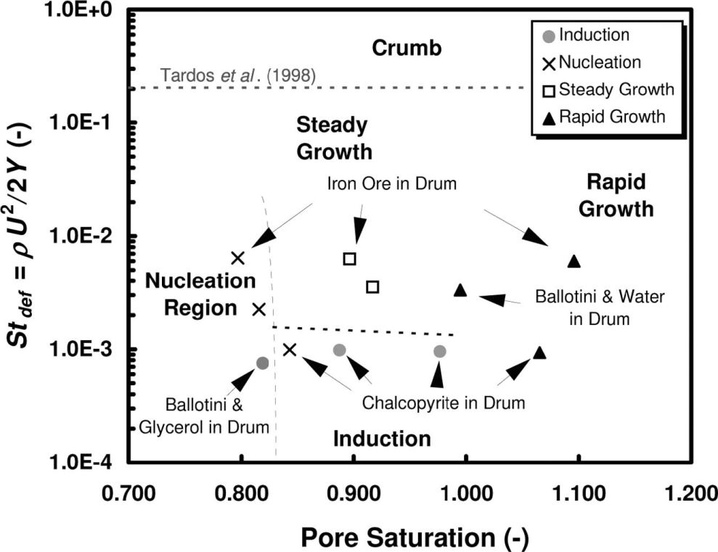
BACKGROUND
Growth regime dimensionless numbers:
Maximum liquid saturation (S_{max})
Stokes deformation number (St_{def})
w : mass ratio of liquid to solid
ρ_{s}: density of solid particles
ρ_{l}: liquid density
ε_{min}: minimum porosity the formulation reaches
ρ_{g}: granule density
U_{c}: collision velocity
Y_{d}: dynamic yield stress
Iveson et al., Powder Technol., 117, 83-87, 2001

Slide 6
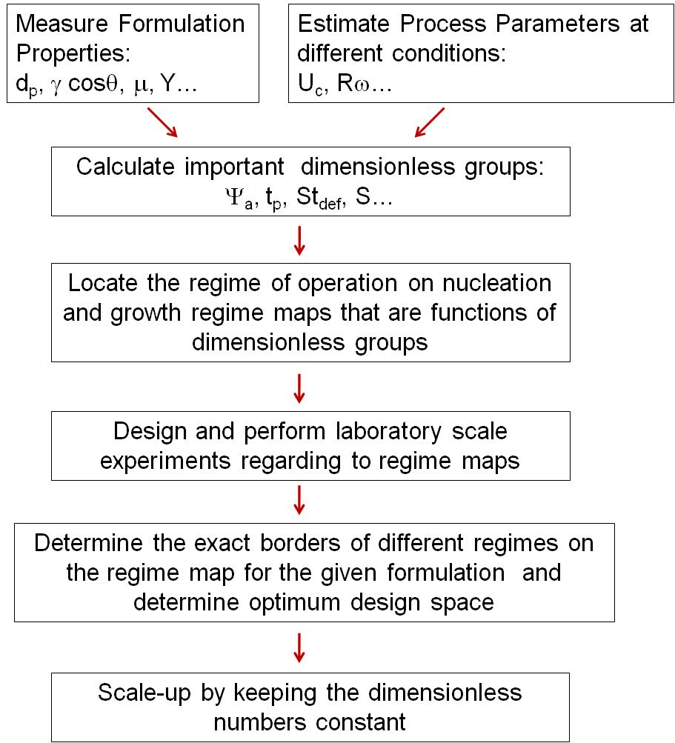
APPROACH

Slide 7
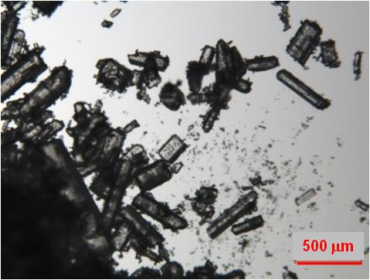
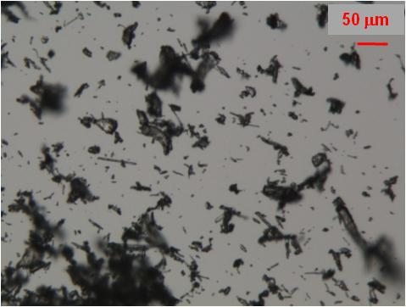
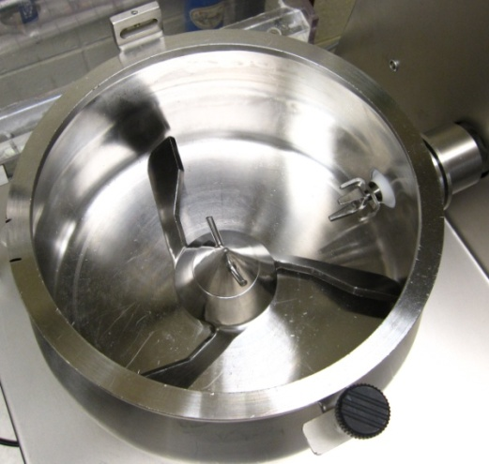
Materials and Methods
Intragranular Materials: Gabapentin + Hydroxylpropylcellulose
(HPC EXF) dry mixture (15:1 w/w %)
Granulator : Diosna (6l)
Gabapentin
HPC

Slide 8
Formulation Characterization
d₁₀: 67 µm
d₅₀: 163 µm
d₉₀: 291 µm
18 %
Particle size distribution of Gabapentin
Notes:
Amount of liquid added
I will change this to frequency distribution graph (Malvern data)

Slide 9
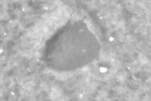
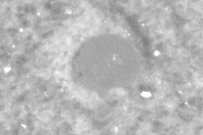
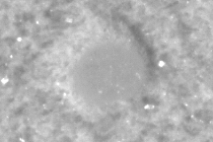
Formulation Characterization
Water penetration time into Gabapentin + HPC EXF
h
Experiments were performed with 22 Gauge needle. The drop penetration time for the drop sizes of interest are calculated by:
 | 2.63 mm | 93 μm | 72 μm | 7 mm
Penetration time (sec) | 80* | 0.1 | 0.06 | 566

Slide 10
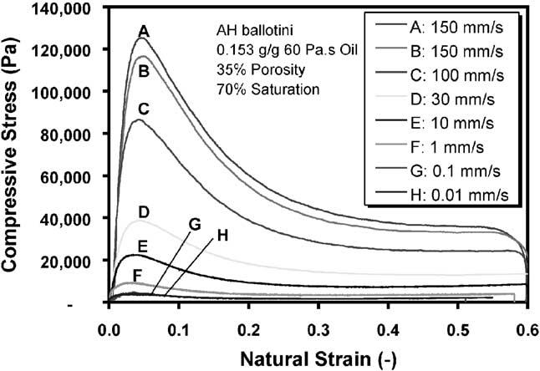
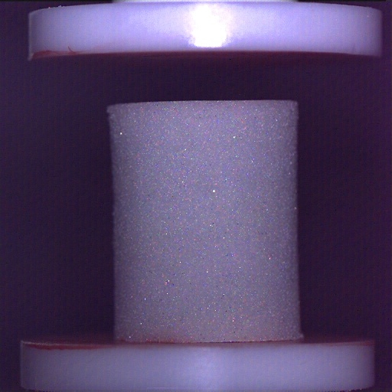
Formulation Characterization
Wet granule dynamic yield stress
Impeller speed (rpm) | Peak Stress (kPa)
 | 2% | 4% | 10%
250 | 808 | 465 | 242
500 | 962 | 591 | 325

Slide 11

Process Characterization
Flow behavior and surface velocity are monitored by high speed imaging at different impeller speeds.
Dry gabapentin + HPC – 250 rpm
Powder surface velocity at 35 % fill ratio:
250 rpm
500 rpm
0.36 m/s
0.37 m/s

Slide 12


Process Characterization
Spray characterization (flowrate, width, and drop size are measured)
Top view
Powder flow direction
Flowrate = 29 ml/min
Spray width = 5 cm
Drop size = 93 μm
Flowrate = 119 ml/min
Spray width = 6 cm
Drop size = 73 μm
Flowrate = 245 ml/min (dripping)
Spray width = 0.7 cm
Drop size = 0.7 cm
12

Slide 13
Experimental Design
Exp. # | Ψ_{a} | τ_{p} | Smax | St_{def} | Liquid to solid ratio (w/w %) | Impeller speed (rpm) | Liquid Flow Rate (ml/min)
1 | 0.43 | 0.1 | Low | 0.00012 | 2 | 250 | 29
2 | 0.42 | 0.1 | Low | 0.00041 | 2 | 500 | 29
3 | 1.91 | 0.6 | Low | 0.00012 | 2 | 250 | 119
4 | 1.86 | 0.6 | Low | 0.00041 | 2 | 500 | 119
5 | 0.43 | 0.1 | Medium | 0.00022 | 4 | 250 | 29
6 | 0.42 | 0.1 | Medium | 0.00068 | 4 | 500 | 29
7 | 1.91 | 0.06 | Medium | 0.00022 | 4 | 250 | 119
8 | 1.86 | 0.06 | Medium | 0.00068 | 4 | 500 | 119
9 | 0.43 | 0.1 | High | 0.00044 | 10 | 250 | 29
10 | 1.86 | 0.1 | High | 0.00132 | 10 | 500 | 119
11 | 0.35 | 566 | Medium | 0.00022 | 4 | 250 | 245
Fill ratio: 35 %
Chopper speed: 1000 rpm
Dry mixing: 5 minutes
Wet massing time: 2 minutes
Notes:
Operate in roping regime
Three different nucleation regimes
Three different growth regimes
For each Smax value two different Stdef were tested.

Slide 14
Nucleation regime map
3
1
2
1
3
2
3

Slide 15
Comparison of different regimes on nucleation regime map

Slide 16
Effect of Liquid Amount and Impeller Speed (St_{def})
Increasing S_{max}
Notes:
Change these to frequency plots

Slide 17
Growth Regime Map
S_{max} values combined with St_{def} values give the amount of liquid required for granulation as well as the failing conditions.
Calculation of S_{max} needs more experiments and analysis for this system since it has wide size distribution with fines and has dry binder.
As S_{max}
Dry binder is also activated by addition of liquid and may act like additional amount of liquid.
Notes:
For the moment water amounts, were determined experimentally

Slide 18
Tentative Growth Regime Map

Slide 19
Summary
The effect of the change in the nucleation regime on the PSD is shown for the formulation of interest.
For scale up experiments, the dimensional spray flux needs to be kept as small as possible to get the narrowest possible PSD and least amount of lumps.
S_{max} calculation needs more experiment and analysis for a formulation with dry binder and wide particle size distribution.

Slide 20
Tranfer from Diosna 6 l to Gral 4l at Duquesne University
HPC grade was changed. Drop penetration experiments were performed with new grade of HPC. Water penetration time is almost 20 times lower into Gabapentin plus HPC EF dry mixture compared to Gabapentin plus HPC EXF mixture .
Very low levels of liquid addition rates (15 ml/min) were used to keep the dimensional spray flux as low as possible (∼0.1).
Both the lower drop penetration time with the new grade of HPC and the lower dimensional spray flux (almost in the drop controlled regime) resulted in production of lower amount of lumps (granules < 1 mm).

Slide 21
Tranfer from Diosna 6 l to Gral 4l
It is not possible to obtain exactly the same flow characteristics between two different granulator designs. However, flow regime at different impeller speeds was determined with high speed camera to confirm that granulations experiments are run in “roping regime”.
Liquid level was optimized for the new formulation (5%) .
Notes:
DOE approach was used for the Duquesne experiments, but the variables were varies in a narrow range due to the information from regime maps (particularly from nucleation regime map)

