Slide 1


Linking Drug Stability to Manufacturing
Physical Chemical Foundations
Gabapentin
L. E. Kirsch
Stability team leader

Slide 2



Stability Team
Group | Team member
Minnesota | Raj Suryanarayanan (Co-PI)
 | Aditya Kaushal (post-doc)
Kansas | Eric Munson (Co-PI)
 | Dewey Barich (post-doc)
 | Elodie Dempah, Eric Gorman (grad. students)
Iowa | Lee Kirsch (Co-PI)
 | Greg Huang (Analytical Chemist)
 | Salil Desai, Zhixin Zong, Tinmanee Radaduen, Hoa Nguyen, Jiang Qiu (grad students)
Duquesne (Unit-op team Interface) | Ira Buckner

Slide 3
Linking manufacturing to stability
Manufacturing Stress
API*
(Unstable form)
Physical
transformation
Chemical
transformation
API
Degradant
(Stable form)

Slide 4
Gabapentin as a model drug substance
Multiple crystalline forms
Susceptible to stress-induced physical transformations
Susceptible to chemical degradation
KEY QUESTIONS
Are physical and chemical instability linked?
How can manufacturing-induced stress be incorporated in a quantitative chemical instability model?

Slide 5
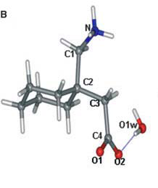
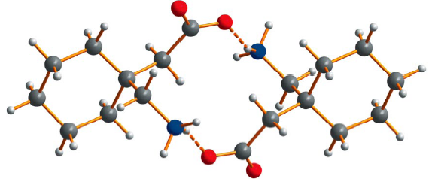
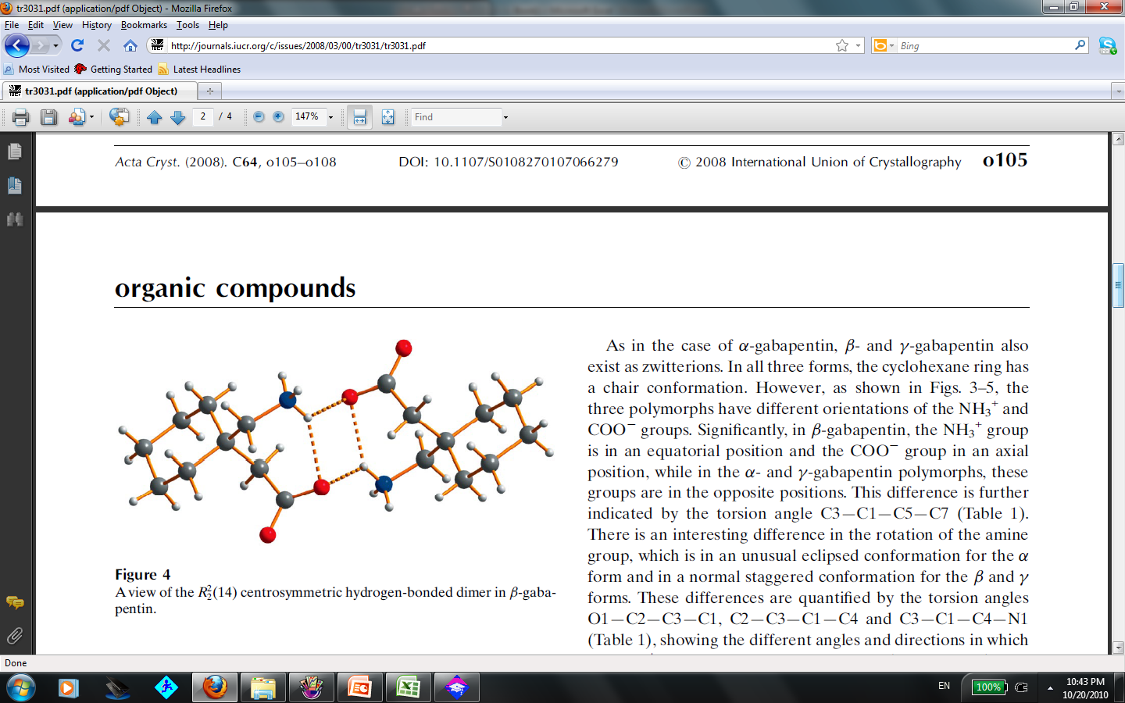
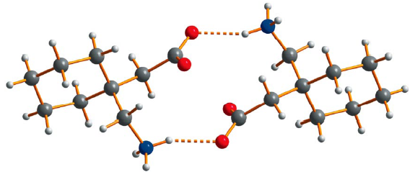
Some Crystalline Forms of Gabapentin
Ibers., Acta Cryst c57, 2001 and Reece and Levendis., Acta Cryst. c64 2008
API form | Crystalline
I
II
III
IV
Hydrate
Stable polymorph
(API)
Intramolecular
H-bonding
Transition between forms by mechanical stress, humidity, and thermal stress

Slide 6
Physical transformation by Mechanical Stress
Form II
Milled
Gabapentin
Form III

Slide 7
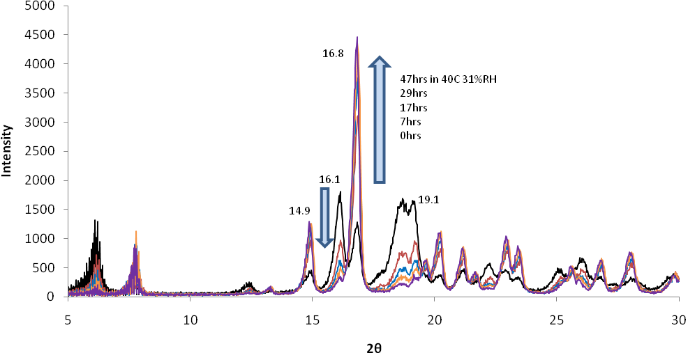

Physical transformation by Humidity
47 hrs in 40C 31 %RH
29 hrs
17 hrs
7 hrs
0 hr
Intensity
2theta

Slide 8
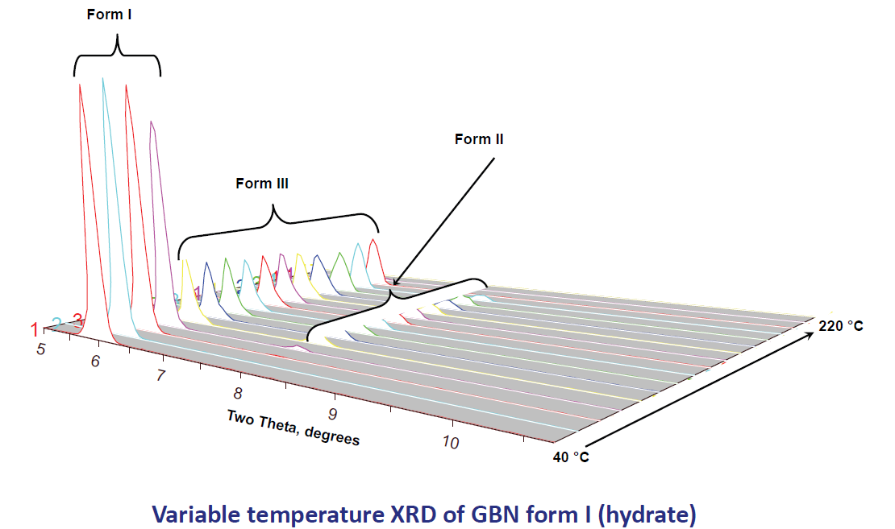
Physical transformation by Thermal Stress
Kaushal and Suryanarayanan., Minnesota Univ. AAPS poster 2009

Slide 9
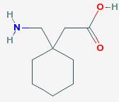
Chemical Degradation of Gabapentin
  nucleophilic attack of nitrogen on carbonyl
Gabapentin
Gabapentin _lactam
toxic
USP limit: < 0.4%

Slide 10
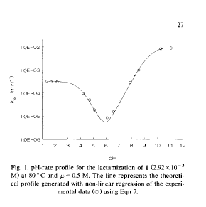
Aqueous degradation kinetics
Irreversible cyclization
+ H₂O

Slide 11
Solid state degradation kinetics
40 C 5% RH, milled gabapentin
autocatalytic lactam formation
rapid degradation of process-damaged gaba
initial lactam

Slide 12
Solid state Degradation Model
autocatalytic branching
spontaneous dehydration
GABA (G)
(stable form)
GABA (D)
(unstable form)
LACTAM (L)
branching termination
Hypothesis:
Manufacturing stress determines initial conditions (G₀, D₀ and L₀)
Environmental (storage) stress determines kinetics (k₁, k₂ and k₃)

Slide 13
Building a quantitative model
Drug
Stability
Environmental
Stress
Manufacturing
Stress
Compositional
Factors
(e.g. excipients)

Slide 14
Effects of Manufacturing Stress:
Initial Lactam and Instability
Thermal stressed at 50 °C, 5%RH
Milling caused faster degradation rate
60 min milled
45 min milled
15 min milled
API as received
Lactam generated during milling
(in-process lactam)

Slide 15
Effects of Milling Stress:
Specific Surface Area
Is the increase of lactamization rate solely due to increase of Surface Area?

Slide 16
Can Surface Area account for Lactamization Rate Changes upon Mechanical Stess?
Samples milled for different time
Sieved aliquots of 15min milled sample
Sieved aliquots of unmilled sample
NO, ALSO increased regions of crystal disorder caused by the mechanical stress.

Slide 17
Effects of Milling based on Change in Initial Condition: lactam formation (50 °C)
Treatment | D₀ (%) | k1*10⁴ (%mole⁻¹hr⁻¹) | k2 (hr⁻¹)
unstressed | 0.02 | 0.6 | 0.017
15min milled | 0.59
45min milled | 1.28
60min milled | 1.62
60min mill
Lactam mole %
45min mill
15min mill
unstressed
Time (hr)

Slide 18
Effects of Environmental Stress: temperature and humidity
Drug
Stability
Environmental
Stress
Manufacturing
Stress
Compositional
Factors
(e.g. excipients)

Slide 19
Lactam kinetics under controlled temperature (40-60 C) and humidity (5-50% RH)

Slide 20
Effects of Temperature: predicted values based on parameterization of autocatalytic model

Slide 21
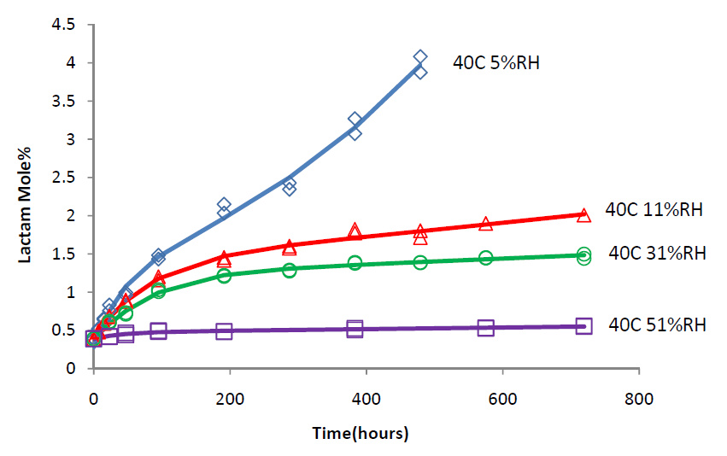
Effects of Moisture

Slide 22

Is the decreased lactam rate due to reversible reaction?
Thermal stress of solid state (milled) or aqueous gabapentin_lactam
  No detectable loss of lactam and no appearance of gabapentin in solution and solid state
+H₂0
Gabapentin
Gabapentin_lactam
Zong et.al., Draft submitted to AAPS Pharm Sci Tech. 2010

Slide 23
Why moisture appears to slow and shut down lactam formation?
In general, effect of moisture is NOT to slow reaction rates
Analytical issue?
Reversible reaction?
Formation of stable hydrate?
Most gaba-L could be recovered from solid powder, only ignorable gaba-L was detected in saturated salt solution.
No gabapentin formed from gaba-L in solution or solid state
No hydrate found from XRD patterns
Moisture-facilitated termination of branching

Slide 24
Effect of Moisture:
Shut down Lactam Formation
Thermal stress: 50°C 5%RH
Pretreated at 5% RH 25°C for 24 hours before thermal stress
Pretreated at 81% RH 25°C for 24 hours before thermal stress

Slide 25
Effects of Moisture
k1 (%mole⁻¹hr⁻¹) |  | k2 (hr⁻¹) | D0 (%) | L0 (% mole)
0.000021 |  | 0.0074 | 1.05 | 0.37
k3(%mole⁻¹hr⁻¹)
5%RH | 11%RH |  | 30%RH | 50%RH
̴0 | 0.014 |  | 0.030 | 0.099
Lactam mole %
40 C 5%RH
40 C 11%RH
40 C 30%RH
40 C 50%RH
Time (hr)

Slide 26
Effects of Compositional Factors: excipient effects
Drug
Stability
Environmental
Stress
Manufacturing
Stress
Compositional
Factors
(e.g. excipients)

Slide 27
Excipient Effects
Comparison of lactam formation kinetics between neet gabapentin and gabapentin/HPC controlled temperature (40-60 C) and humidity (5-50% RH)
Gabapentin
Gabapentin & 6.5% HPC

Slide 28
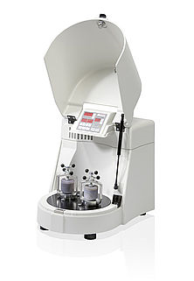
Evaluation of the role of excipients in gabapentin SS degradation
  Mixtures of gabapentin & excipients
  Co-milled
  Storage conditions: 5 to 50% RH at 50 ˚C
Excipients (50% w/w)
  CaHPO₄.2H₂0 (Emcompress)
  Corn starch
  Microcrystalline cellulose (Avicel PH101)
  HPMC 4000
  Colloidal SiO₂ (Cab-O-Sil)
  Talc (Mg silicate)
  HPC (6.5% w/w)
Saturated solution 50˚C
HPC
CaHPO4
Avicel
SiO2
HPMC
Lactam mole %
Talc
Starch
Gaba
Time (hr)

Slide 29
Model parameterization using excipient-induced variation in crystal damage during milling and termination rate
Excipient | k₁ | k₂ | k₃10⁴ | D₀ (%)
SiO₂ | 0.000074 | 0.016 | 5.55 | 21.1
CaHPO4 |  |  | 2.37 | 10.6
Starch |  |  | 2.62 | 4.5
MCC |  |  | 7.80 | 7.2
Talc |  |  | 1.35 | 8.4
HPMC |  |  | 1.20 | 7.4
HPC (6.5%) |  |  | 4.04 | 6.5
Excipient effects
Crystal damage (D₀) during milling
Kinetics of branching and termination(k₃)

Slide 30
Effect of Excipients based on Change in Initial Conditions and Rate Constants: under low humidity
 | k1 *10⁴ (%mole⁻¹hr⁻¹) | k2 (hr⁻¹) | D₀ (%) | L₀ (% mole)
SiO2 | 0.27 | 0.0208 | 21.16 | 2.6
Talc | 0.33 | 0.0116 | 8.44 | 0.98
Starch | 0.35 | 0.0150 | 4.54 | 0.30
HPMC | 0.41 | 0.0123 | 7.42 | 0.30
Avicel | 0.49 | 0.0148 | 7.21 | 0.26
HPC (6.5%) | 0.55 | 0.0209 | 6.52 | 0.30
Gaba | 0.74 | 0.0149 | 1.05 | 0.37

Slide 31
Effect of Excipients based on Change in Rate Constants: under low humidity
 | k1 (%mole⁻¹hr⁻¹) | k2 (hr⁻¹) | k3*10² (%mole⁻¹hr⁻¹) | D₀ (%) | L₀ (% mole)
HPMC | 0.000074 | 0.016 | 0.012 | 7.42 | 0.30
Talc |  |  | 0.014 | 8.44 | 0.98
CaHPO4 |  |  | 0.023 | 10.6 | 0.60
HPC (6.5%) |  |  | 0.041 | 6.52 | 0.30
SiO2 |  |  | 0.056 | 21.1 | 2.60
Avicel |  |  | 0.078 | 7.21 | 0.26
Starch |  |  | 0.260 | 4.54 | 0.30
Gaba |  |  | ̴0 | 1.05 | 0.37

Slide 32
Moisture and excipient effects
No excipient
Co-milled excipient (SiO₂)
30 %RH
5 %RH
11 %RH
Lactam mole %
50 %RH
5 %RH
11 %RH
30 %RH
50 %RH
Time (hr)

Slide 33
Linking Stability in Design Space
Manuf.
Design
Space
Model
Post-
Manuf.
Degradation
Model
L_{t}
End
of
Expiry
L₀
D₀
Key Research Findings
  Manufacturing Stress impacts drug stability upon storage:
    L0 (in-process lactam)
    D0 (unstable gabapentin)
  Predictive model for drug stability includes:
    Environment factor: temperature (⬆) & humidity (⬇)
    Compositional factors: both kinetic and initial condition effects
    Manufacturing factors: L0 and D0
  Model validation: completion of long term stability

Slide 34
Measuring the manufacturing stress effects
Physical methods
  Raj Suryanarayanan (University of Minnesota)
  Eric Munson (University of Kentucky)
Chemical and kinetic measurements
  Lee Kirsch (University of Iowa
Solid State NMR | Kansas
Raman spectroscopy | Minnesota
Powder x-ray diffraction (XRD) | Minnesota
DSC/TGA | All
Water vapor sorption | Minnesota
HPLC | Iowa

Slide 35
Chromatographic methods
Comparison of HPLC chromatograms before (black) and after (red) thermal stress:
∆ lactam = 0.004%.
Comparison of HPLC chromatograms before (black) and after (red) thermal stress:
∆ lactam = 0.059%.
Comparison of HPLC chromatograms before (black) and after (red) thermal stress:
∆ lactam = 0.174%.

Slide 36
Manufacturing-stability measurements
In process lactam (L₀)
  Change in lactam levels during specific treatment or unit operation in % lactam/gabapentin on molar basis
Initial Rate of Lactam Formation (V₀ or STS)
  Daily rate of lactam formation upon thermal stress at 50°C under low humidity
D₀ from Chemical Analysis

Slide 37
Insert Sury

Slide 38
Insert Eric

Slide 39
Applied Manufacturing-stability Measurements to Design Space and Risk Assessment
Laboratory scale stability design space
Pilot scale stability design space
Risk assessment using Manufacturing-stability Measurements

