Slide 1
Level Set Dissolution
Dan Braido
Alberto Cuitino

Slide 2
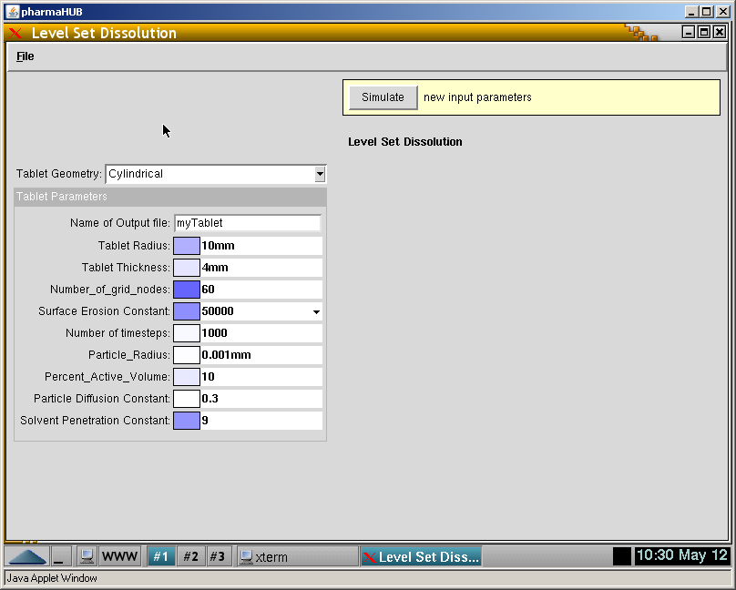
PharmaHub Tool Walkthrough

Slide 3
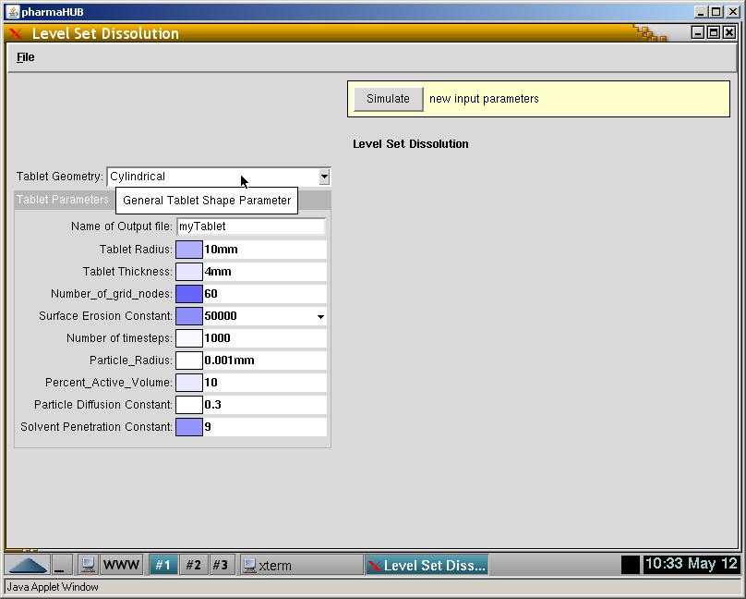
General Shape Type

Slide 4
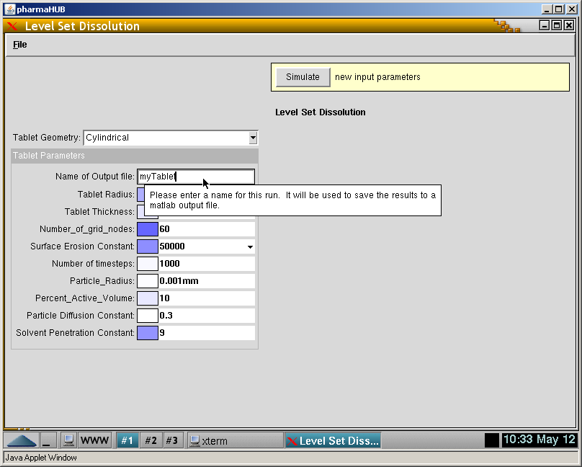
Session Title

Slide 5
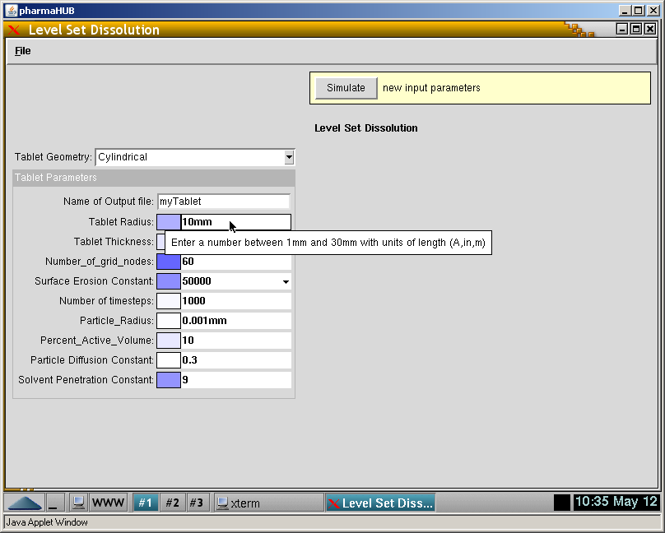
Tablet Radius

Slide 6
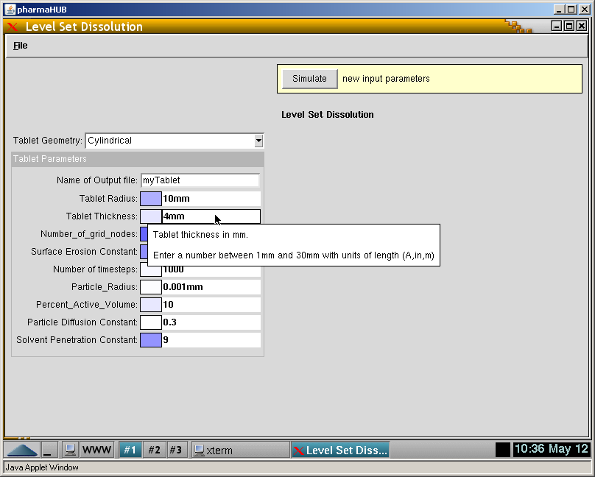
Tablet Thickness

Slide 7
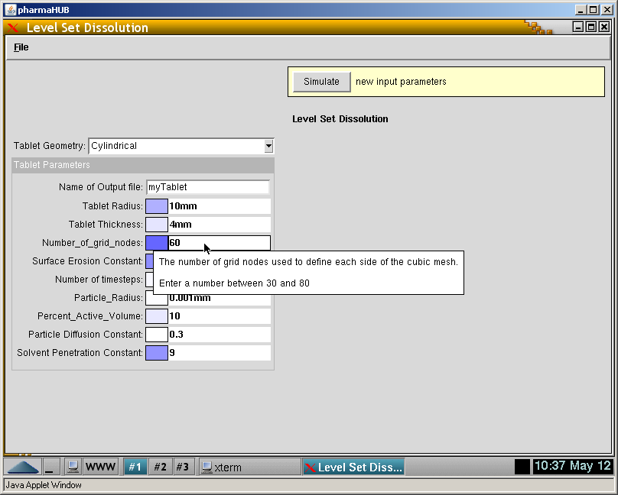
Mesh Size

Slide 8
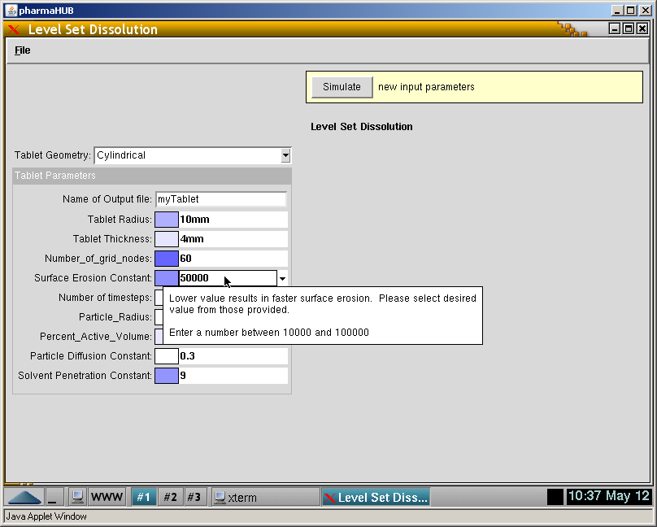
Surface Erosion Speed

Slide 9

Simulation Length

Slide 10
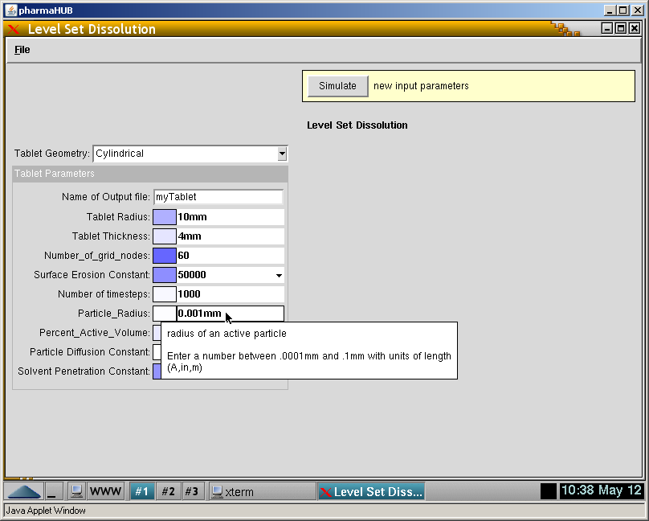
Size of Actively Diffusing Particles

Slide 11
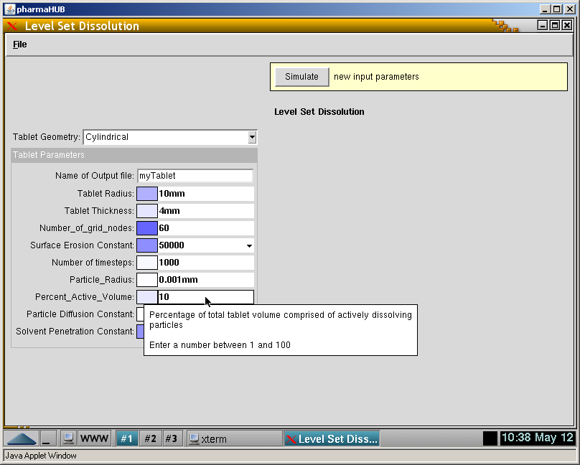
Total Volume of Active Particles

Slide 12
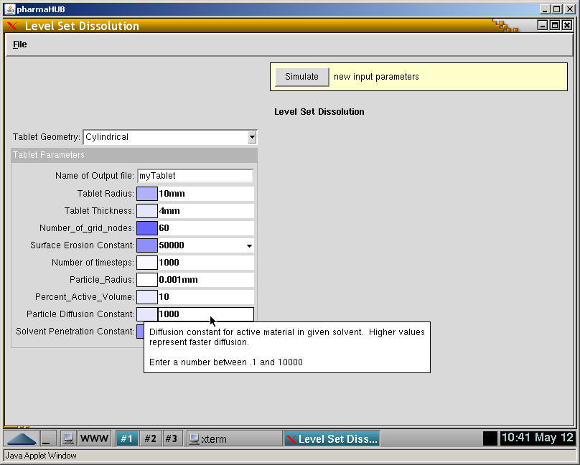
Particle Diffusion Speed

Slide 13
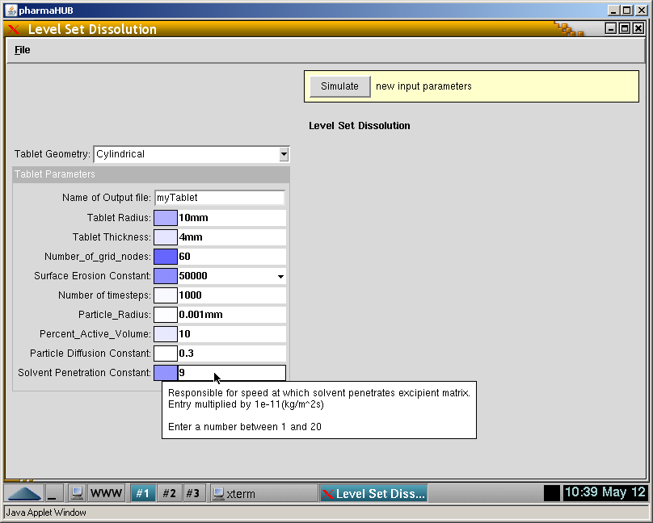
Solvent Penetration Speed

Slide 14
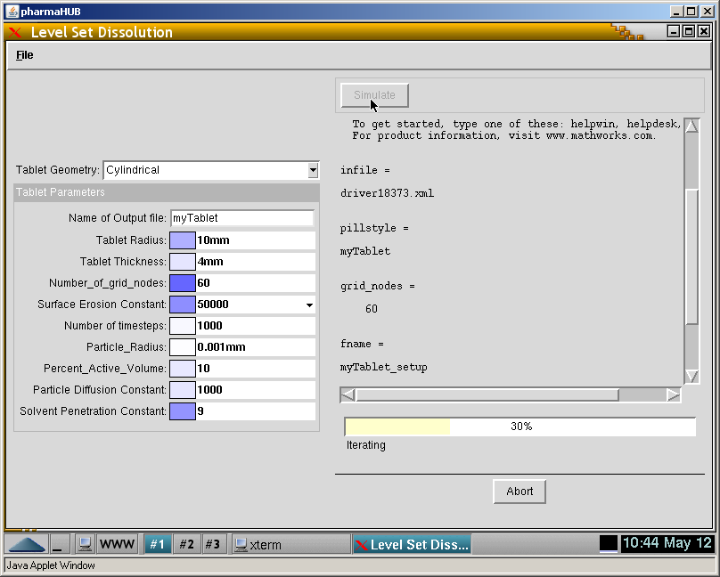
Simulation Running

Slide 15
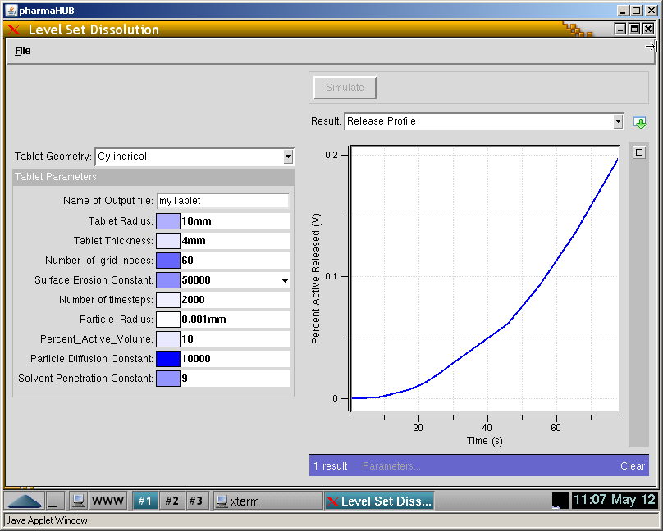
Output

