Slide 1
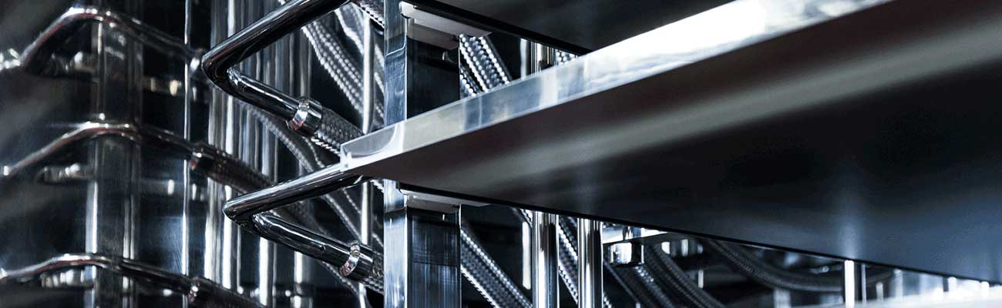



LyoHUB
Advanced Lyophilization Technology Consortium
Birck Nanotechnology Center

Slide 2
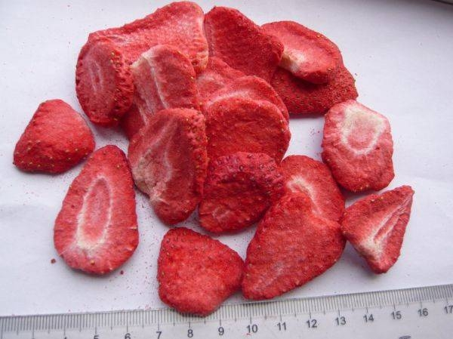
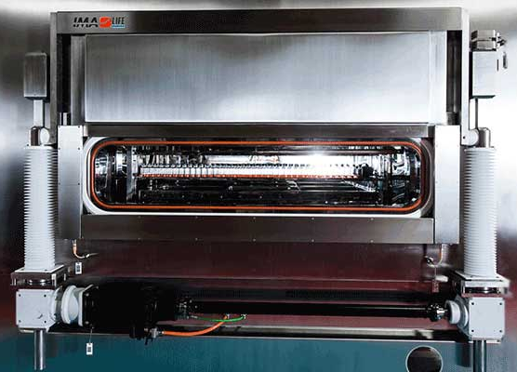
LyoHUB: The Goal of LyoHUB
to advance the science and technology of freeze-drying/lyophilization
Immediate objectives are:

Slide 3
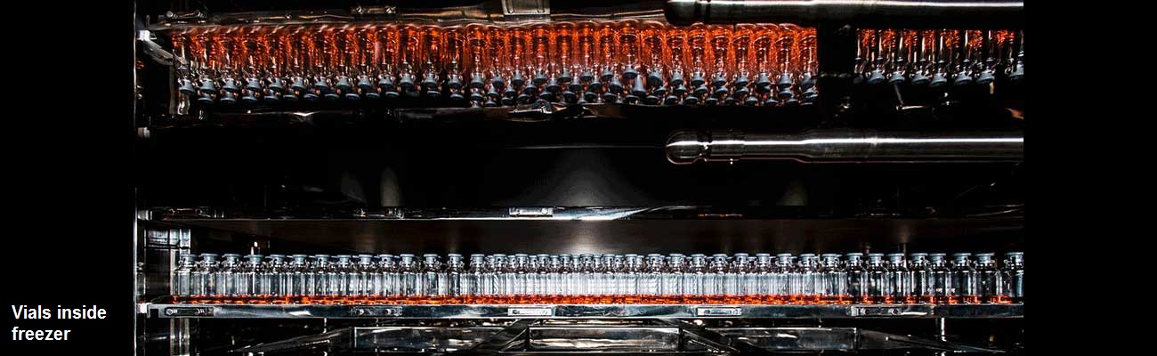
Development of standards for lyophilization equipment performance, testing and validation

Slide 4
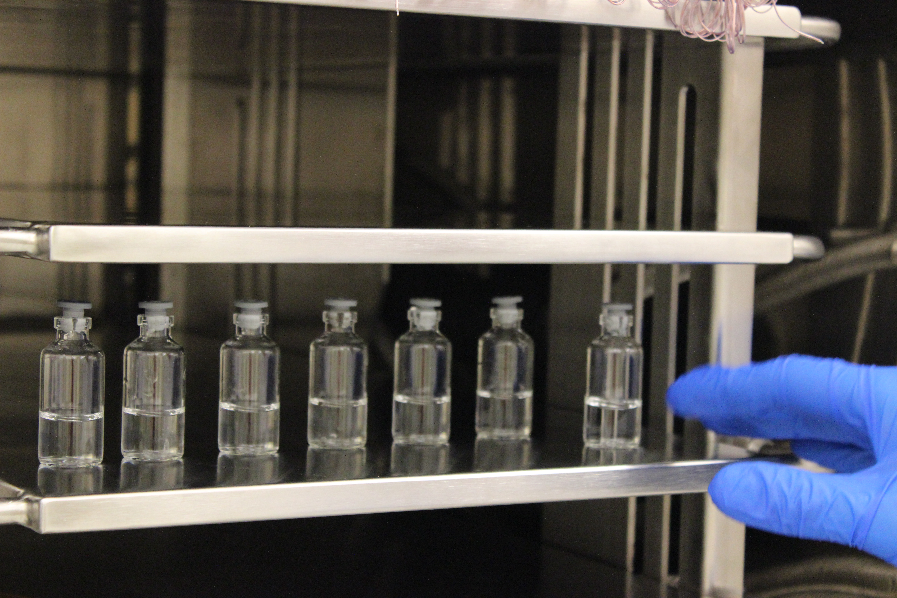
Advancement of process analytical technologies and sensors for process development, monitoring and control

Slide 5
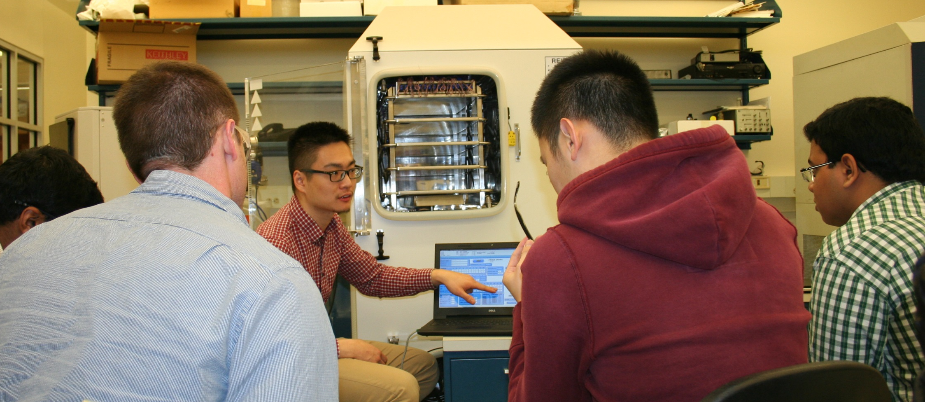
LyoHUB: Creation and dissemination of education and training materials describing the state-of-the-art scientific understanding and best practices in lyophilization

Slide 6
LyoHUB: Why is the advancement of lyophilization so important?
For many high­‐value proteins, peptides and vaccines, lyophilization is the only way to produce stable, biologically active products with long shelf-life.
The U.S. is currently the leader in the pharmaceutical biotechnology sector with 43% global market share, a projected annual growth rate of 9.6% and a stronger development pipeline than any other nation.
About 25% of new injectable drugs, vaccines and biological products are formulated in lyophilized form.

Slide 7



LyoHUB:
The lyophilization process is currently:
Time consuming
Expensive to Run
Energy inefficient

Slide 8
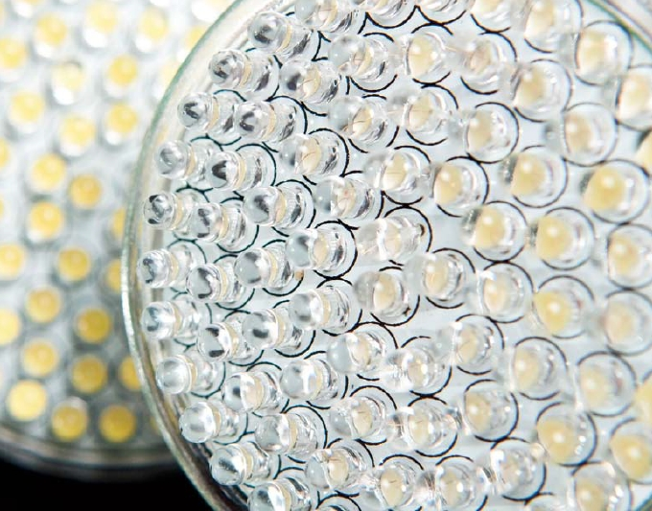
LyoHUB:
Advances in freeze-drying technology are required to meet the growing demand for high-capacity and efficient ^{freeze‐dryers.}

Slide 9







LyoHUB: Industry-led Partnership to advance the science and technology of lyophilization/freeze-drying

Slide 10
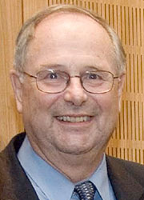


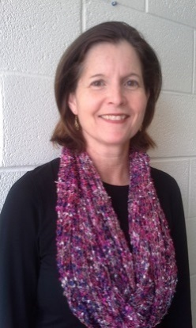
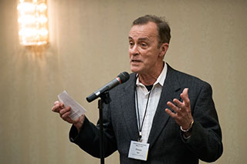
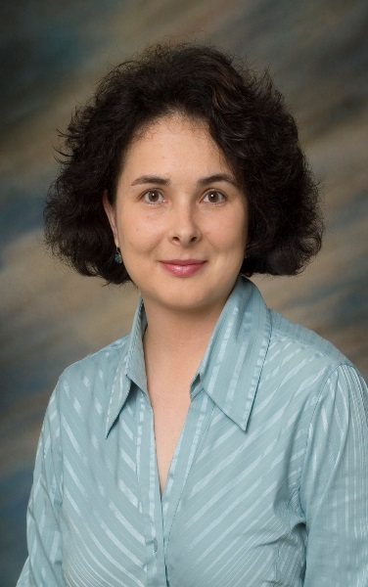
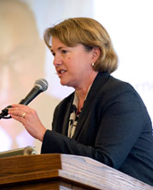

LyoHUB:
LyoHUB Leadership Team & Staff
Carlos Corvalan
Purdue Food Science
Steve Shade
Purdue Engineering
Jen Gray
LyoHUB
Mike Pikal
UConn Pharmacy
Steve Nail
Baxter
Liz Topp
Purdue Pharmacy
Alina Alexeenko
Purdue Engineering
Weiling Li
Willie Burgess

Slide 11

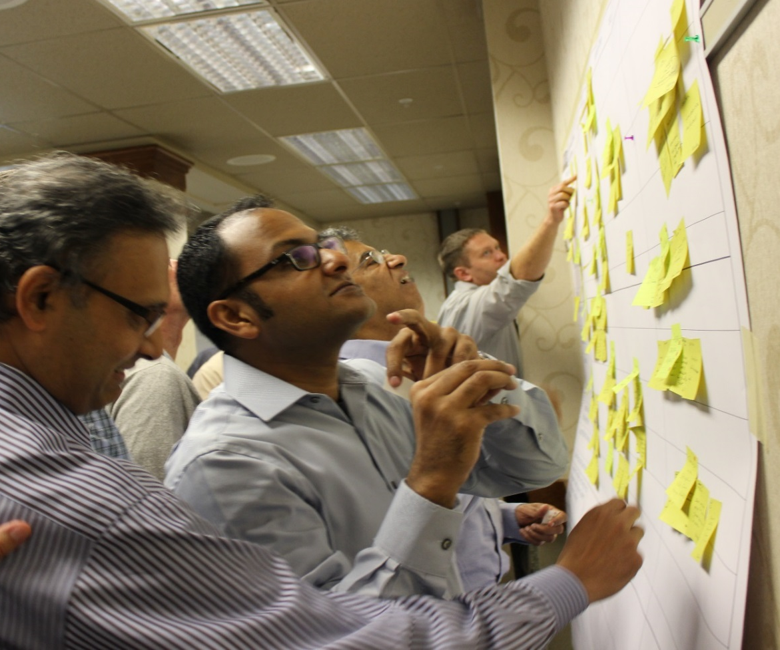
LyoHUB: LyoHUB brings together industry members, from pharmaceutical and food processing sectors, as well as equipment manufacturers, to engage with both university and federal partners.

Slide 12
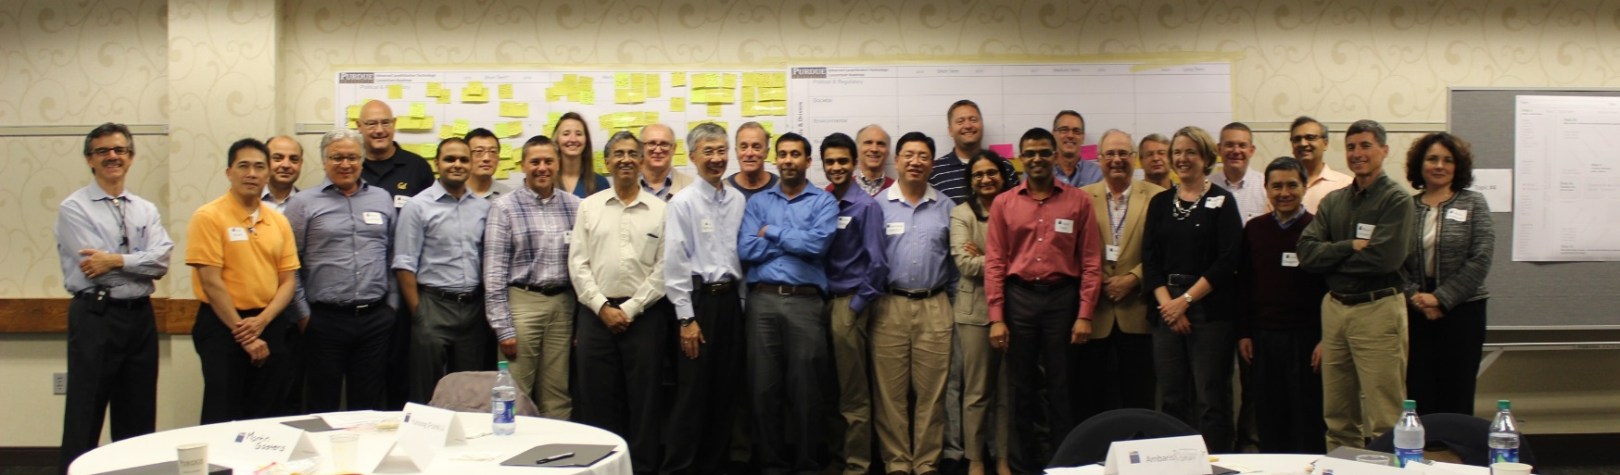
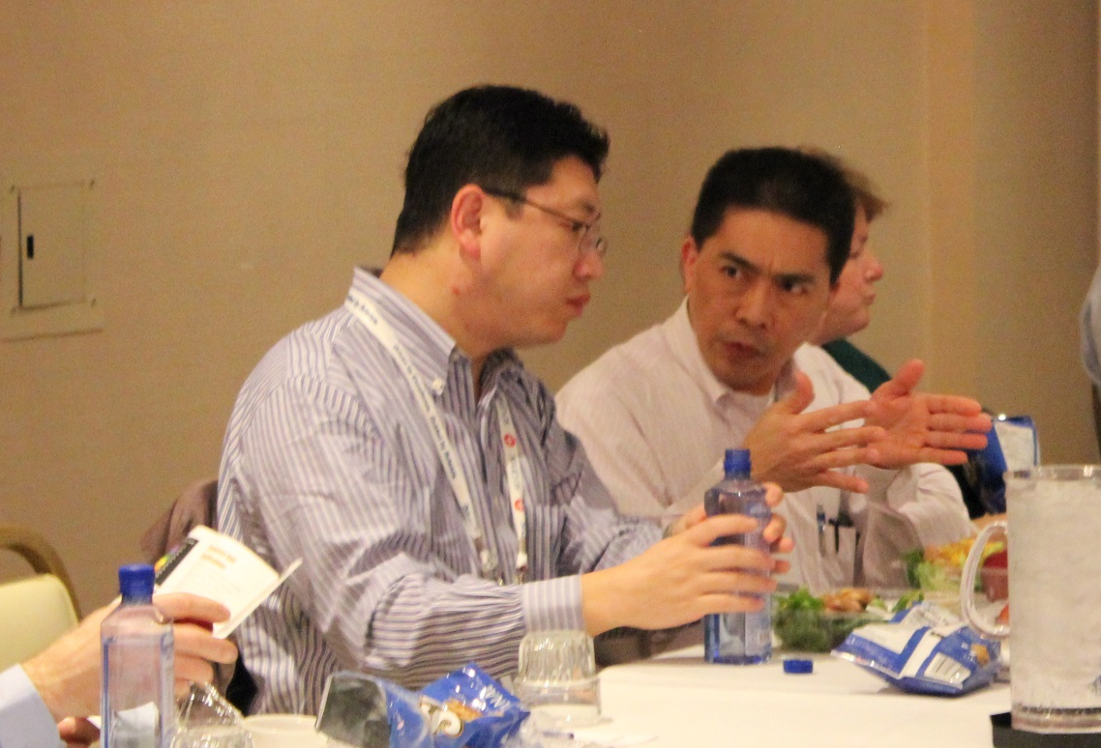
LyoHUB:
LyoHUB Roadmapping Workshops
Purdue University
October 6-7, 2015
25 Industry Representatives
San Diego, CA
January 20, 2016
2 Government Representatives
7 University Representatives
17 Industry Representatives
7 University Representatives

Slide 13
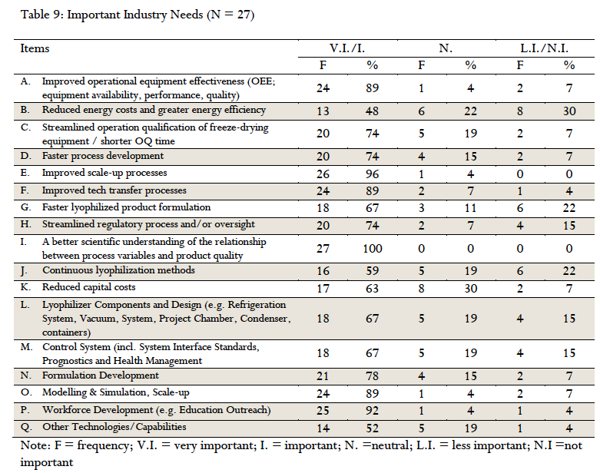
Freeze-Drying: Industry Needs

Slide 14

LyoHUB:
Development of Best Practices
Steve Nail, Baxter

Slide 15
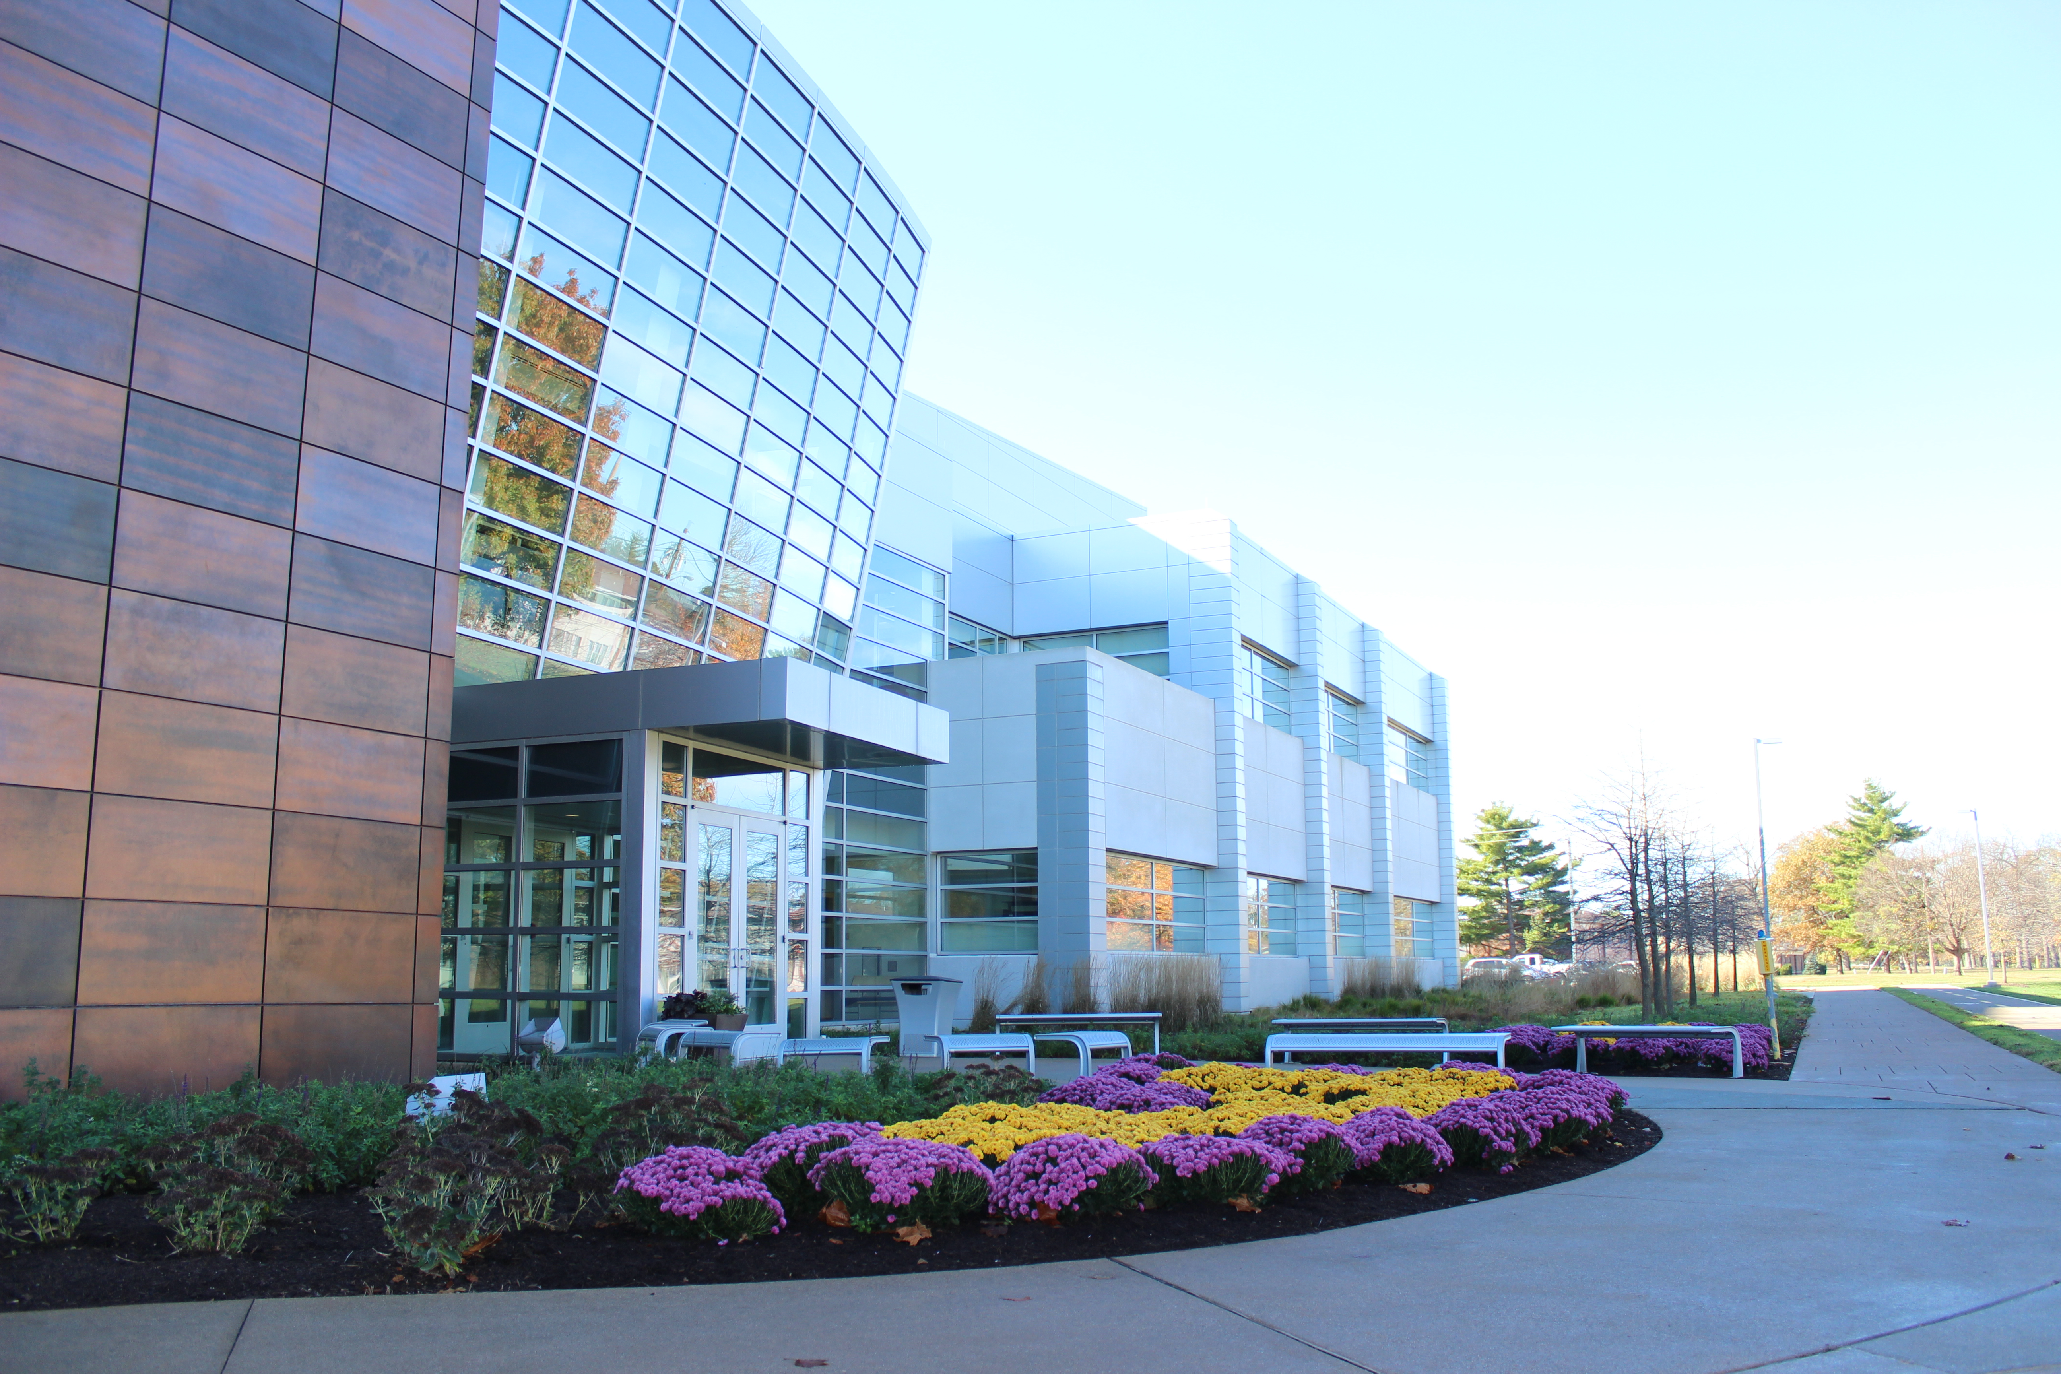
Lyophilization Demonstration Facility located in Birck Nanotechnology Center at Purdue University for use in lyophilization research, development and pilot demonstration projects

Slide 16
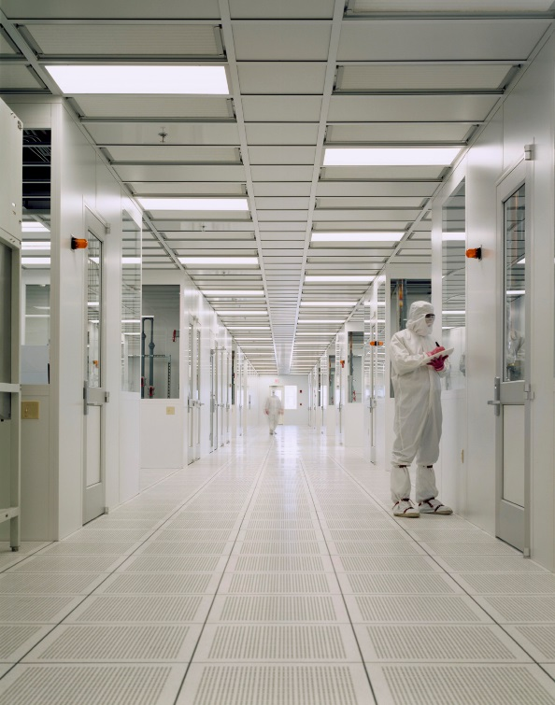
LyoHUB Demo Facility:
World-Class, World Renowned Research Facility
25,000 sq. ft. Class 1-10-100 nanofabrication cleanroom
special low vibration rooms for nanostructures research, with temperature control to less than 0.1 °C
unique nanotechnology incubator facility is provided for interaction with industry
Birck Nanotechnology Center

Slide 17
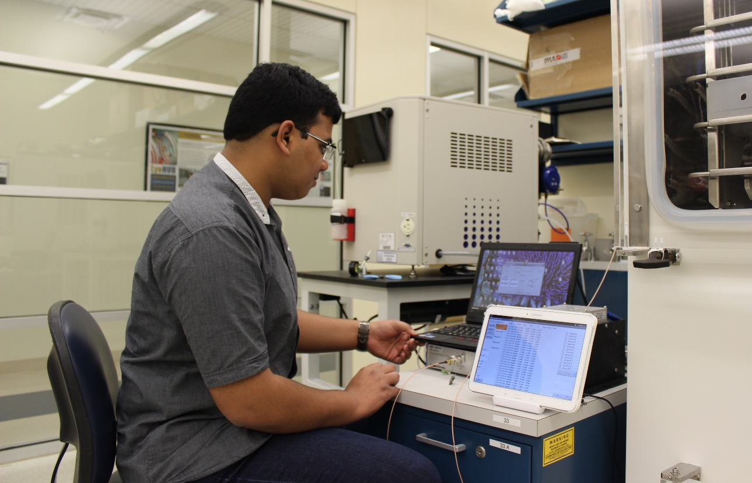
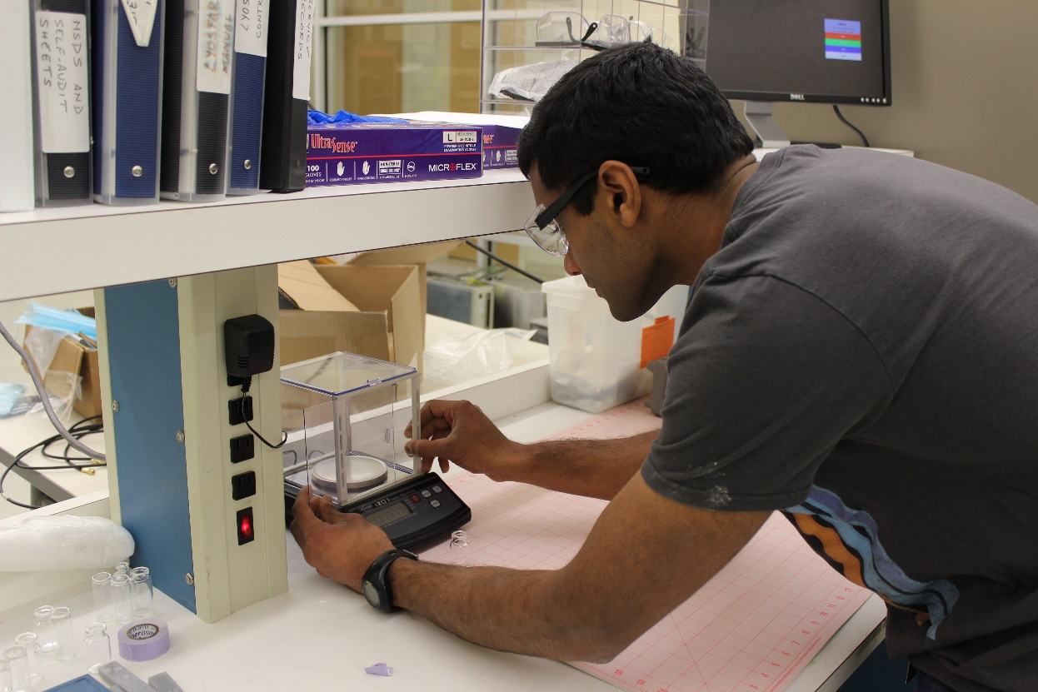
LyoHUB Demo Facility: Initiation of Pilot Technology Development
and demonstration projects

Slide 18
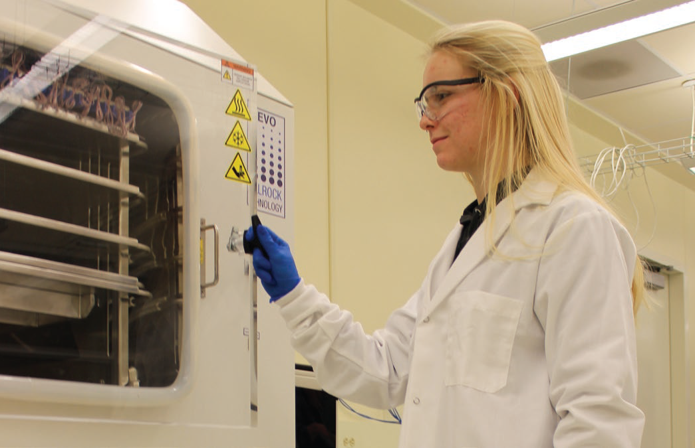
LyoHUB Demo Facility: Equipment and Capabilities
Two lab-scale lyophilizers:
LyoStar 1 with Millrock Controlled Nucleation
Revo (arrived Fall 2015)
Lyostar 3 (scheduled delivery end of July 2016)
In operation since February 2016.
Other BNC Equipment available for use:
Imaging: AFM, SEM, Optical/Confocal/Infrared microscopy
Surface analysis: XPS, STM, HREEL, LEED
Biological characterization: bio-cleanroom (BSL-1 and BSL-2) cell counters, physiological probes
Nano/microfabrication: patterning, etching, deposition, thermal, back-end
Notes:
LEED: Low energy electron difraction
HREEL: High resolution electron energy loss

Slide 19
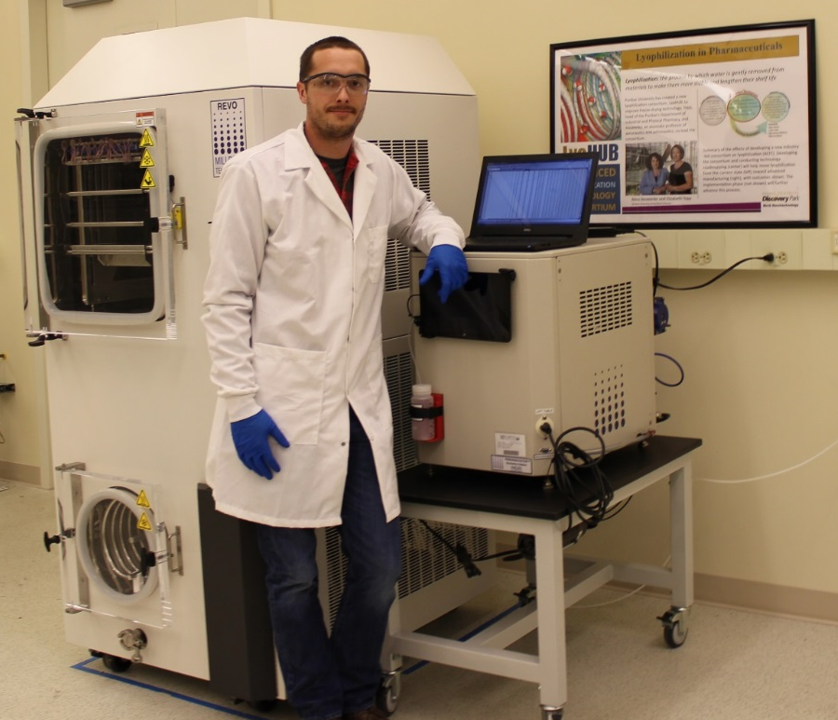
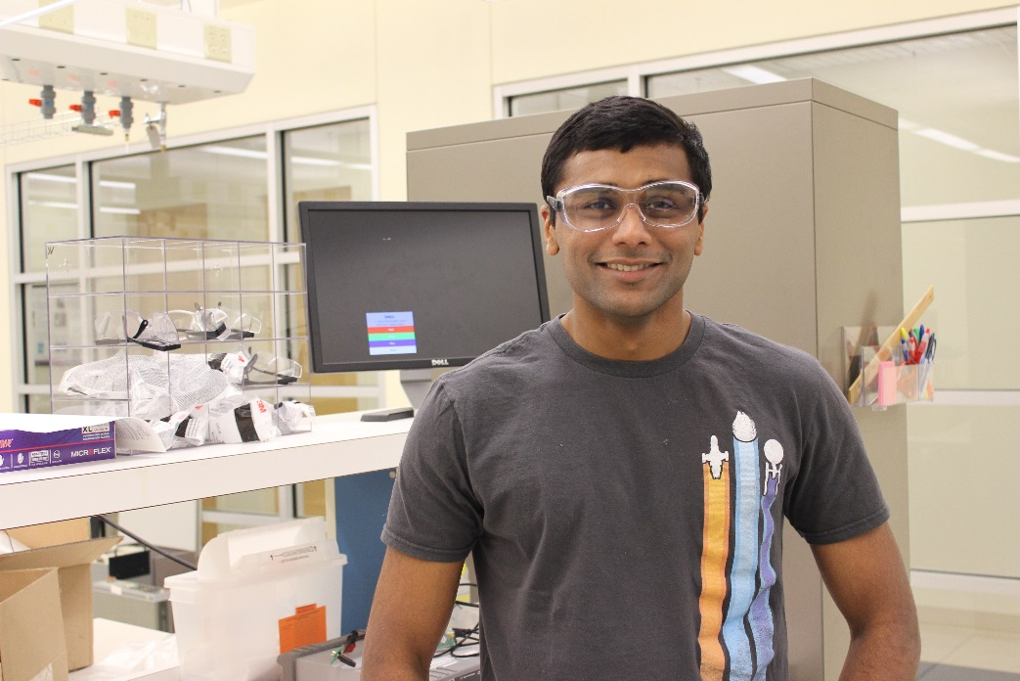
Drew Strongrich
PhD student in AAE
LyoHUB User Training – Superusers
Nithin Raghunathan
Staff Engineer in EE
Research: Wireless sensor testbed development which communicates vial head space temperature and humidity to the user.
Research: Highly localized measurement of gas pressure, temperature and water vapor concentration, key parameters in evaluating overall drying (lyophilization) process.

Slide 20
LyoHUB:
Lyo Launch Pad
Limited access to lyo demo facility to complete a short-term project (~5-10 days = 1 – 2 weeks) of run time
Opportunity for new prospective SME industry members to test drive lyo demo facility before joining as a member or fee-based use
Opportunity for LyoHUB to broaden membership, applications base and form new partnerships outside traditional bio/pharma & equipment manufacturers
Requirements:
  Approval by Co-Directors
  Company reports results of the project to LyoHUB consortium members in form of webinar

Slide 21

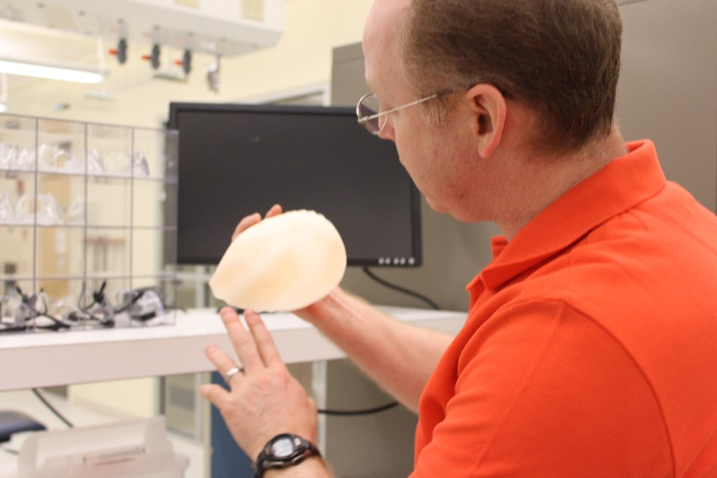
LyoHUB:
Lyo Launch Pad
Nanovis LLC - First prospective Lyo Launch Pad project:
  Indiana-based medical devices company – maker of FortiCoreTM 3D scaffold for implants
  Proposed project – test lyophilization to aid in the manufacture of gelatin sponges for soft-tissue implant and other medical applications
  Gelatin/formaldehyde with trace dichloromethane/ethyl acetate solvents; primary drying: < 20% moisture 8-10 hours; secondary drying: < 1% 12-14 hours

Slide 22
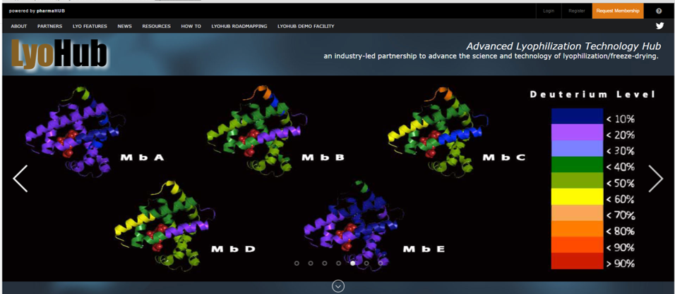
LyoHUB: Online Hub at www.LyoHUB.org

Slide 23
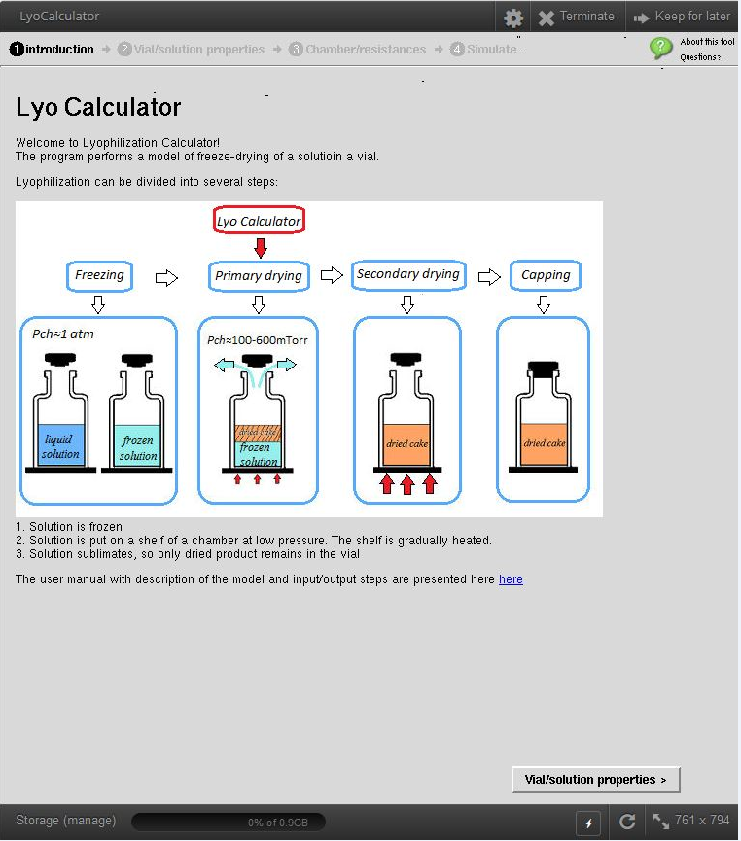
LyoHUB Online: Interactive Process Simulation Tools Such as LyoCalculator

Slide 24
LyoHUB Working Groups
6 working groups were formed during the April 2016 LyoHUB meeting resulting in the following projects:
1. Scale-Up/Data: LyoHUB will establish communication pathways between production scale and laboratory scales. Use data to improve, develop and validate models. Project will reduce scale-up time and costs.
2. Scale-Up/Modeling: Predict scale up through modeling. Establish white papers and case studies (coming from different companies)
3. Equipment/Real Time Optimization: Creation of a proposal for a study on real-time process optimization.

Slide 25
LyoHUB Working Groups
6 working groups were formed during the April 2016 LyoHUB meeting resulting in the following projects:
4. Equipment/Wall Temperature Control: LyoHUB will work to develop temperature controlled walls to be used in lyophilizers.
5. Education/ Lyo Short Course Survey: LyoHUB will develop short, lyo training courses. These courses may include performance and design of different lyophilizers, bridging the gap between process & formulation, and exclusive training for new hires.
6. Education/ FDA Database: Develop a center for up-to-date regulatory FDA guidelines education. Develop the search method to find observations. Define search method to search the last 5 years.

Slide 26
LyoHUB Upcoming Activities
Working group outline of white paper on scale up optimization: Breckinridge, CO July 13, 2016
Strategic Doing workshop with members on FDA, industry, academia: September 19, 2016 in Washington DC
Day long sessions to work on Best Practices in Freeze Drying at Purdue University with members of industry and academia: October 11, 2016

Slide 27

LyoHUB:
Membership Benefits
Use of lyophilization Demonstration Facility at Purdue University for research, development and pilot demonstration projects, using state-of-the-art lyophilization equipment and PAT.
Participation in creating Best Practices papers for lyophilization equipment standards.
Access to on-line hub for Educational and Training Materials, as well as a database of consortium research studies.
Join Experts from NIST, IMA Life North America, Janssen, Inficon, Pfizer, Millrock, Baxter & SP Scientific as we roadmap the future of lyophilization.

Slide 28
LyoHUB:
Membership Options
$10,000/ yearly membership rate,
minimum 3 year commitment
$10,000/ first year membership fee plus,
Equipment Donation
Lyo Launch Pad: limited-time access to demo facility for prospective industrial users

Slide 29

LyoHUB:
IN-MaC
LyoHUB proposal to participate in SME program selected by IN-MaC on February 29, 2016
IN-MaC will cover half of the annual membership fee ($5K) for any Indiana-based small & medium sized enterprise (SME) that joins LyoHUB

Slide 30


LyoHUB:
For more information
Visit us online at
www.LyoHUB.org
Follow us on Twitter at
https://twitter.com/lyohub
Alina Alexeenko alexeenk@purdue.edu
Elizabeth Topp topp@purdue.edu
Jennifer Gray gray160@purdue.edu

