Slide 1
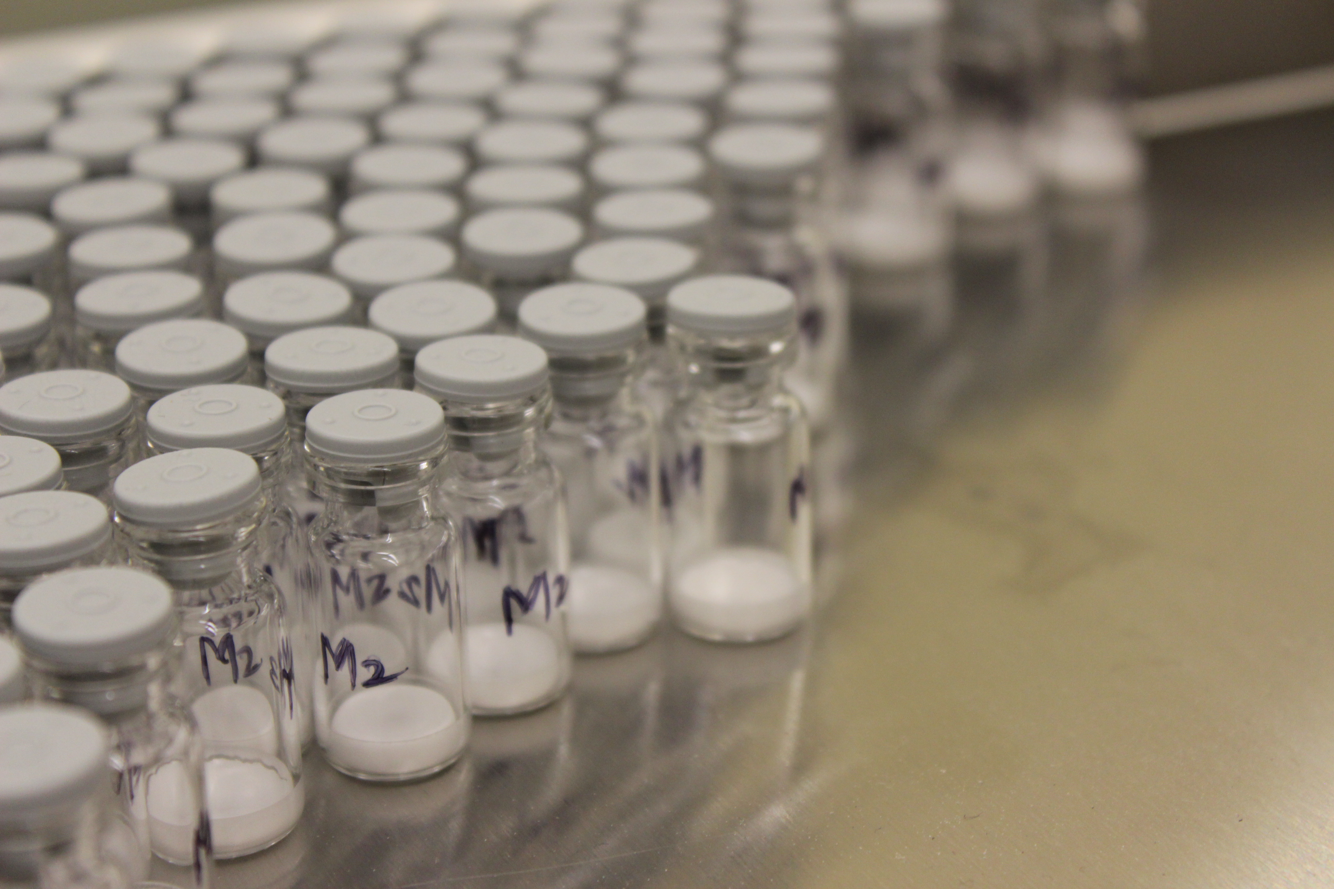

LyoHUB Demonstration Facility

Slide 2
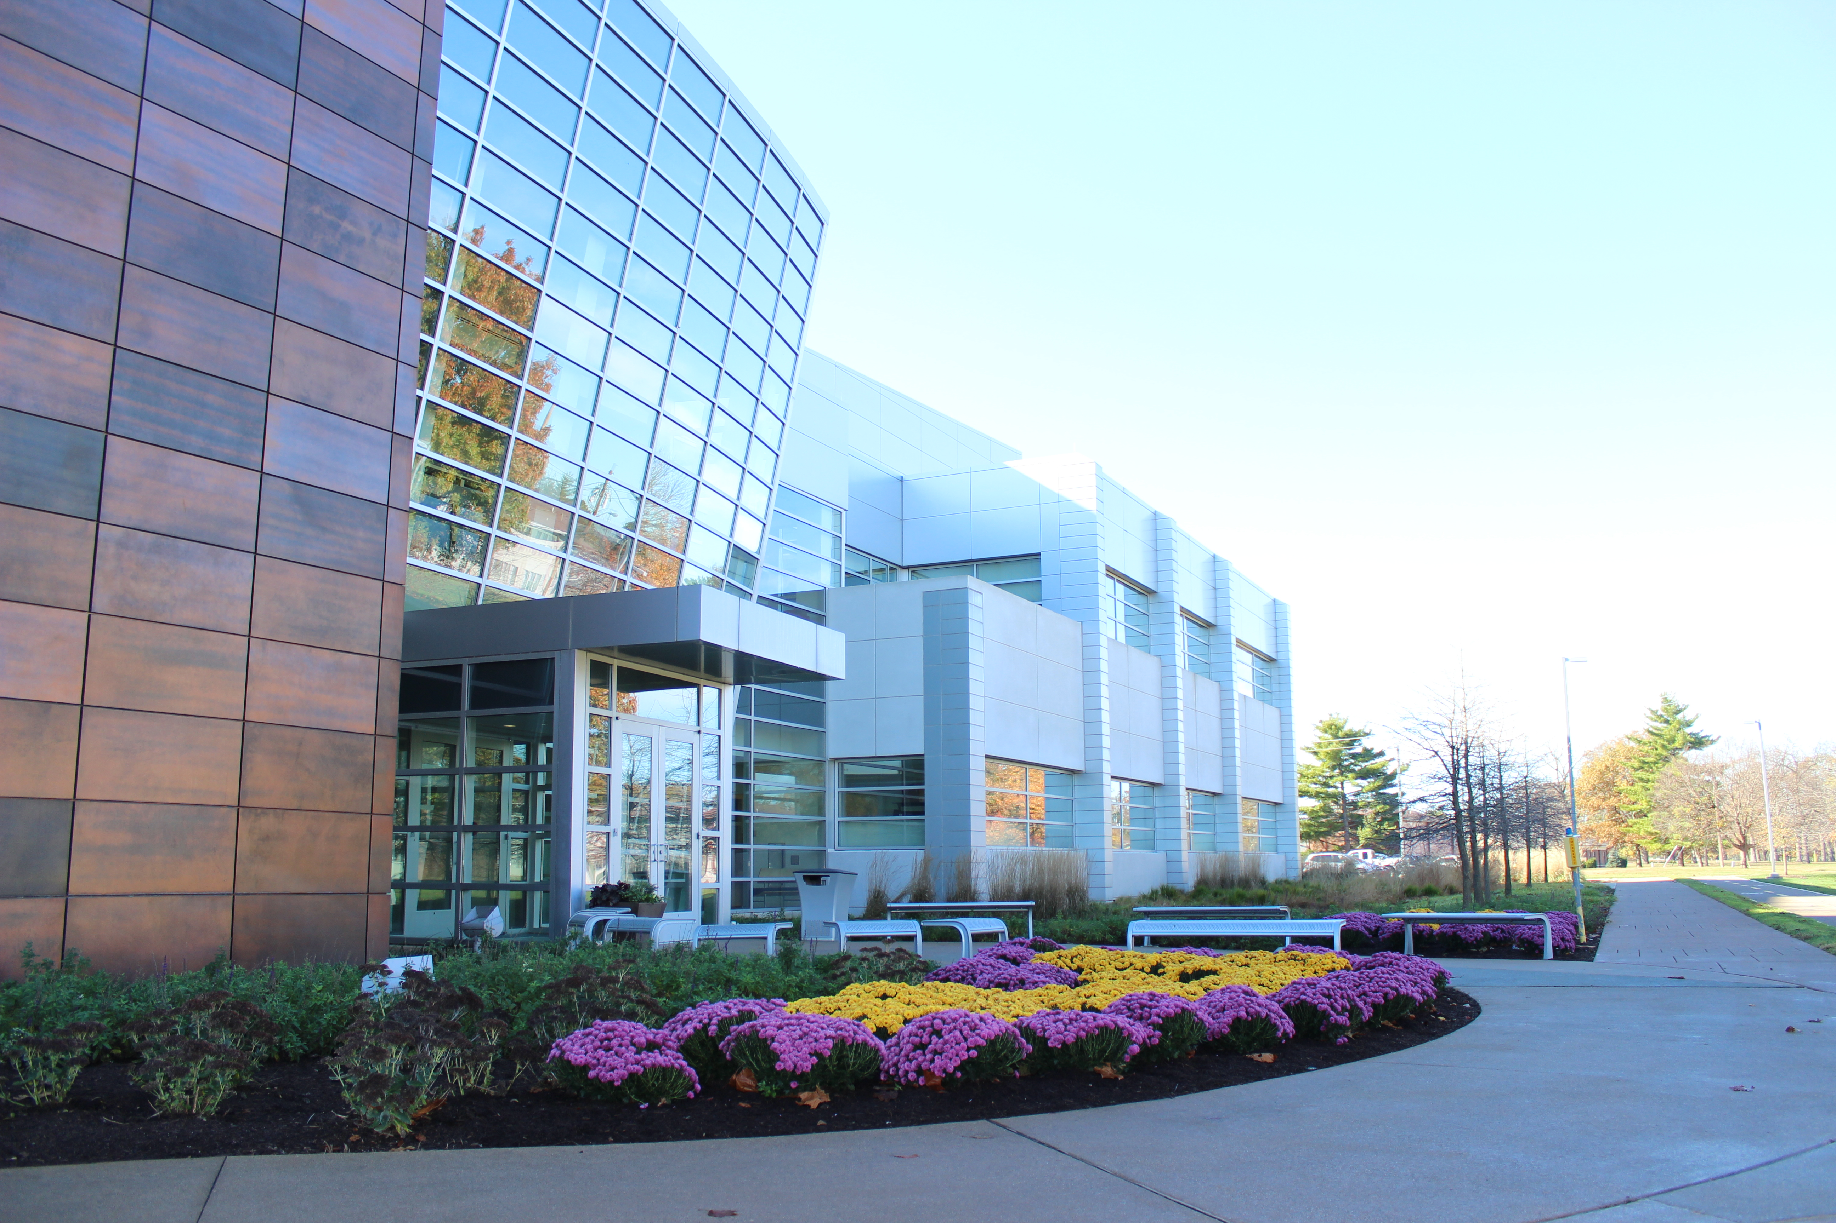
Birck Nanotechnology Center at Purdue University

Slide 3

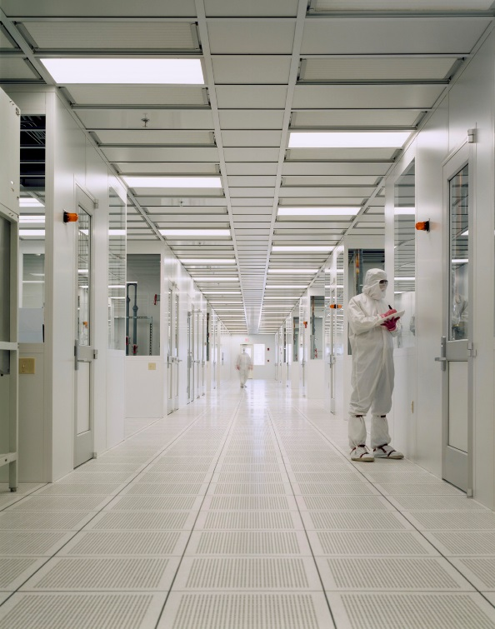
LyoHUB Demo Facility:
World-Class, World Renowned Research Facility
25,000 sq. ft. Class 1-10-100 nanofabrication cleanroom
special low vibration rooms for nanostructures research, with temperature control to less than 0.1 °C
unique nanotechnology incubator facility is provided for interaction with industry
Birck Nanotechnology Center

Slide 4
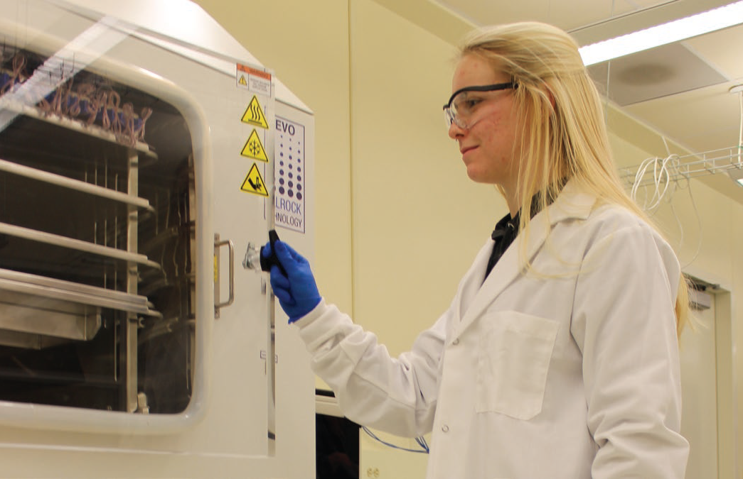
LyoHUB Demo Facility: Equipment and Capabilities
Two lab-scale lyophilizers:
LyoStar 1 with Millrock Controlled Nucleation
Revo (arrived Fall 2015)
In operation since February 2016. About $11k installation charges.
Other BNC Equipment available for use:
Imaging: AFM, SEM, Optical/Confocal/Infrared microscopy
Surface analysis: XPS, STM, HREEL, LEED
Biological characterization: bio-cleanroom (BSL-1 and BSL-2) cell counters, physiological probes
Nano/microfabrication: patterning, etching, deposition, thermal, back-end

Slide 5
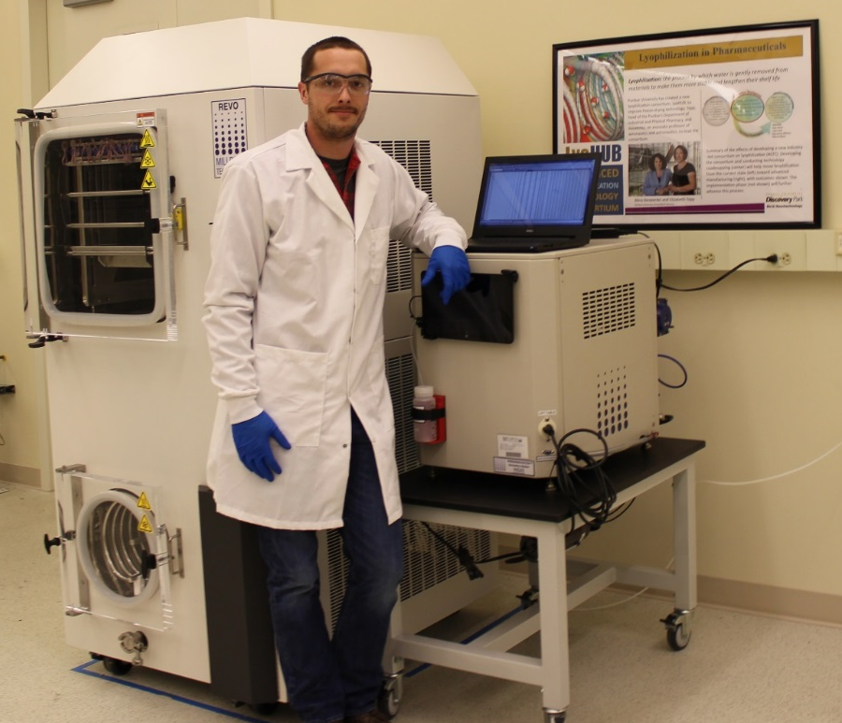
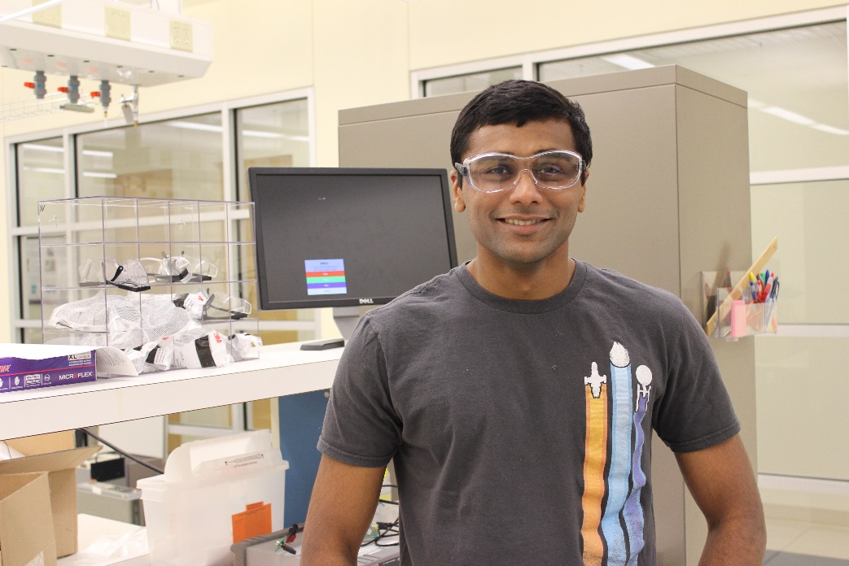
Drew Strongrich
PhD student in AAE
LyoHUB User Training – Superusers
Nithin Raghunathan
Staff Engineer in EE
Research: Wireless sensor testbed development which communicates vial head space temperature and humidity to the user.
Research: Highly localized measurement of gas pressure, temperature and water vapor concentration, key parameters in evaluating overall drying (lyophilization) process.

Slide 6
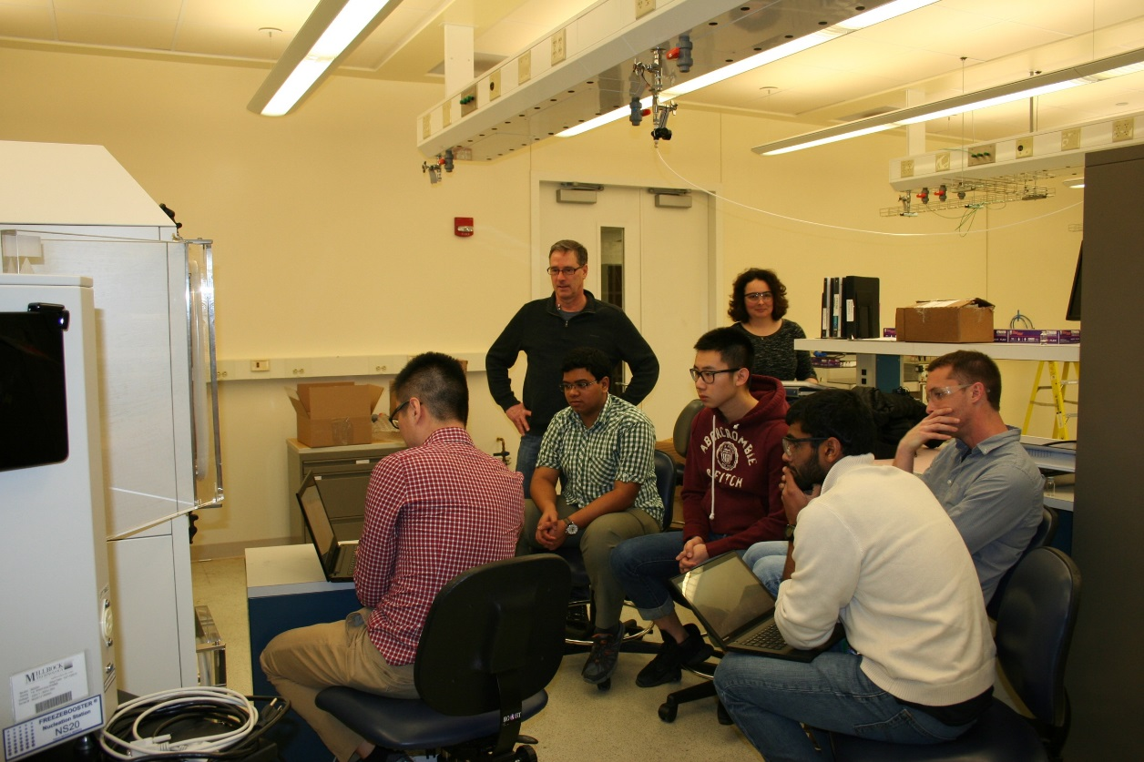
LyoHUB User Training
Distance training by Millrock for superusers – Fall 2015
On-site training on LyoPAT – February 2016
Training by superusers in demo facility – ongoing
Web-based training materials – TBA in Summer 2016
6 Users trained in Feb – March 2016:
3 Pharmacy students + 2 Engineering (1 ECE; 1 AAE)
1 company user (Nanovis Inc.)

Slide 7
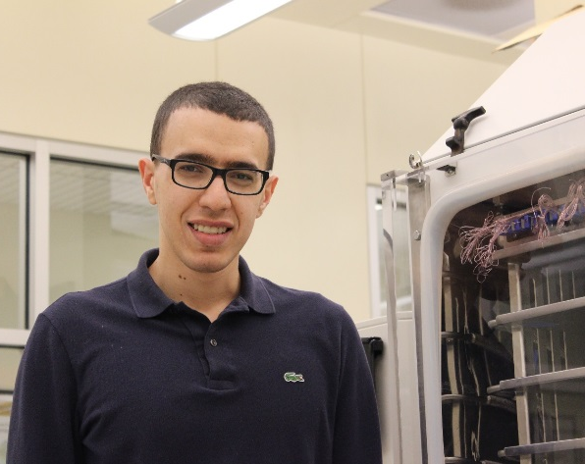
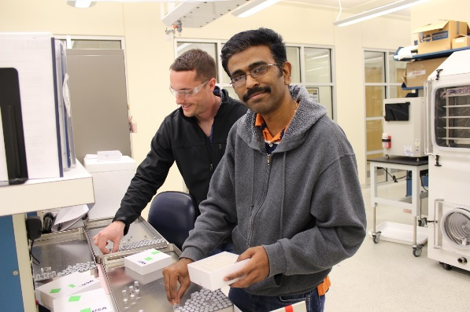
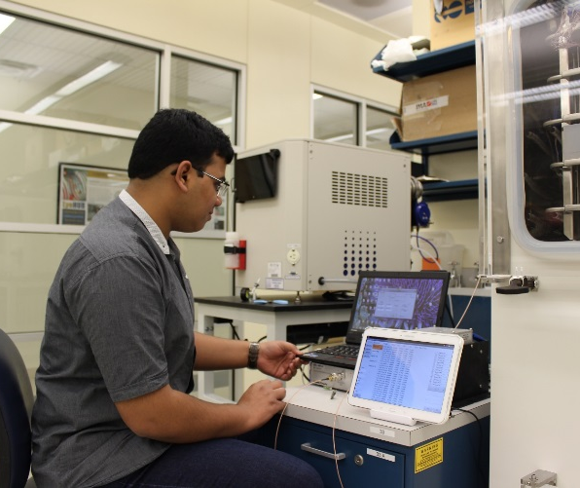
LyoHUB: Meet the Demo Facility Users!
Ehab Moussa,
PhD student in IPP
Lyophilization of samples to understand the dynamics of protein drugs in the solution and solid states
Dr. Shenbaga Moorthy, Research Scientist IPP
Lyophilization of protein formulations to advance the stability and aggregation of therapeutic proteins in both liquid and lyophilized formulations.
Vaibhav Kshirsagar,
PhD student in IIT
Operational qualification performance evaluation on the REVO lyophilizer. Results from these tests will be used to develop a design space for users, providing information on the unit's permissible operating envelope.
Assessing the effect of lyophilization on chemical degradation of pharmaceutically useful peptides in order to suggest formulation strategies to improve their quality and long-term stability.
Anshul Mishra
PhD student in IPP

Slide 8
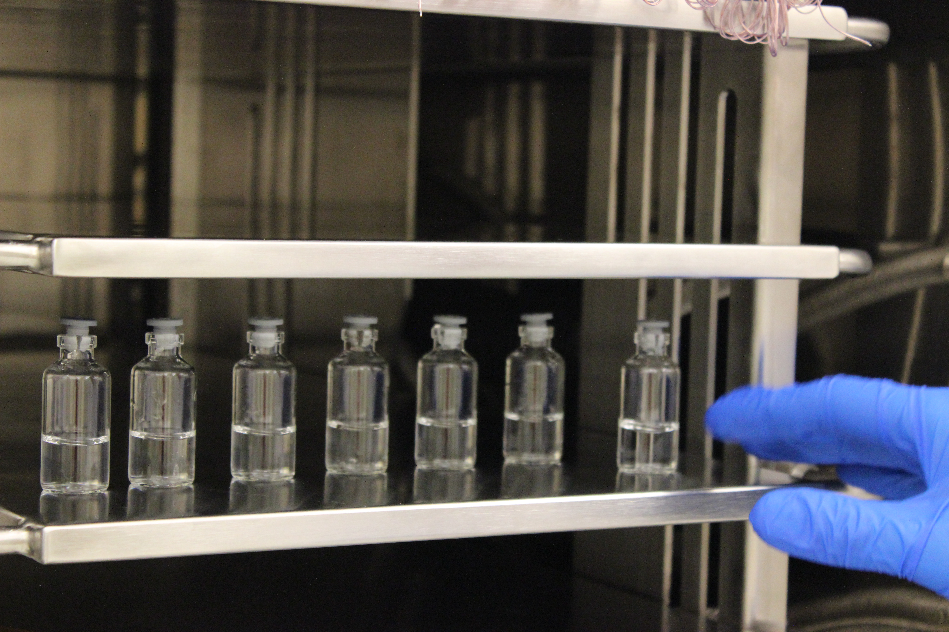
To learn more about the LyoHUB Demonstration Facility, visit www.lyohub.org

