Slide 1
NIR Spectroscopy: From PCA to Regression
Following the Guiding Discipline
Rodolfo J. Romañach, Ph.D.
UPR-Mayagüez
rromanac@yahoo.com
August 19, 2012.

Slide 2
Begin with the End in Mind – View from 30,000 feet
There are many aspects in this work. Powder samples, tablets, production equipment and the NIR instruments used to obtain spectra and monitor a process.
Software like SIMCA, Unscrambler, Pirouette, PLS Tool Box, PLS IQ, etc that facilitate the careful observation of spectra (or other patterns) studying & understanding the data and then developing the calibration model.
A number of companies sell software for real time predictions. Software that enable the use of the regression equation in the production environment. This is another software that is just for “use” of the calibration model and provide the information to a distributed control system or plant manufacturing data system.
Software for production that control all production systems, including real time predictions, and pickup all the data (e.g. SIPAT, SynTQ, etc.)
Notes:
We are going to make a transition from #1 to #2 today, but want everybody to keep in mind the full scope of the work.

Slide 3
Scattering and Diffuse Reflectance
Light propagates by scattering.
As light propagates, remittance, transmission and absorption occur.
The radiation that comes back to the entry surface is called diffuse reflectance.
Notes:
The term scattering is used in many of the texts that describe NIR spectroscopy. Scattering simply refers to the propagation (movement) of light. As scattering occurs some of the radiation is absorbed, while is some is transmitted, and some is returned back to the entry surface (remitted).
Diffuse reflectance is when the light source and detector are in the same side. In transmittance, the light source and detector are in opposite sides.
In NIR spectroscopy, sample preparation is not performed in the vast majority of applications. Therefore, need to visualize the interaction between light and the sample matrix.

Slide 4
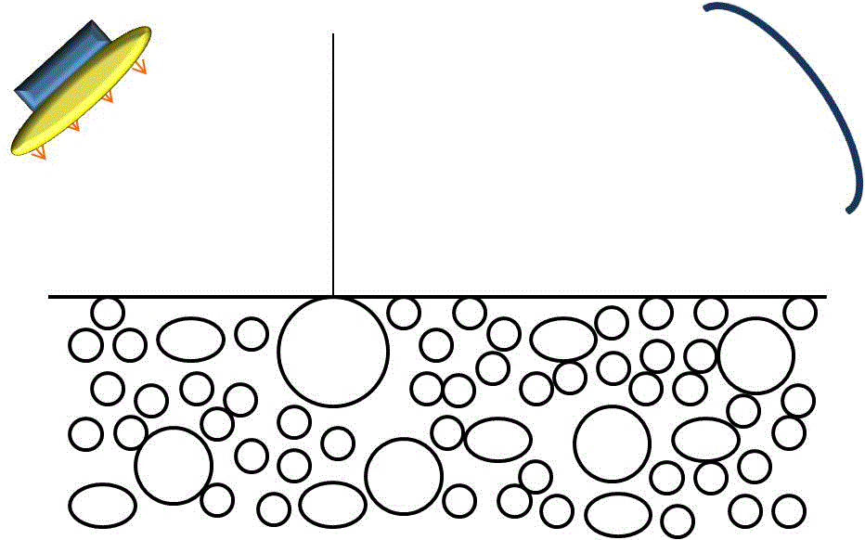
Diffuse Reflectance
Reflectance is termed diffuse where the angle of reflected light is independent of the incident angle
Spectra Affected by:
Particle size of sample.
Packing density of sample, and pressure on sample.
Refractive index of sample.
Crystalline form of sample.
Absorption coefficients of sample.
Characteristics of the sample’s surface.
J.M. Chalmers and G. Dent, “Industrial Analysis with Vibrational Spectroscopy”, Royal Society of Chemistry, 1997, pages 153 -162.
Notes:
Diffuse reflectance – light source and the detector are on the same side of the sample. The diffuse reflectance instrumental set up also includes optical components that collimate the radiation that is received from many angles and focus it on the detector. There are many accessories for diffuse reflectance probes such as fiber optic probes, and various configurations that may be attached to pharmaceutical blenders for real time monitoring.

Slide 5
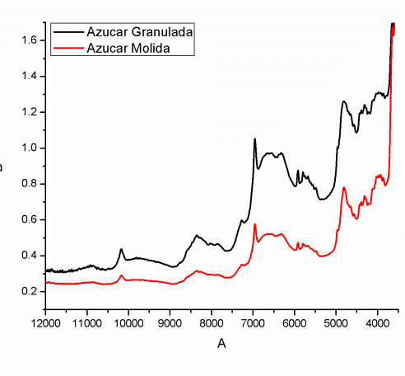



Particle Size and Scattering
Smaller particle sizes
More remission, less transmission
Absorbing power (absence of scattering)
Absorption coefficient (includes effects of voids, surface reflection, distance traveled)
Larger particle sizes
Less remission, more transmission
Notes:
Once students understand what is diffuse reflectance, the professor should explain what effects have particle size and scattering regarding the light. Students have to be able to understand that smaller particles permit less transmission but more remission and that larger particles permit less remission but more transmission.

Slide 6
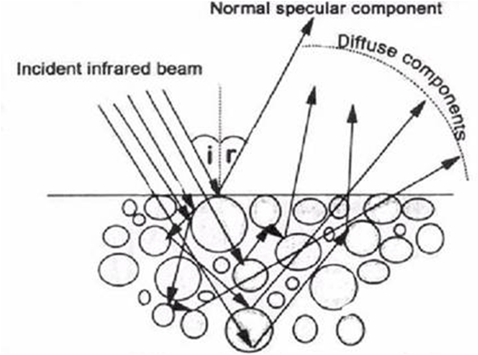
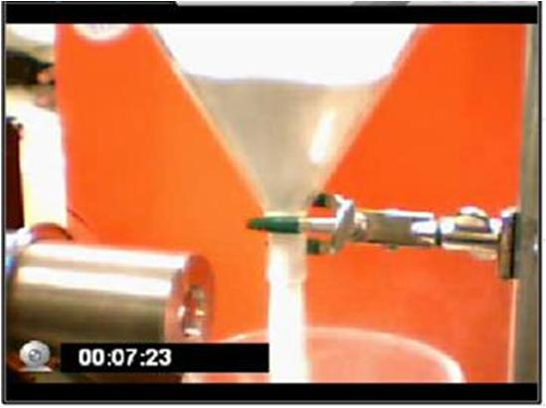
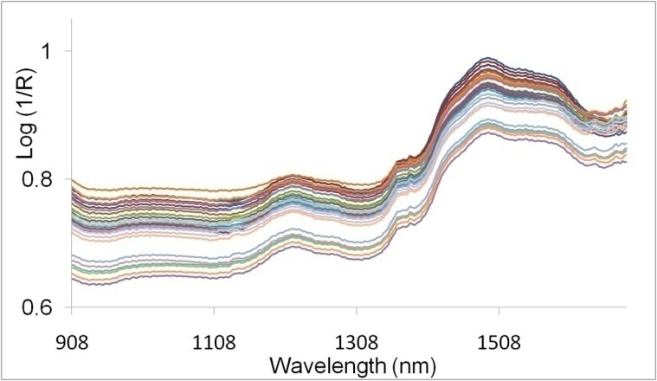
Additive Scatter Component
Only a fraction (1/c) of the remitted light is detected for a particular sample.
I _{detected} = 1/c x I_{remitted}
A_{detected} = - log (R_{detected}) = - log (I_{detected}/I₀)
= log c + log (I₀/I_{remitted}) = c’ + A
If c’ = log (c) is sample dependent, this will cause an additive baseline difference between the samples, i.e. an additive effect in the absorbance values.
Naes, Isaksson, Fearn, and Davis, Multivariate Calibration and Classification, page 106- 107, NIR Publications, 2002.
Notes:
This explains the differences in baseline. The radiation is not going to be of the same intensity always; it will not strike the same particles always. The mirrors will not pick up all the photons that are remitted, but a fraction of the remitted light (1/c).
Baseline changes will likely be greater when the powder is flowing and the fraction of the radiation that the detector receives changes more frequently (1/c – is changing). In addition, I_{remitted} could also be changing and not be the same for all experiment. However, even when the powder is not flowing there will be changes in baseline due to differences in particle size, crystallinity, etc.
Chemists with experience in working with UV-Vis spectroscopy will expect the same baseline in every experiment. This consistent baseline is to be expected when the same is a clear liquid (without suspended particles) that is non-scattering. However, in this case we are working with a turbid, scattering matrix.

Slide 7
Analytical methods provide information
In NIR spectroscopy this information can be physical or chemical.
If we are not careful we can confuse the two.
Differences in baseline will interfere, with chemical observations, such as drug or water concentration.
Differences in baseline may be removed with pretreatment methods such as first and second derivative.
Notes:
The discussion continues with applications where the baseline is removed, so that models can be developed without interference from physical effects.

Slide 8
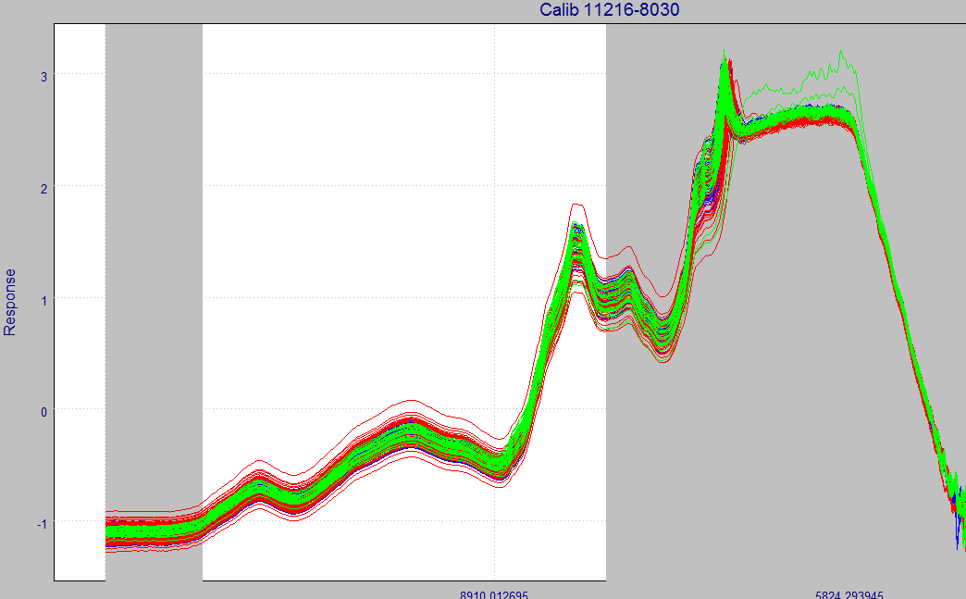
Differences in Baseline and Slope of Spectra
Joshua León, Undergraduate Research, Aug. – Dec. 2008
Notes:
Differences in baseline and slope are common in NIR spectra. These differences are minimized with “pretreatment of spectra”.

Slide 9
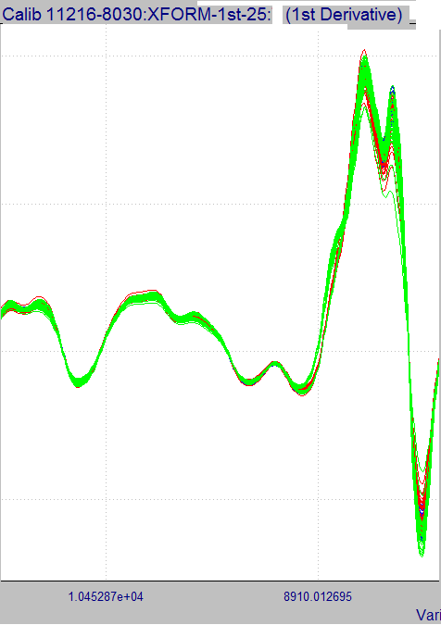
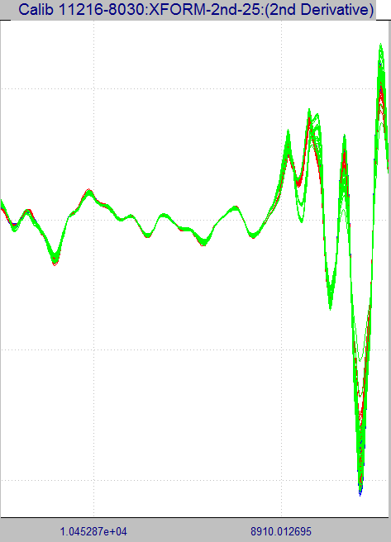
1st and 2nd Derivative Spectra
Remember derivatives indicate change, so a number of changes in spectra may become more evident.
Joshua León, Undergraduate Research, Aug. – Dec. 2008
Notes:
First and second derivatives are often used to remove these spectral differences. Other methods involve normalization of spectra.
These are not true derivatives dy/dx as in the calculus books. Derivatives are performed with a limited number of points. The choice of 15 or 25 points is quite common.
Most NIR calibration models are multivariate. The absorbance at multiple wavelengths or frequencies are mathematically related to an analyte concentration or physical property. The variation is a spectral range such as this one is examined.

Slide 10
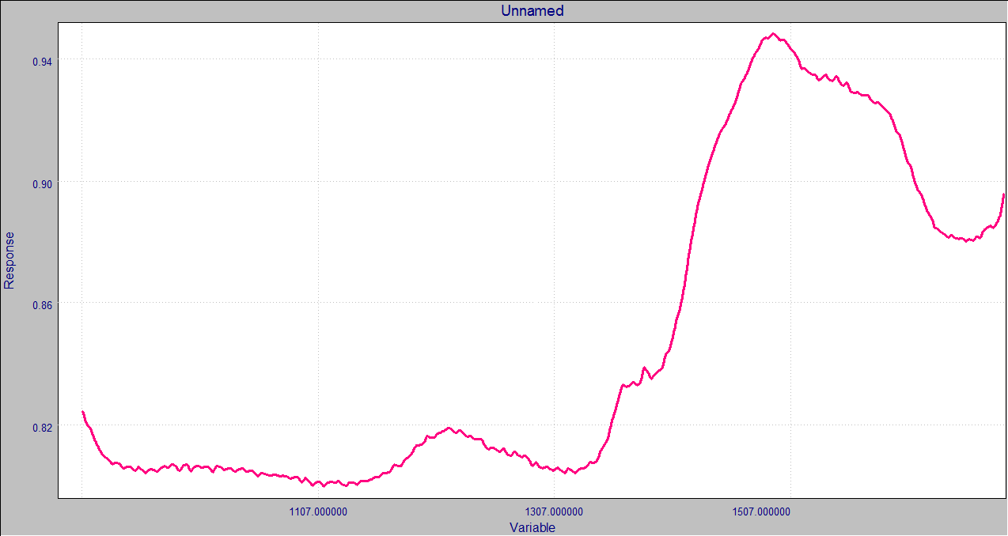
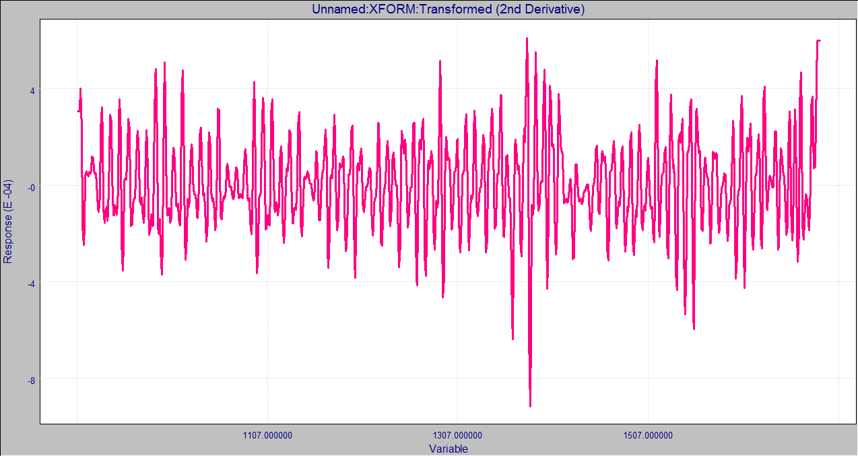
2nd Derivative, 5 Points Segment
Original Spectrum
Observe the derivatives carefully afternoon performing, working with a low # of points will highlight high frequency noise.
2nd D- 5 points segment
Notes:
When developing a method do not perform a transform such as the derivative without looking (examining) its result. The choice of too few data points could lead to the emphasis of high frequency noise.

Slide 11
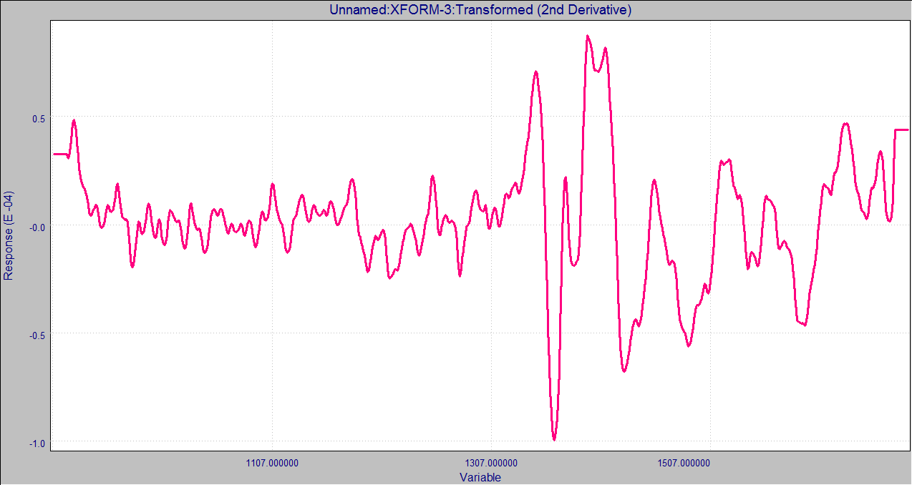
2nd Der., 25 Points Segment
Original Spectrum
2nd D- 25 points segment

Slide 12
Chemometrics
“Chemometrics is a chemical discipline that uses mathematics, statistics and formal logic
a) to design or select optimal performance experimental procedures.
b) To provide maximum relevant chemical information by analyzing chemical data.
c) To obtain knowledge about chemical systems”
Handbook of Chemometrics and Qualimetrics: Part A. D.L. Massart, et. Al. Elsevier, 1997, page 1.

Slide 13
Chemometrics
A = - log I/I₀ = - log T.
pH = - log [H⁺]
Simple examples of chemometrics since it helps to visualize data.
May be used for qualitative analysis such as identification testing. Comparison of patterns.
Used for quantitative methods such as drug content in a tablet.

Slide 14
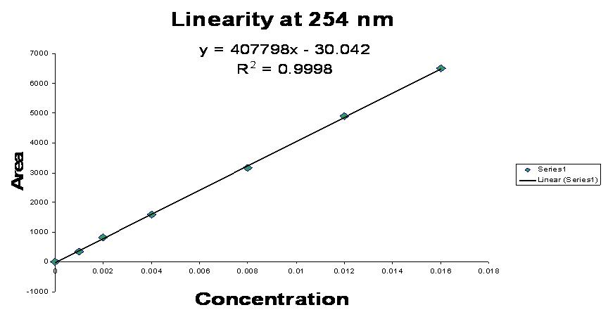
Current Univariate Methods
HPLC used for a large number of analysis.
Only one signal used (absorbance at one wavelength)
A significant amount of time and solvent employed to separate everything and obtain only one component to be measured by the detector.

Slide 15
The Power of Multivariate Analysis
Based on Figure 5.2, page 184. Beebe, Pell, Seasholtz, Chemometrics a Practical Guide), Wiley, 1998.
Notes:
If an instrument measures two variables and you have a pure compound, then expect that measurement #1 be 6, and then measurement #2 be 2 or a third of the response for measurement #1. If you have just pure components then the second response, should be a third of the first response.
So if you measure two variables, and the response shown in the bottom part of the page is observed then you know there is a problem.
On the other hand if only variable 1 is measured (univariate calibration model), then you will not discover that you have an interference in your sample.
Therefore, if you want to measure only one variable then you have to separate all your components and make sure that you are only analyzing pure components. This is the reason why HPLC is so popular, and 50 – 70% of all pharmaceutical methods are HPLC.

Slide 16


0856
0855
Difficult to see the differences between the two

Slide 17


Notes:
Multivariate regression models like PCR, PLS are used, unlike the univariate linear least squares method used in most analytical chemistry. The pattern (spectrum) is used in the calibration model instead of a single point.

Slide 18
The Chemometric Approach
First, establish a purpose
Simple Understanding: Exploratory Analysis (look at the data, carefully examine it, get a simple visual idea about the main relationships between samples. Chromatogram may contain hundreds of peaks – but the human eye cannot tell those that vary the most from sample to sample Learn
Property Prediction: regression modeling. Compare spectra or patterns. Model
Automate Routine Predictions: if modeling
succeeds. Use
Infometrix, Chemometrics Training Course, 2004, R.G. Brereton, Chemometrics Data Analysis for the Laboratory and Chemical Plant, Wiley, 2003, page 183.
Notes:
This slide emphasizes that chemometrics is more than a word, or more than a method.
Chemometrics is a scientific approach to working with data.
Having a certain amount of knowledge in your brain is important. However, how you approach or face a problem is also very important.

Slide 19
Working with Variation Patterns
Spectrum, A = f(λ), A = f(ν)
Chromatogram Area = f(t_{r})
Mass Spectra, Intensity = f(m)/e)
Many of the detector responses that we know are patterns of variation, that may be compared. May compare one variable or multiple variables.

Slide 20
Spectra in Spreadsheet Format
Row vector, x = [ x₁ x₂ …., x_{m}] x₁ x₂ x_{m} are called elements of vector.
Row vector x = [ 0.090334 0.091461 0.092569 0.093737]
Each row vector applies to a different sample.

Slide 21
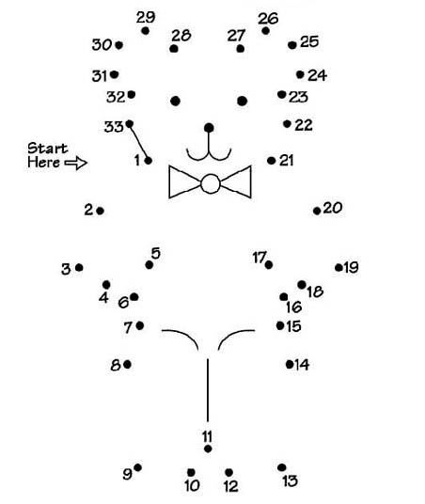
Spectrum is a Variation Pattern (function)
Interpolation between the different responses provides the spectrum, much like a connect the dots drawing.

Slide 22
Orthogonal Projection
The orthogonal projection u of a vector x on another vector y is shown in Fig. 9.4.
u = proj x = ║x║y cos θ
║y║
Orthogonalization. Vector x is decomposed in two orthogonal (uncorrelated) vectors u and v; u is the orthogonal projection of x on y and v is the vector orthogonal to y. Figure 9.4 Handbook.
Notes:
22
An airplane could travel in a straight line from San Juan to Newark. This will never occur in reality since airplanes always circle Newark several time before landing, however, for now lets assume that it travels in a straight line.
One could also take another path: travel to Miami in a straight line and then go 90º to Newark. This second route takes paths that are completely unrelated to one another that orthogonal. The path from San Juan to Miami has nothing in coming with the pathe from Miami to Newark.
The variation that one projected vector (v) has is totally independent from the other projected vector (u) but both combined reach to the same point thatn the original vector.

Slide 23
Corr. Coeff. For x & y is: 0.9982
Could visualize in terms of two orthogonal vectors. A first that is equivalent to the line y = 1.9818 x + 0.2727, and a second that explains the rest of the variation (residuals).
Notes:
The least squares regression line explains the principal source of variation in the y-data. However, it is not able to account for all of it. We can consider this line y = 1.9818 x + 0.2727. We could redraw (re-align) such that this line becomes the x-axis, and then we could use a second vector (shown at 90º) to explain the variation not included in the first vector.
This is the basis of principal component analysis.

Slide 24
Alignment of Data
Y_{aligned} may be obtained by subtracting from y the value of the least squares regression, y = = 1.9818 x + 0.2727. The correlation between x and x is now – 0.000618.

Slide 25
PCA – Score Plot
X = X’ = T_{k}L_{k}^{T} The columns of L are the principal components, the new factors or linear combinations of the original variables.
Residuals express the remaining or unexplained variation.
PC2
PC1 drawn along the axis with > variation of the data PC1 = a₁₁X₁ + a₁₂X₂ + … + a_{ip}X_{p} based on linear combination of original variables.
Residual
Score
T (scores) co-ordinates in the new axis
P (loadings) cosines of new angles with original axes
PC1
Projections from the original x₁ x₂ space on PC1 are called the scores of the objects on PC1.
Notes:
Each score represents a sample. This sample may have been represented by 1000 variables in the original data set. Therefore, their a significant reduction in the data structure that we see.
PC1 = a11X1 + a12X2 + … + aipXp is based on linear combination of the original variables

Slide 26
Reduction of
Variables
Same Information
Fewer No. Of Original
Variables
Principal Component Analysis
0,02
0,01
Score PC2
X = T P ^{t} + E
0,00
X is Matrix of Spectra
-0,01
T (scores) co-ordinates in the new axis
P (loadings) cosines of new angles with original axes
-0,02
-0,04
-0,03
-0,02
-0,01
0,00
0,01
0,02
0,03
Score PC1
● Synthetic samples
 Doped Samples
■ Production Samples
Provides differentiation of samples.
Developed Manel Alcalà, Ph.D.
Notes:
Chemometric methods are necessary in NIR spectroscopy due to the high number of spectra obtained. It is often impossible or very challenging to see differences in the spectra just by visual inspection.
PCA helps reduce the number of variables. The variables are transformed from the original to the latent variables. PCA decomposes the spectral matrix into a product of scores and loadings. The scores are the new coordinates of the samples in the new axes or principal components.

Slide 27
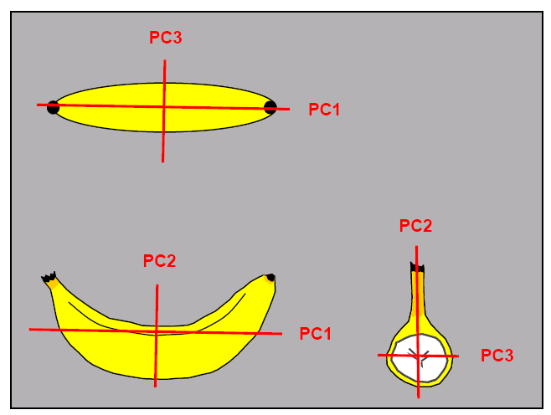
Principal Components Analysis (PCA)
PCA is built on the assumption that variation implies information. Spectra are variation patterns.
The first PC is the direction through the data that explains the most variability in the data.
The second at subsequent PC’s are orthogonal (at right angles) to the first PC and explain the remaining variation.
The values of individual samples can now be expressed in terms of the PCs as linear summations of the original data multiplied by a coefficient (score).
Multivariate Data Analysis, Version 3.11, Infometrix, available from www.infometrix. com
Notes:
I can explain that PCA is a process of elimination as explained on page 110 of Duckworth.
By iteratively eliminating each independent variation from the calibration spectra in series, it is possible to create a set of eigenvectors (principal components) that represent the changes in the absorbances that are common to all, so that eventually the data is reduced to: a matrix of scores and loading, and a residual matrix (that represents the differences between the original data set and the reconstructed spectra).

Slide 28
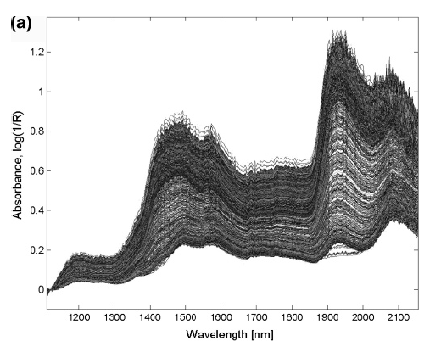
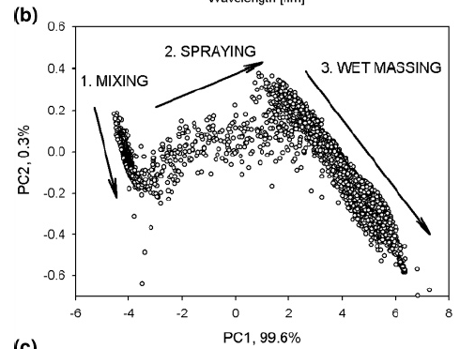
Advantage of PCA Scores in Understanding a Granulation Process
J. Rantanen, H. Wikström, R. Turner, and L.S. Taylor, “Use of In-Line Near-Infrared Spectroscopy in Combination with Chemometrics for Improved Understanding of Pharmaceutical Processes, Anal. Chem., 2005, 77, 556 – 563.
Notes:
The scores in part b of this figure are the representation of the spectra in part a but in the new axes or principal components. The observation of differences in part A is not easy, there are many spectra. The observation of differences (variation) in part b is much easier.

Slide 29
Latent Variables
A PC is a latent variable.
This means that the variable is not manifest, it cannot be measured directly.
The latent variables are computed as linear combinations of a set of manifest input variables.
They are called principal because they are particularly dominant or relevant.
H. Martens and M. Martens, Multivariate Analysis of Quality, An Introduction. John Wiley & Sons, page 93.

Slide 30
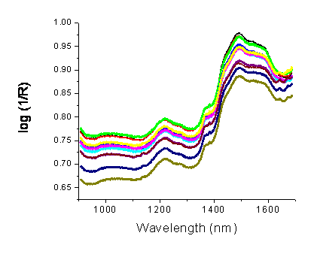
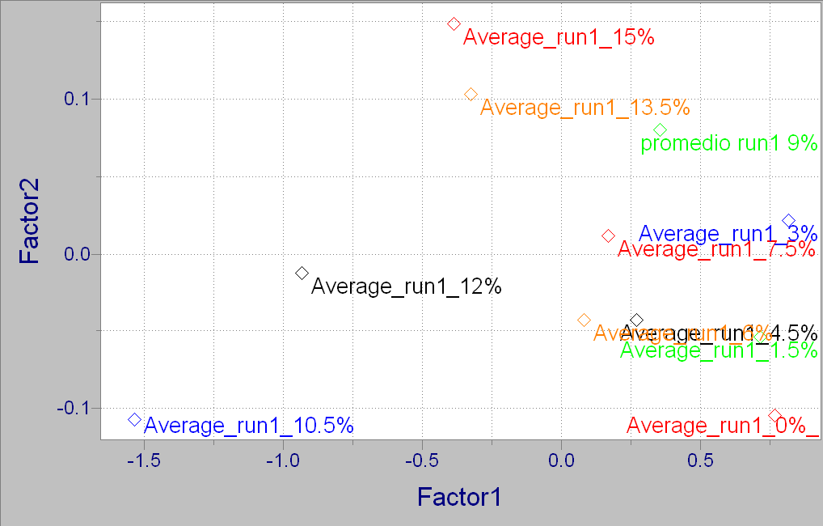
Spectra, PCA Scores Plot, (without pre-treatment)
What changes do you see in the spectra ?
What is the main source of variation in the spectra ?
Notes:
Just by visualizing the spectra you can see that the baseline changes a good bit, and the principle change in the spectra might be related to the baseline.

Slide 31
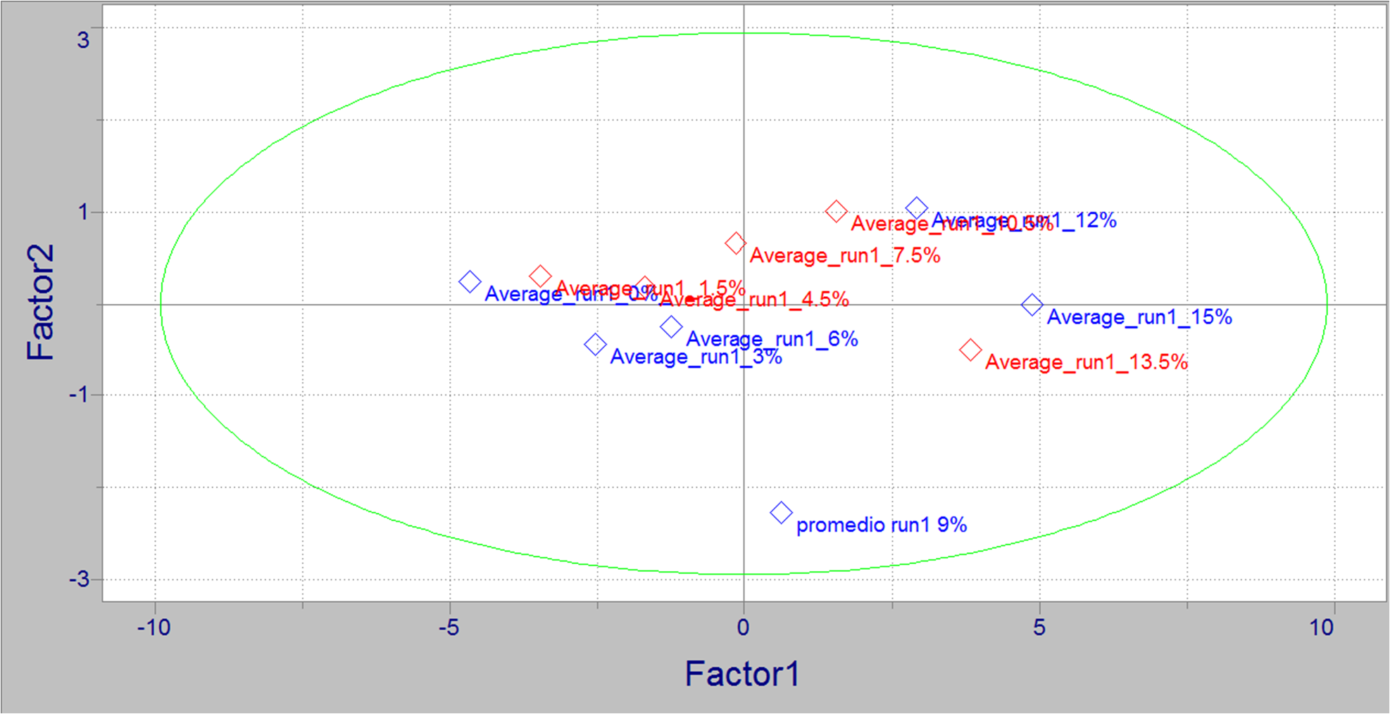
After Pre-Treatment of Spectra
After pretreatment – in this case SNV-1st-11, the first PC marks the changes in concentration.
Notes:
The changes in baseline are not the principal source of variation. The principal source of spectral variation is now concentration. Therefore spectral pretreatment is done with a purpose of objective in mind. In this case, the differences in baseline have been removed --- revealing the differences in concentration.

Slide 32
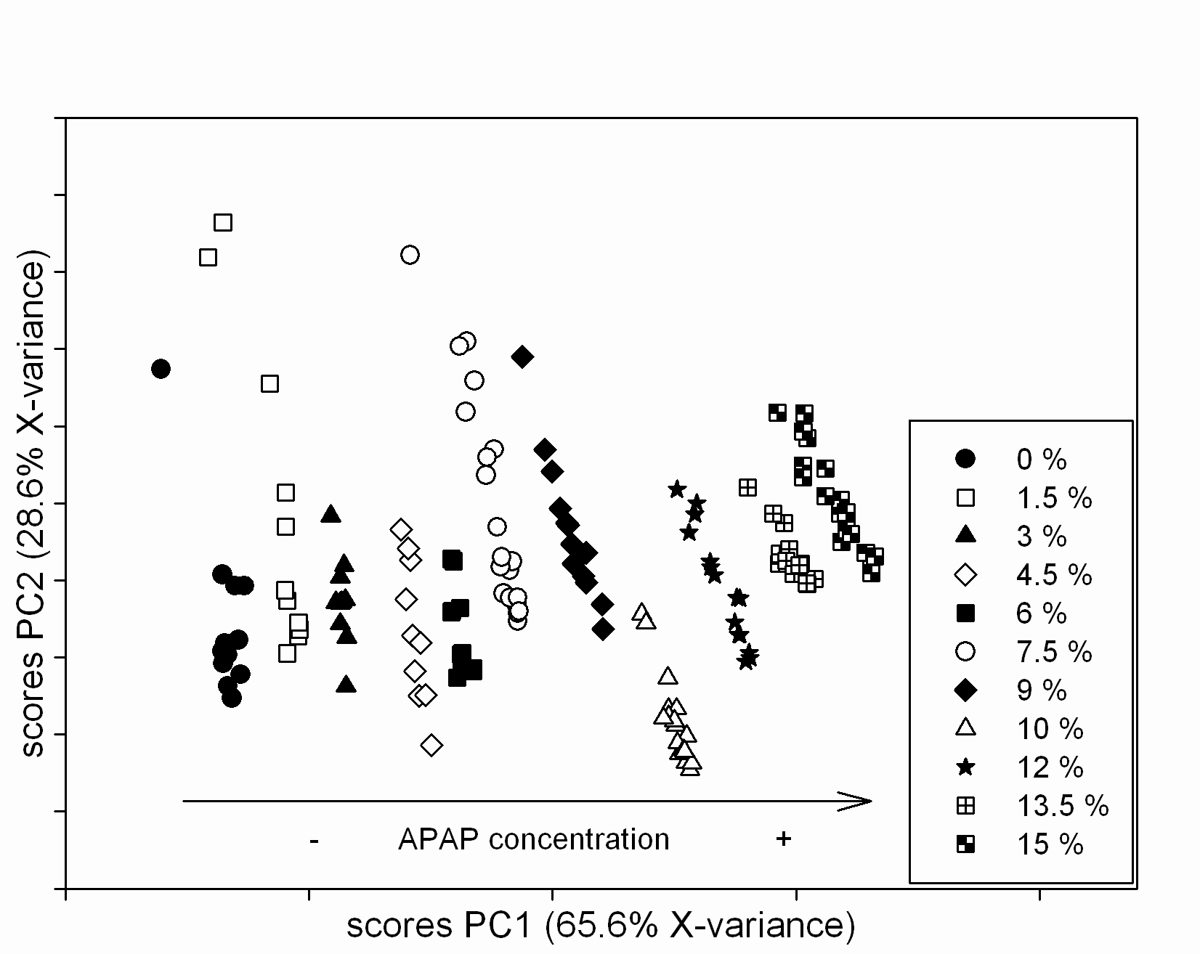
PCA Scores Plot
A.U. Vanarase, M. Alcalà, J.I. Jerez Rozo, F.J. Muzzio and R.J. Romañach, “Real-time monitoring of drug concentration in a continuous powder mixing process using NIR spectroscopy, Chemical Engineering Science, 2010, 65(21), 5728 – 5733.

Slide 33
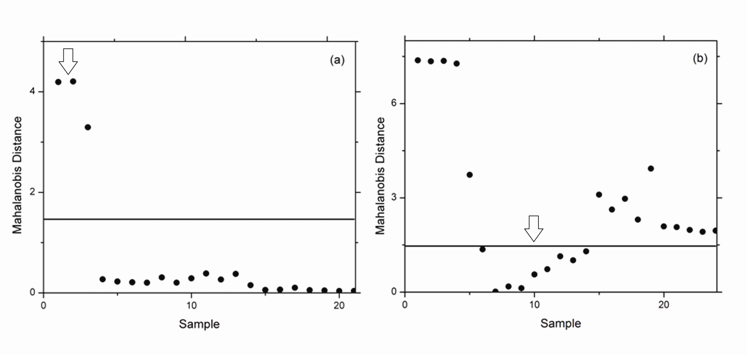
Monitoring of Ribbon Density During Roller Compaction. PCA Model Developed with ribbons compacted from 30 – 35 bar.
D. Acevedo et.al., AAPSPharmscitech,
DOI: 10.1208/s12249-012-9825-0.
Notes:
The main objective with this slide is to show that scores may be used to keep track of a process. These are plots of Mahalanobis distance or distance from the center of the expected spectra. It is much easier to plot the scores than the spectra themselves.

Slide 34
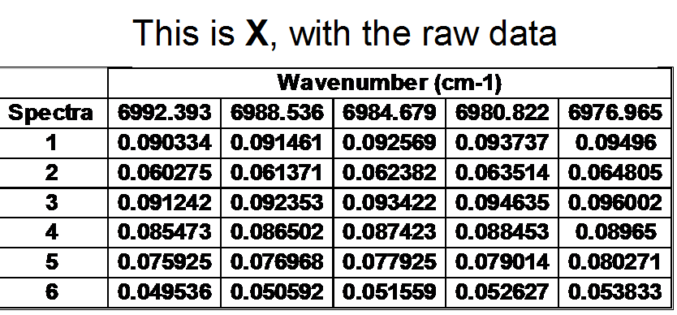
A second look at the Math
X = X’ = T_{k}L_{k}^{T} The columns of L are the principal components, the new factors or linear combinations of the original variables which are described in X.
T are the scores or weights, and the loadings are the linear combinations of the original variables. The product of T_{k}L_{k}^{T} summarizes the spectral variation observed in X but with orthogonal components. The k refers to the number of vectors or pc’s that will be used to summarize the variation.

Slide 35
PCA – Orthogonality
Obtained for spectra from previous slide. Notice that first factor summarizes most of the variation, and then it starts decreasing. Each factor summarizes new variation, not included in previous factors. Pretreatment was not used, only mean centering.

Slide 36
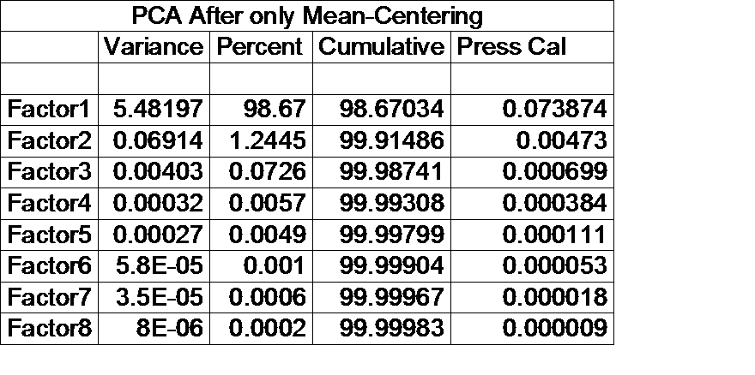
Principal Components Analysis (PCA)
If you know that spectral noise is about 0.1%, then how many
principal components should be used to explain the data ?
Here we have the opportunity to filter or reduce the spectral
noise since we do not have to keep the eight factors.

Slide 37
PCA Scores Plot- The Transition from Qualitative to Quantative
A.U. Vanarase, M. Alcalà, J.I. Jerez Rozo, F.J. Muzzio and R.J. Romañach, “Real-time monitoring of drug concentration in a continuous powder mixing process using NIR spectroscopy, Chemical Engineering Science, 2010, 65(21), 5728 – 5733.
Notes:
This score plot shows that spectral variation is related to concentration. This is good comforting information when the objective is to develop a calibration model which consists of a mathematical relationship between spectra and concentration.

Slide 38
Calibration Concepts
  Calibration requires a training or calibration set (standards) containing measurement of known samples used to prepare the calibration model.
  The samples in the calibration set should be as representative as possible of all of the unknown samples, which the calibration is expected to successfully analyze.
  Projection to the Future
  Reference Method - Standard method that is designated or widely acknowledged as having the highest qualities and whose value is accepted without reference to other standards.
  Secondary Method - Method whose value is assigned by comparison with a primary standard of the same quality.
Notes:
38

Slide 39
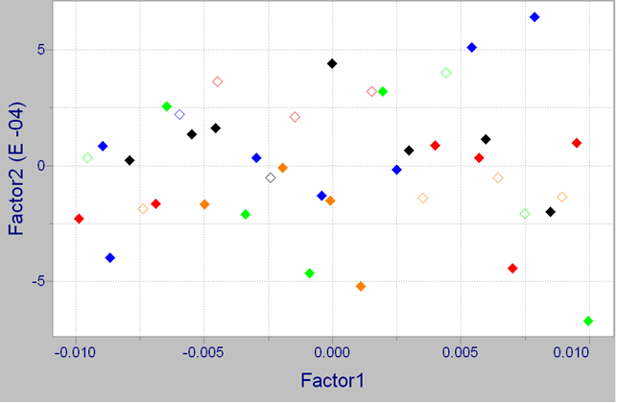
Use of PCA to Evaluate Whether Calibration Samples are Representative of Production Samples
Comparing the Calibration (highlighted) and Prediction (empty quadrangles) set samples. Calibration – projection to the future.
Notes:
In terms of projection to the future – this is very comforting.

Slide 40
Developing a Calibration Model
Most NIR calibration models are multivariate. The absorbance at multiple wavelengths or frequencies are mathematically related to an analyte concentration or physical property.
Multivariate regression models like MLR, PLS are used, unlike the univariate linear least squares method used in most analytical chemistry.

Slide 41
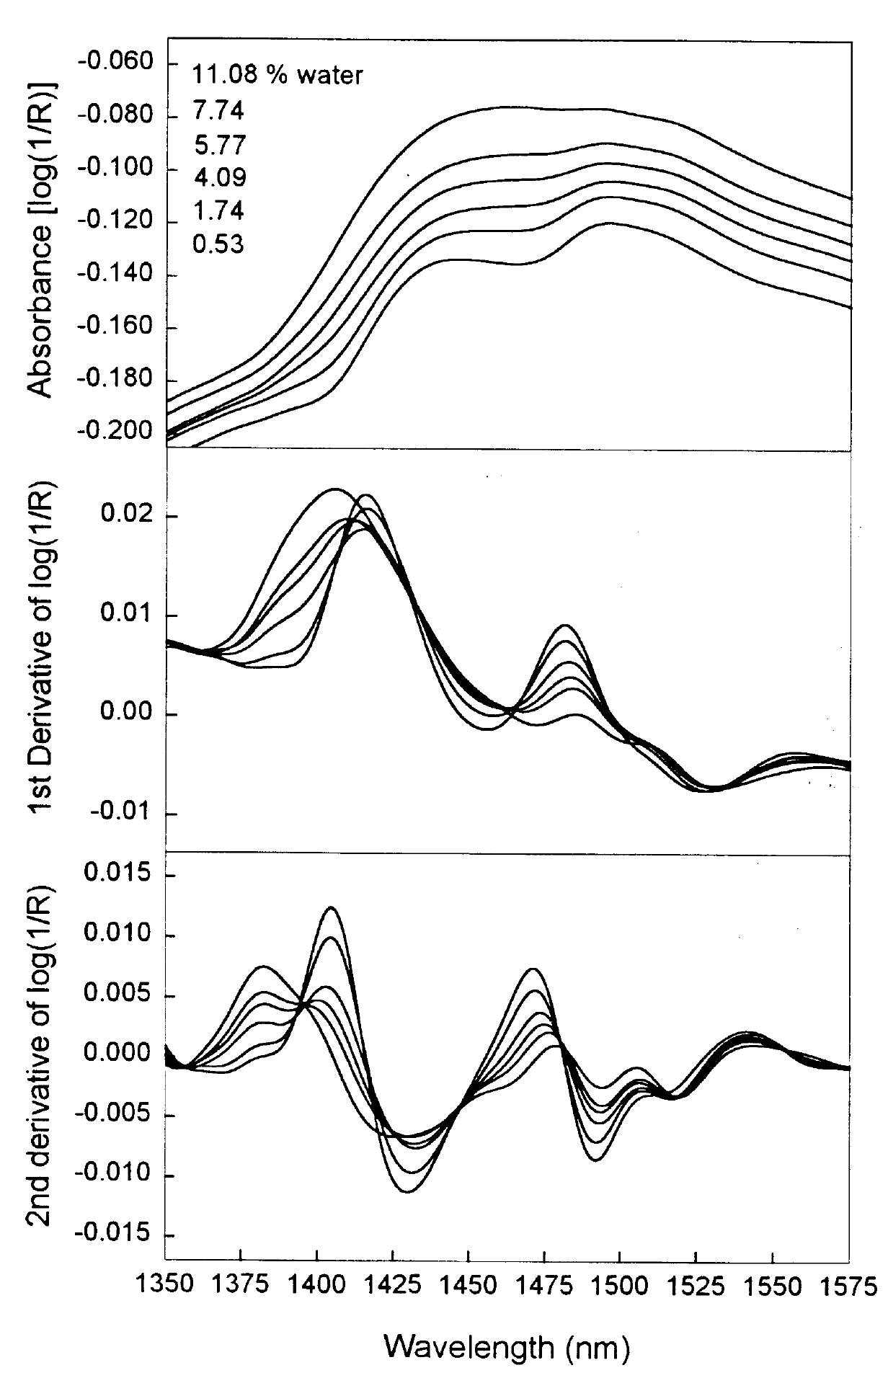
O-H first overtone
Variation Implies Information !!
However, variation could come from differences in moisture content (chemical info) or variation in particle size, porosity, density (physical info).
Absorbance, 1st-derivative, and 2nd derivative spectra.
X. Zhou, P. Hines, and M.W. Borer, “Moisture Determination in a Hygroscopic drug Substance by Near Infrared Spectroscopy”, Journal of Pharmaceutical and Biomedical Analysis, 17(1998), 219-225.

Slide 42
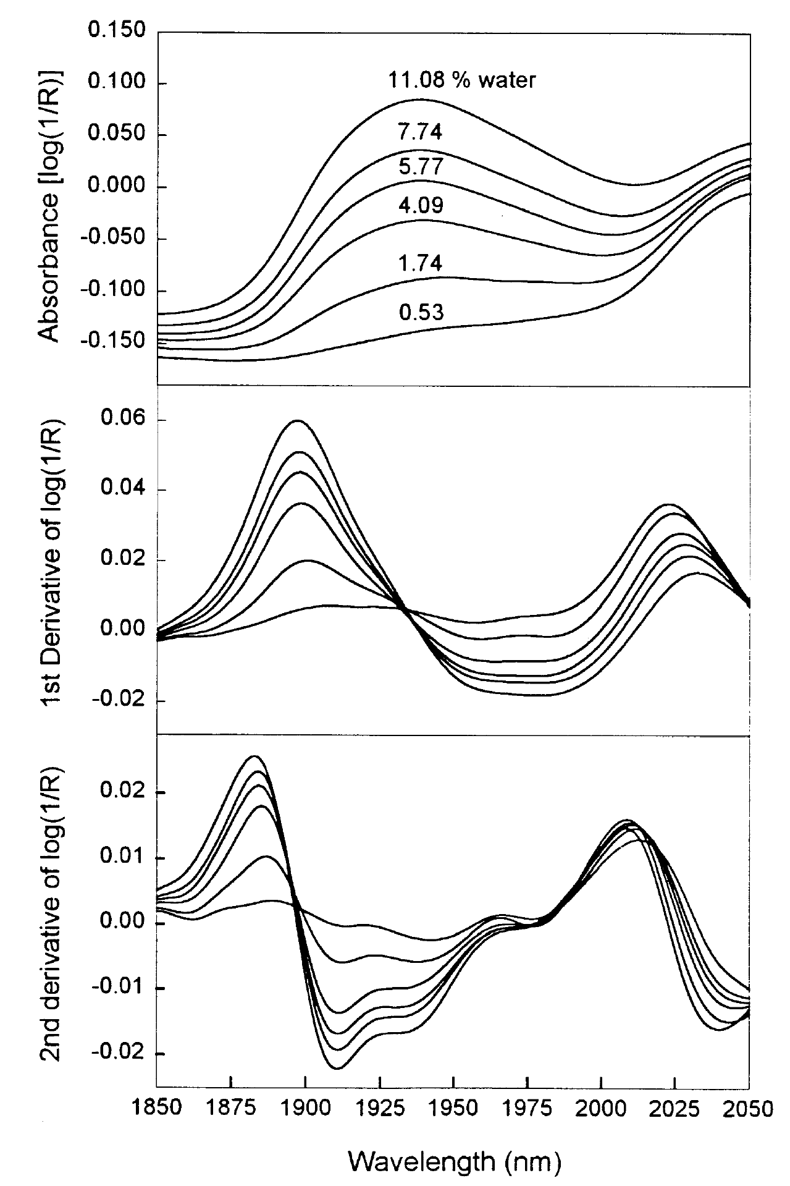
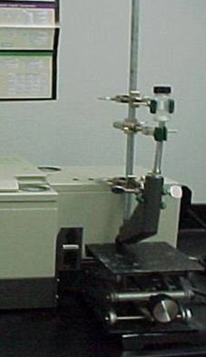
O-H combination band
X. Zhou, P. Hines, and M.W. Borer, “Moisture Determination in a Hygroscopic drug Substance by Near Infrared Spectroscopy”, Journal of Pharmaceutical and Biomedical Analysis, 17(1998), 219-225.
Absorbance, 1st-derivative, & 2nd derivative spectra.

Slide 43
Evaluation of pretreatment and spectral area for quantitative method
Evaluation of pretreatment and spectral area for quantitative method – C. Peroza Meza, M.A. Santos, and R.J. Romañach, “Quantitation of drug content in a low dosage formulation by Transmission Near Infrared Spectroscopy”, 2006, 7(1), Article 29 (http://www.aapspharmscitech.org).
Notes:
This is a recommended exercise during the method development efforts

Slide 44
Begin with the End in Mind – View from 30,000 feet
There are many aspects in this work. Powder samples, tablets, production equipment and the NIR instruments used to obtain spectra and monitor a process.
Software like SIMCA, Unscrambler, Pirouette, PLS Tool Box, PLS IQ, etc that facilitate the careful observation of spectra (or other patterns) studying & understanding the data and then developing the calibration model.
A number of companies sell software for real time predictions. Software that enable the use of the regression equation in the production environment. This is another software that is just for “use” of the calibration model and provide the information to a distributed control system or plant manufacturing data system.
Software for production that control all production systems, including real time predictions, and pickup all the data (e.g. SIPAT, SynTQ, etc.)
Notes:
We are going to make a transition from #1 to #2 today, but want everybody to keep in mind the full scope of the work.

